Slide 1

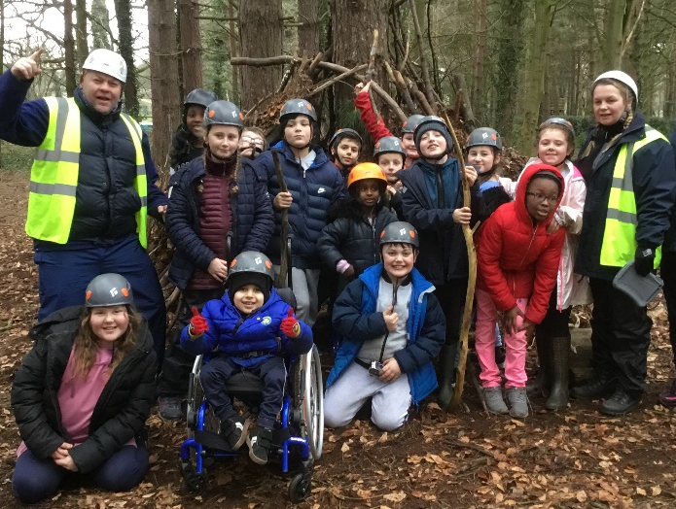
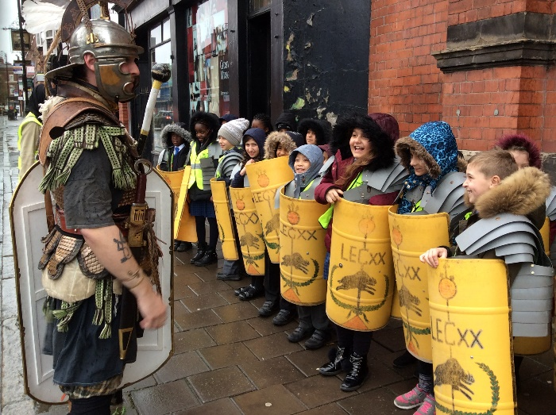
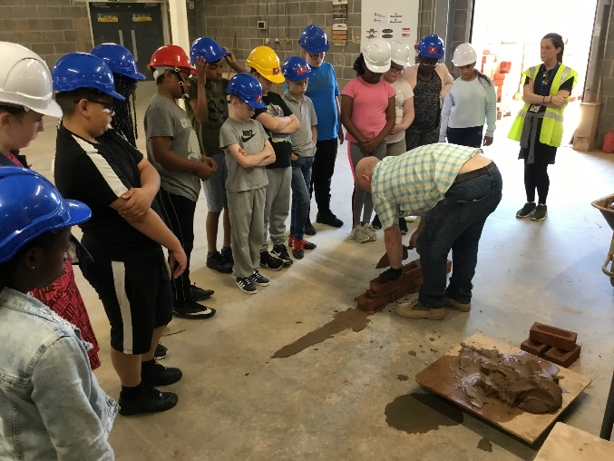


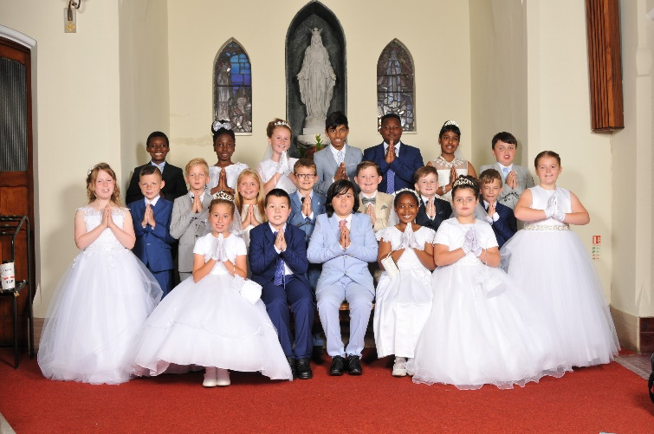
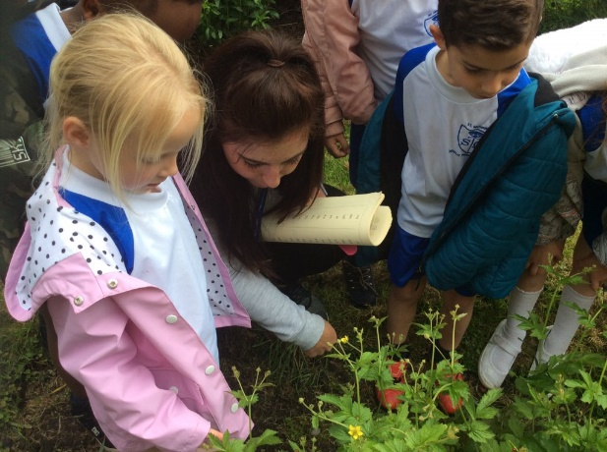
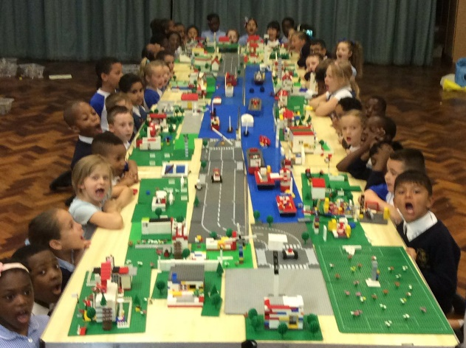
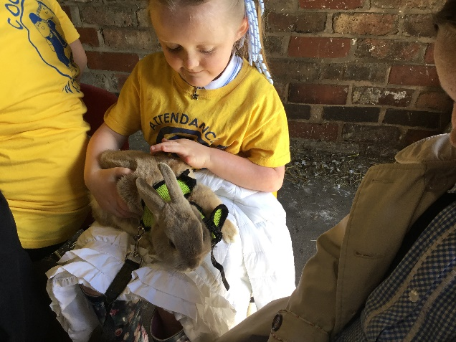
With Jesus we can achieve what we dream and believe
St Michael’s Catholic Primary School

Slide 2
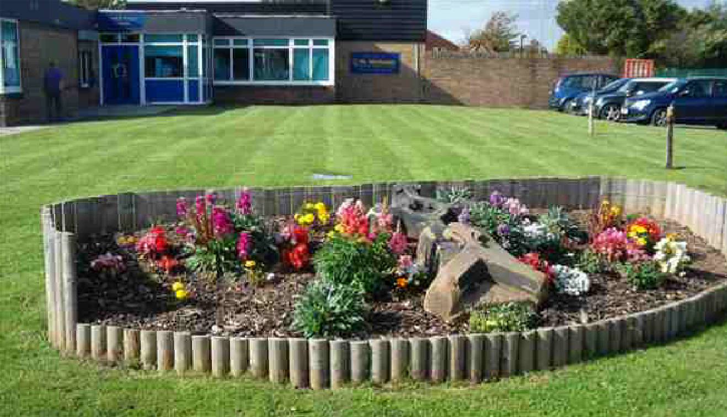
With Jesus we can achieve what we dream and believe
Welcome to Year
Year 3
St Michael’s Catholic Primary School

Slide 3

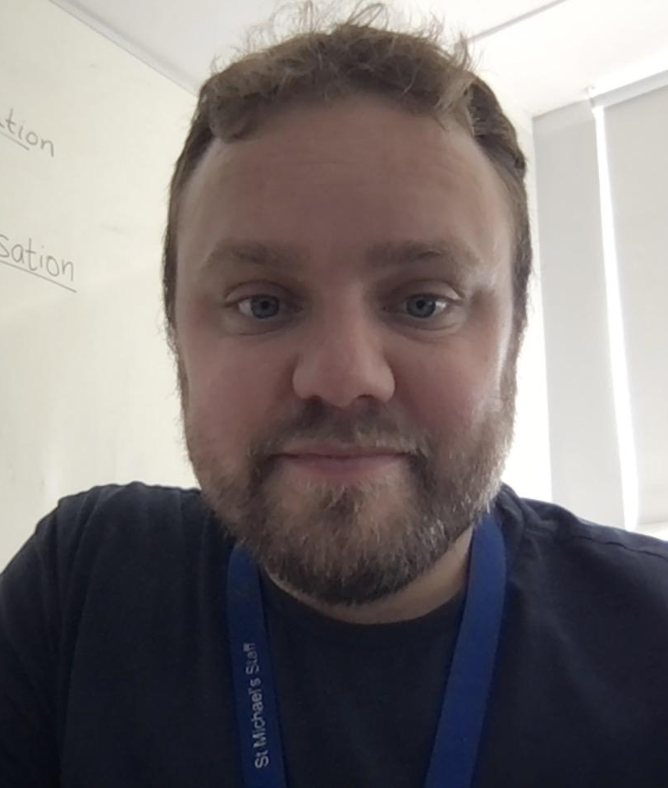
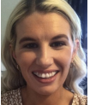
With Jesus we can achieve what we dream and believe
Staff in Year 3
Olympians
Class Teacher
Mr Ferry
LSA
Mr Oliver
1:1
Ms Lawson
LSA
Mrs Crompton
Heroes
Class Teacher
Miss Mc Entee
St Michael’s Catholic Primary School

Slide 4
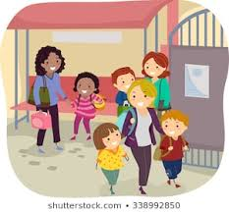
With Jesus we can achieve what we dream and believe
Daily Routines
8:40 - School gates open
8:50 - Pupil registration ends
10:45 - Playtime
12:30 - Lunchtime
3:20 - School ends
St Michael’s Catholic Primary School

Slide 5

With Jesus we can achieve what we dream and believe
Homework is set every Friday and needs to be in on Wednesday’s.
Reading with your child at home is vital.
St Michael’s Catholic Primary School

Slide 6

With Jesus we can achieve what we dream and believe
PE is every Friday. A St Michaels PE kit is required.
St Michael’s Catholic Primary School

Slide 7
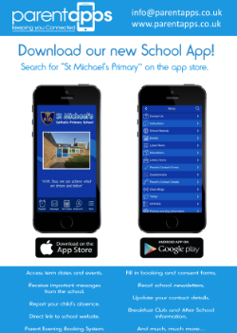
With Jesus we can achieve what we dream and believe
Supporting your child
What you can do to help?
Attendance and Punctuality – on time and attend school regularly. Inform school morning of absence to prevent home visit.
English – Encourage your child to read for pleasure. Good readers become good writers. Model good grammar/vocabulary. Learning weekly spellings.
Maths - Basic skills – Times tables (All). Calculations - (All operations) Teach your child the time. TTRs/Hit the button
Ensure school has up to date contact details – should be contactable at all times
Download school app - search for @St Michael’s Catholic Primary on the app store.
St Michael’s Catholic Primary School

Slide 8
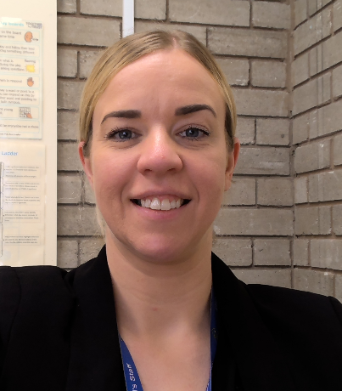
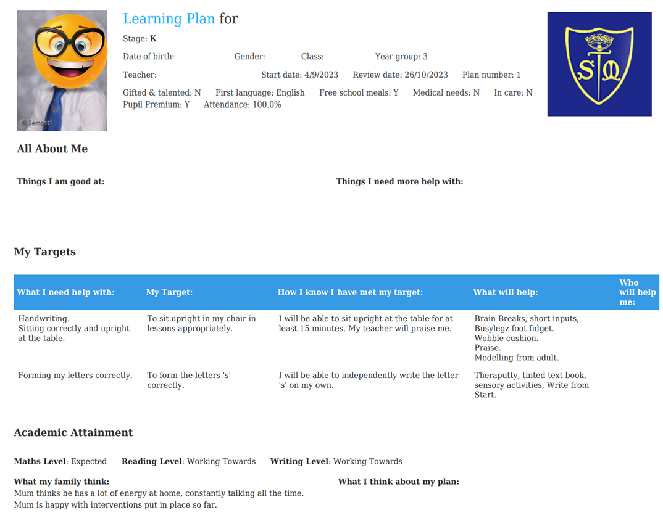
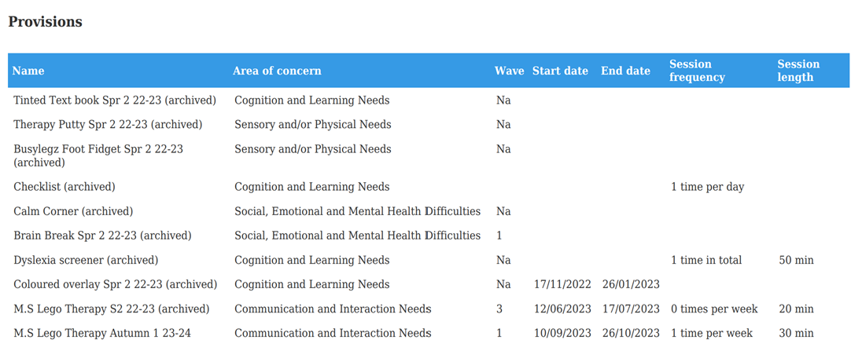
Special Educational Needs and Disability- SEND/SEN
Learning Plan
Mrs Reilly: SENCo
Sometimes our children require additional or different support to that of their peers. When this happens school will use a graduated approach to implement support, which is overseen by Mrs Reilly.
Most of the time we can use high quality teaching approaches to help your child, but on other occasions it may require something more than this for example an intervention, additional or specialised resources or even specialist support from an outreach service like seedlings, speech and language or an educational psychologist.
When a child is receiving additional or different support from school, they will be added to the SEND register and you will receive learning plans before parents evening, showing the child’s targets they are working towards and what extra provisions they are receiving from school to support them.

Slide 9
I think my child may require a diagnosis
While not all children on the SEND register will require a diagnosis, some may and Mrs Reilly will support you to get the necessary assessments to get you the help you require for your child.
If you are worried or need a little extra help:
  Speak to the class teacher and share your concerns:
    They will share what they see in class
    Take some additional information from you around your concerns
  You may be directed to meet with Mrs Reilly who can support with:
    Specialist support, advice
    Request assessments for external services: OT, Speech and Language, School Nurse etc.
    Signposting to other external providers
    Seek parental support for you
    Help with issues such as toileting, independence, diet, behaviour, communication, social interactions etc.

Slide 10
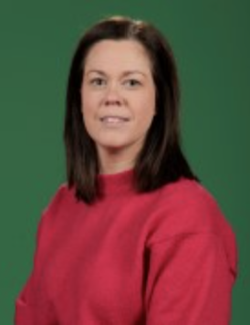
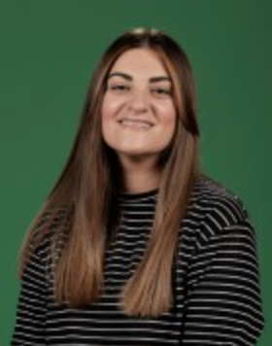
Pastoral Team
We help support the children with SEND interventions, emotional and social well-being, as well as wider family support. Please feel free to speak to us about any concerns or help you may need.

Slide 11






With Jesus we can achieve what we dream and believe
Communication
School App
Used regularly – search for @St Michael’s Catholic Primary on the app store
Newsletter
Sent out on app and available on school website
Website/Twitter
General information and daily class page updates
Phone Calls
School require at least 2 up to date contactable numbers
Face to Face
Staff can make arrangements to meet.
Letters Home
Usually for trips, main
contact through app.
St Michael’s Catholic Primary School

Slide 12
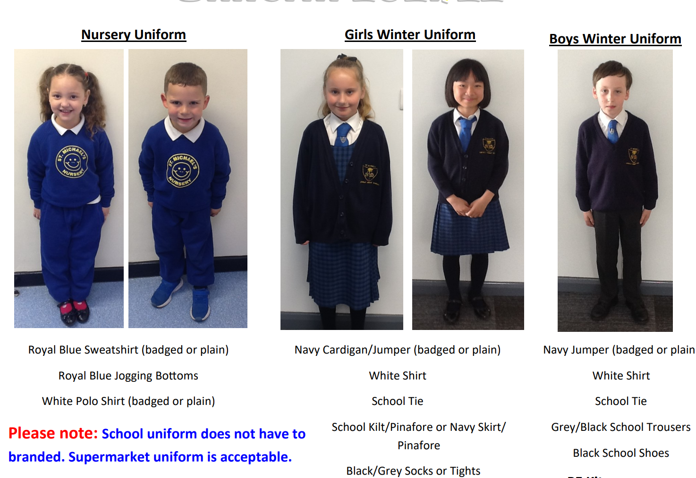

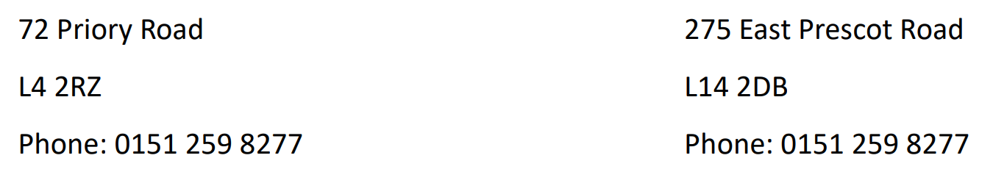
St Michael’s Catholic Primary School
St Michael’s Catholic Primary School
Uniform
Uniform

Slide 13
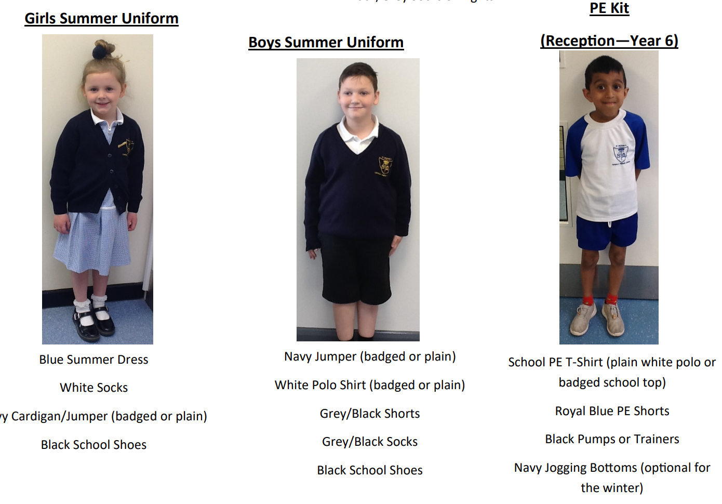
St Michael’s Catholic Primary School
St Michael’s Catholic Primary School
Uniform
Uniform

Slide 14



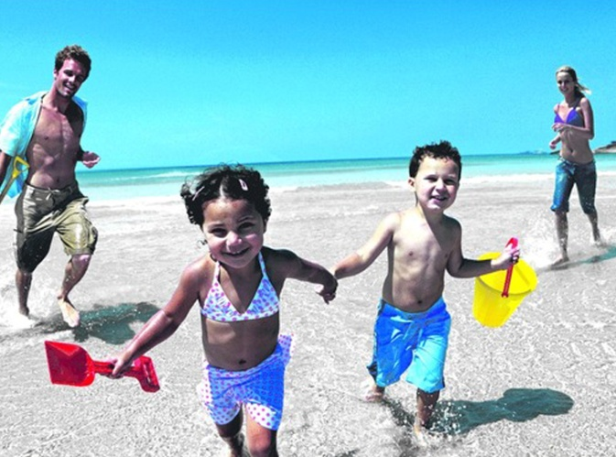
St Michael’s Catholic Primary School
Holidays
During Term Times?
During Half Term and End of Term holidays?
School is Important!

Slide 15


St Michael’s Catholic Primary School
Attendance & Punctuality
Monday
100%
Tuesday
Pupil registration closes at 8:50am
Wednesday
50%
Thursday
0%
Friday
With Jesus we can achieve what we dream and believe

Slide 16


St Michael’s Catholic Primary School
Sickness / Illness
If your child is ill you must let the school know as soon as possible.
Tel. 0151 263 8460

Slide 17
St Michael’s Catholic Primary School
Online Payment System
Access via the school app

Slide 18


St Michael’s Catholic Primary School
Breakfast Club
7:45am – start of school day
50p for breakfast – book and pay using online payment system via school app
All welcome
Entry via infant gate
‘Sparkles’ after school club
End of school day – 5:30pm
Book in advance (by midnight the day before) using online payment system via school £7 full session £4 half session

Slide 19
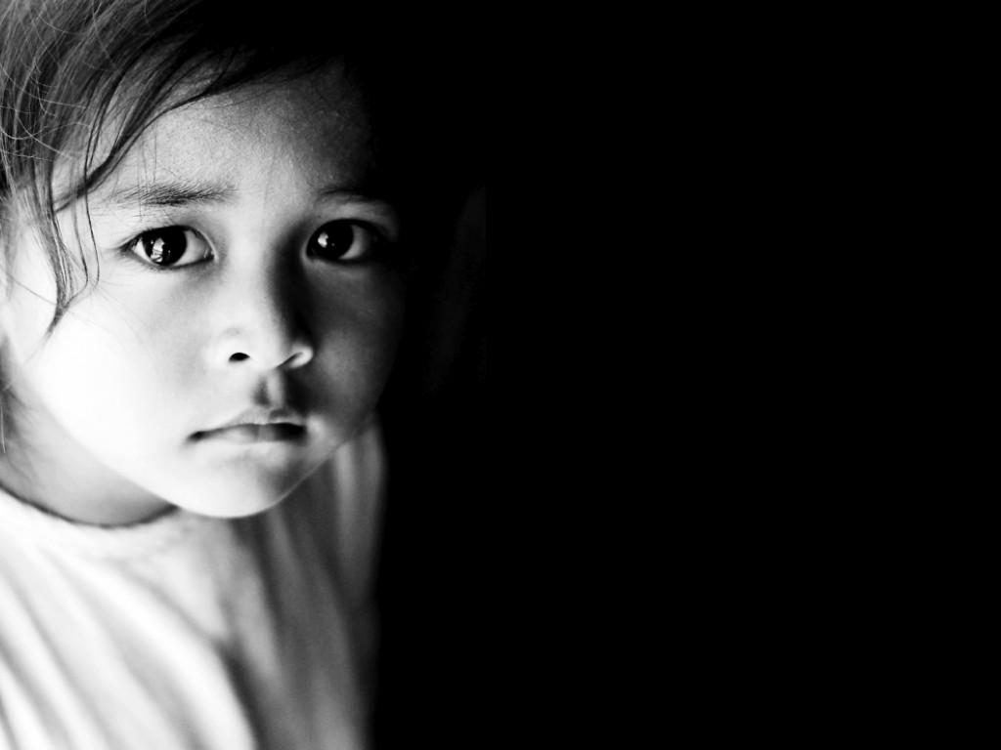
St Michael’s Catholic Primary School
Concerns about your child
Bullying
Unhappy
SEN
Safeguarding
With Jesus we can achieve what we dream and believe

Slide 20
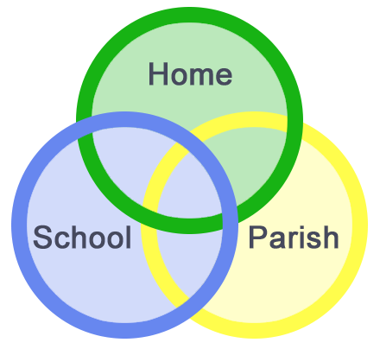
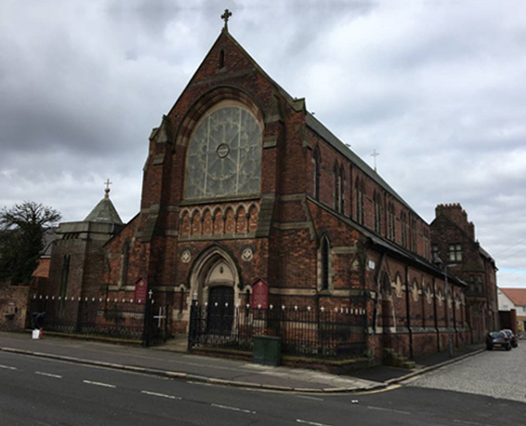
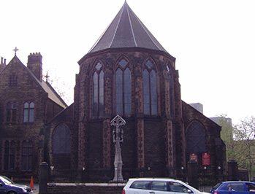

With Jesus we can achieve what we dream and believe
Mass Times
Father Fitz
St Michael’s Church
West Derby Road, L6 5EH
Sundays 10.30am
Sacred Heart Church
Low Hill, L7 8TN
Sundays 6.30pm
St Michael’s Catholic Primary School

Slide 21
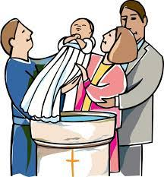
With Jesus we can achieve what we dream and believe
Baptism
Before preparing for First Holy Communion in Year 4, Catholic children must be Baptised (Christened).
If you would like your child to be Baptised, just speak to Fr Fitz after any Mass at St Michael’s Church or Sacred Heart Church.
St Michael’s Catholic Primary School

Slide 22
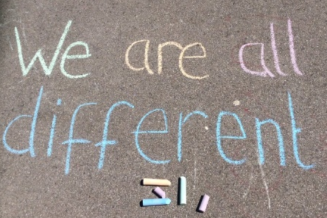
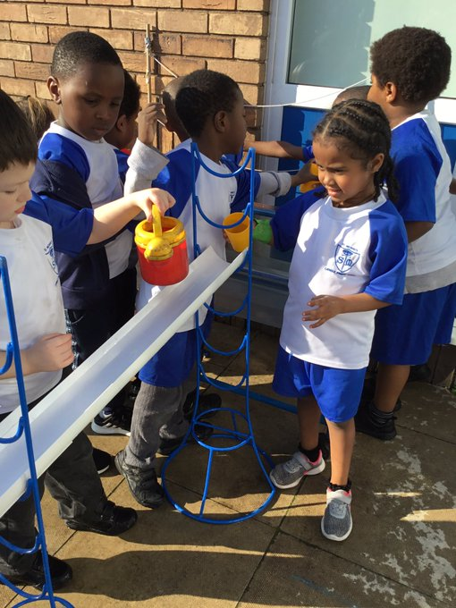
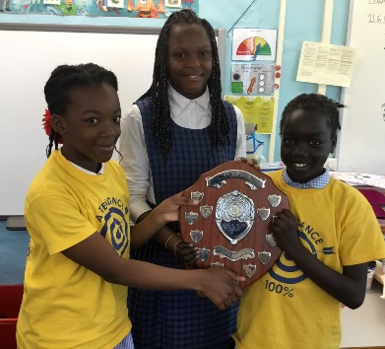
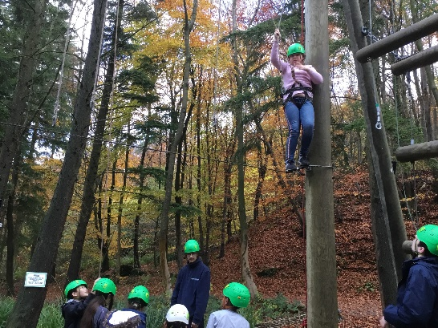
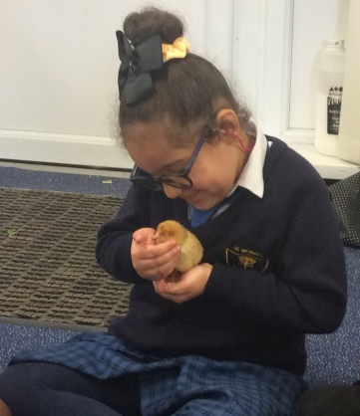
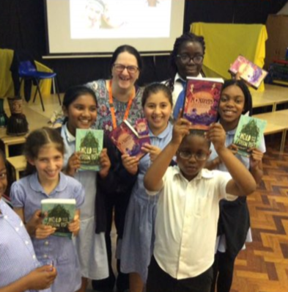
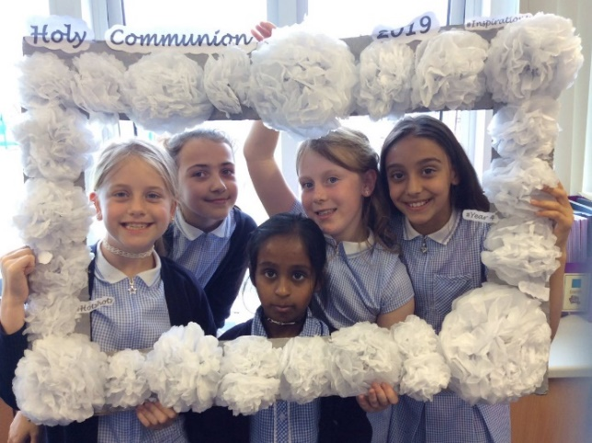
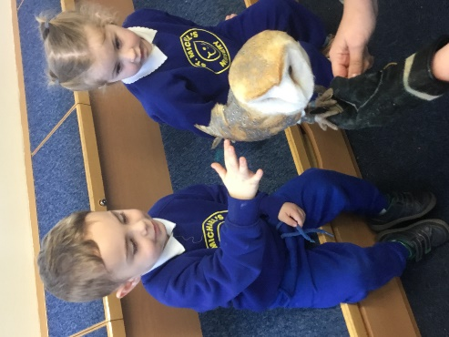
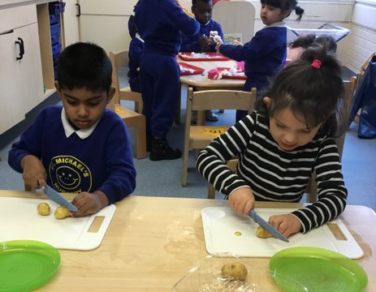
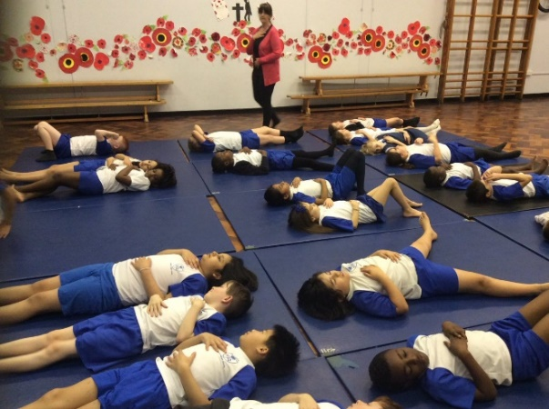
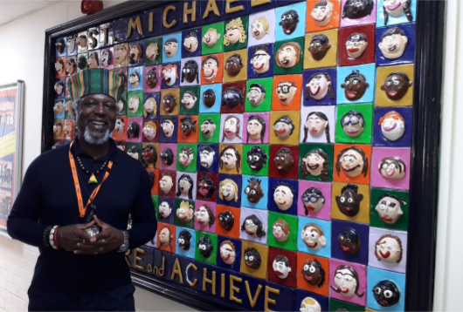
With Jesus we can achieve what we dream and believe
Thank you!
St Michael’s Catholic Primary School

