Slide 1

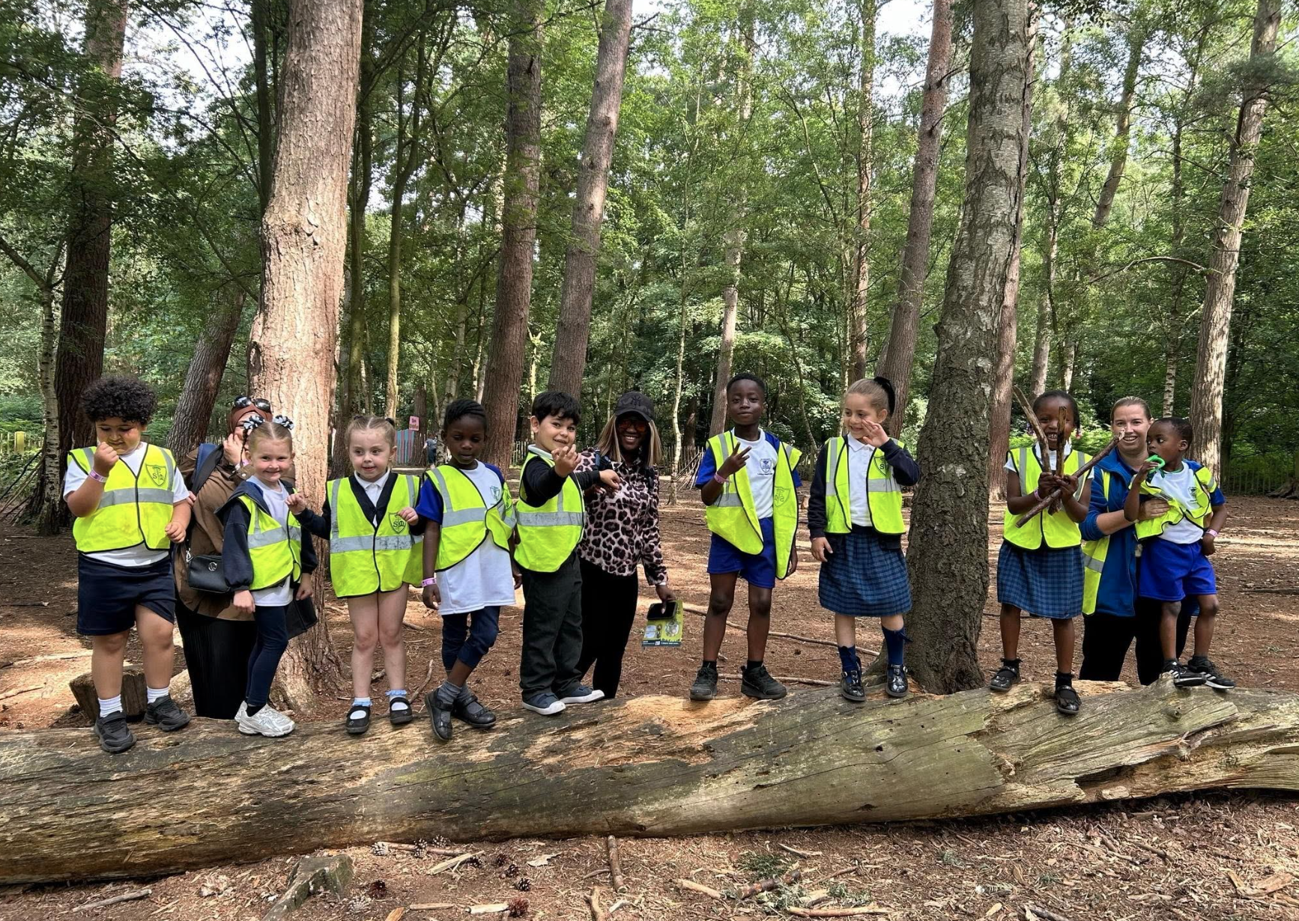
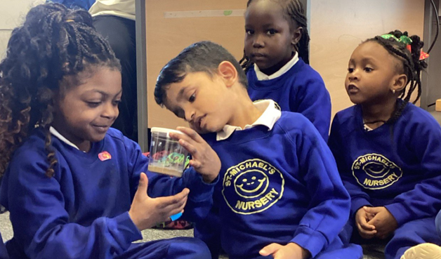
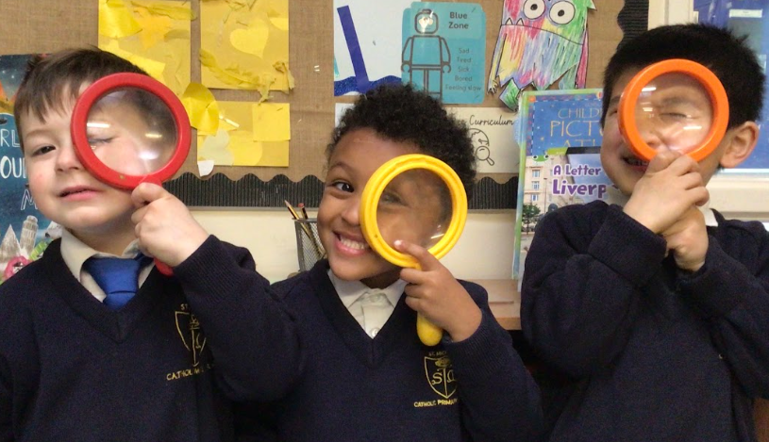

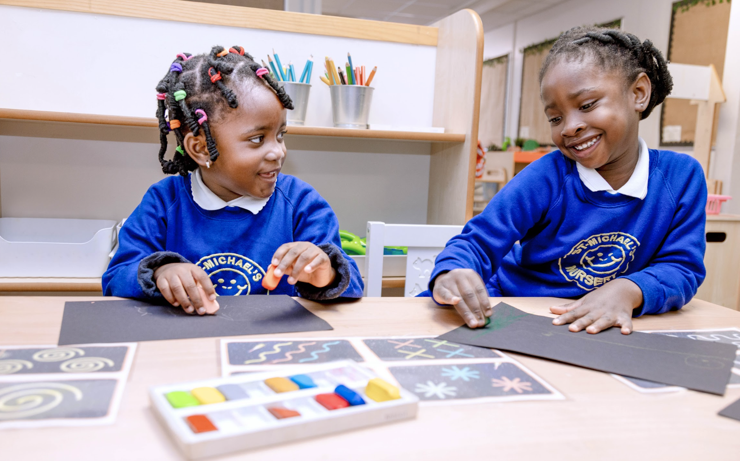
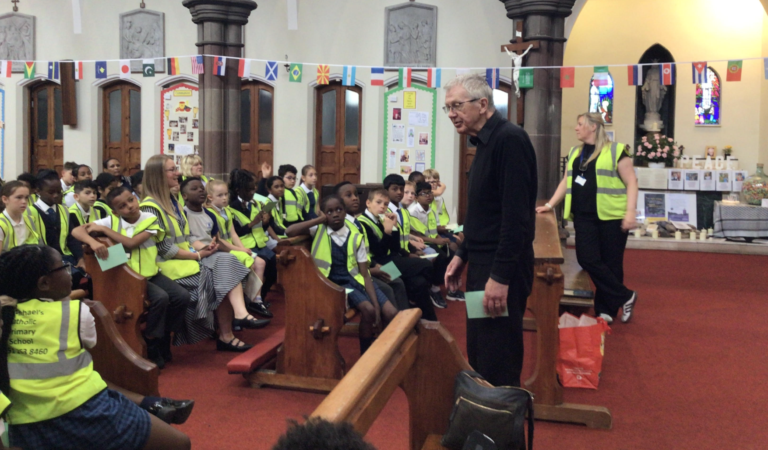
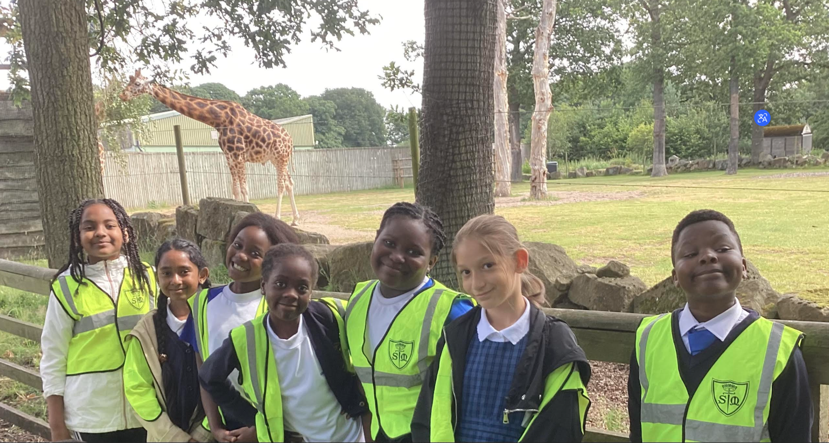
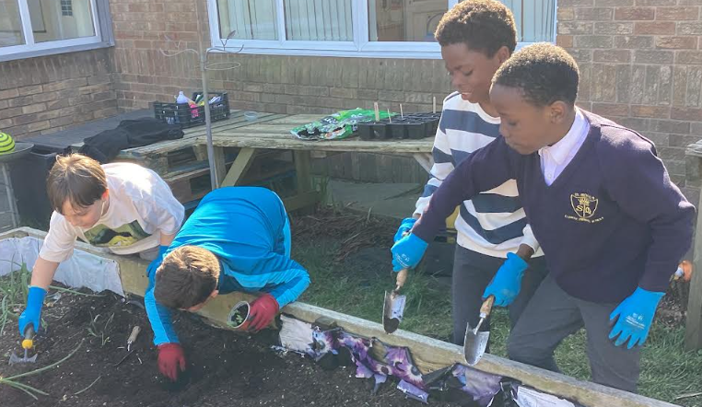
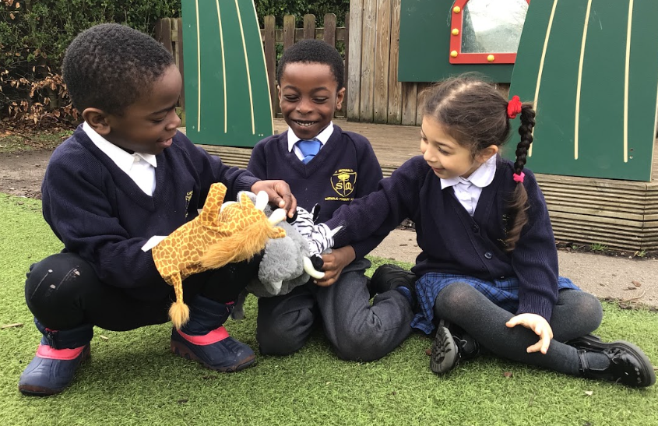
With Jesus we can achieve what we dream and believe
St Michael’s Catholic Primary School

Slide 2
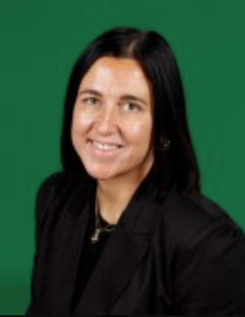
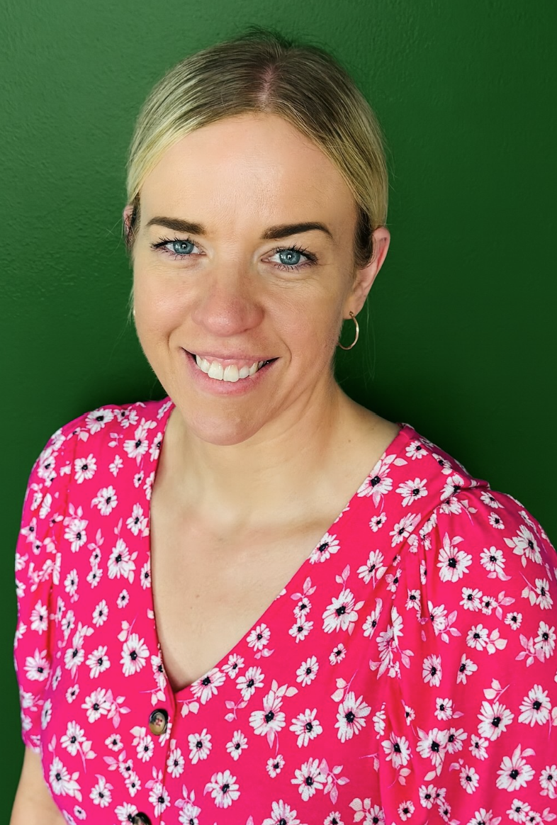
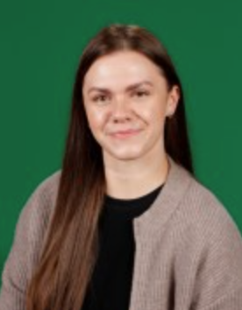
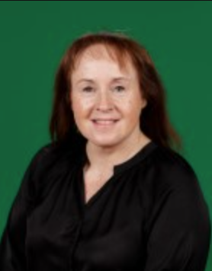
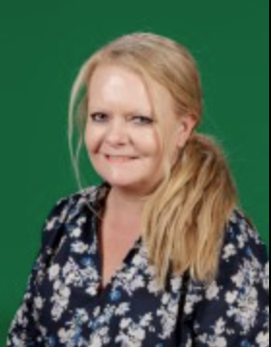
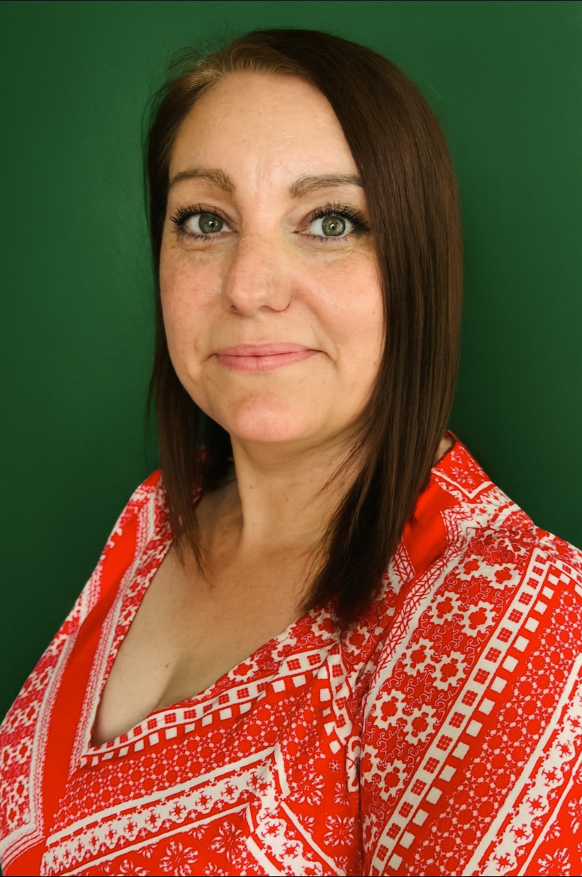
With Jesus we can achieve what we dream and believe
Headteacher
Mrs Gordon
Deputy Headteacher
Mrs Reilly
Senior Assistant Headteacher
Mrs Sillitoe
(On Maternity)
Assistant Headteacher
Mrs Birch
Assistant Headteacher
Mrs Roscoe
EYFS Lead
Mrs Elson
St Michael’s Catholic Primary School

Slide 3
With Jesus we can achieve what we dream and believe
Welcome to
NURSERY
St Michael’s Catholic Primary School

Slide 4
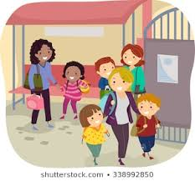
With Jesus we can achieve what we dream and believe
Daily Routines
AM - PM -
8.40am Nursery opens 12.20pm Nursery opens
9.30am Indoor/Outdoor 12.50pm Indoor/Outdoor
10.15am snack 1.30pm snack
11.40am Home time 3.20pm Home time
Forest School is every WEDNESDAY
PE is every FRIDAY
St Michael’s Catholic Primary School

Slide 5

With Jesus we can achieve what we dream and believe
Supporting your child
What you can do to help?
Attendance and Punctuality – on time and attend school every day. Inform school morning of absence to prevent home visit.
Ensure school has up to date contact details – should be contactable at all times
Download school app Arbor – You will be sent an invitation link for the App via email/ text,
please click on link from St Michael’s and follow instructions to activate your account.
St Michael’s Catholic Primary School

Slide 6






With Jesus we can achieve what we dream and believe
Communication
School App- Arbor
Used regularly – You will be sent an invitation link for the App via email/ text, please click on link from St Michael’s and follow instructions to activate your account.
Call into office
if you need
help or have not
received the
invite for the App
Newsletter
Sent out on app and available on school website
Website/Instagram
General information and daily class page updates
Phone Calls
School require at least 2 up to date contactable numbers
Face to Face
Staff can make arrangements to meet.
Letters Home
Usually for trips, main
contact through app.
St Michael’s Catholic Primary School

Slide 7
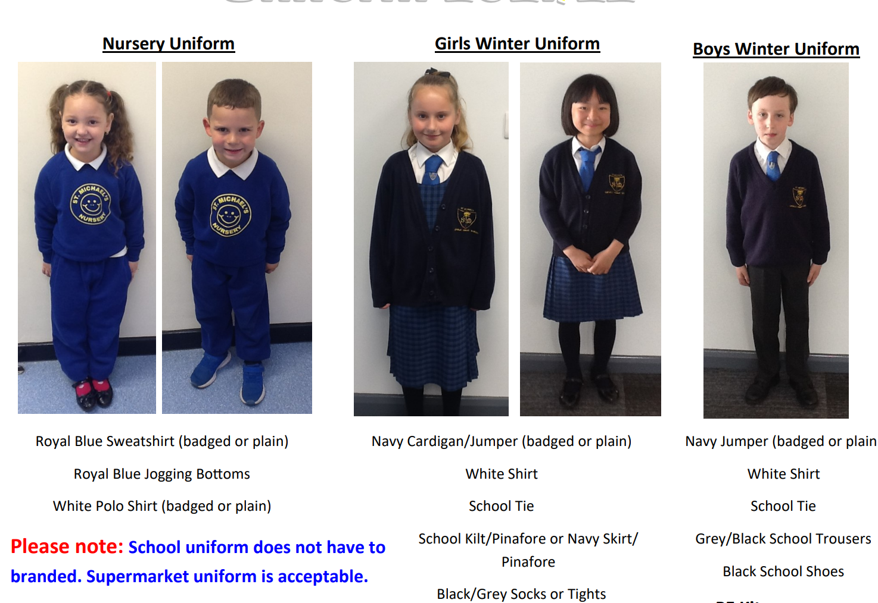

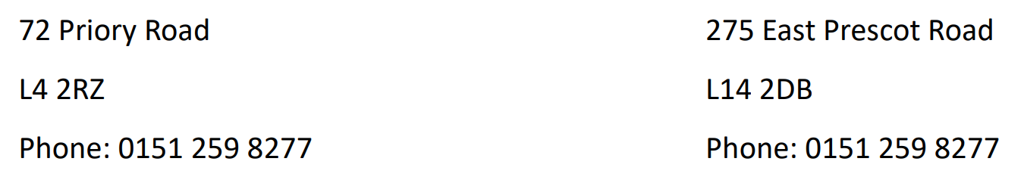
St Michael’s Catholic Primary School
St Michael’s Catholic Primary School
Uniform
Uniform

Slide 8
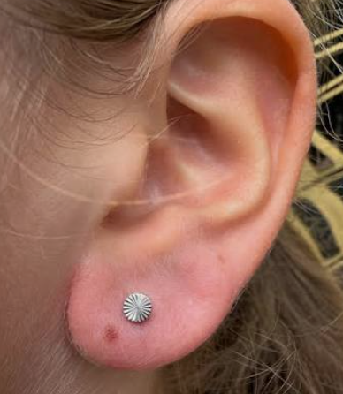
St Michael’s Catholic Primary School
St Michael’s Catholic Primary School
Uniform
Jewellery
Earrings should be studs, with no drop or hoop, which puts the children at risk of harm during school activities.
Earrings and Jewellery will be removed and returned at the end of the day, if worn into school.

Slide 9

St Michael’s Catholic Primary School
St Michael’s Catholic Primary School
Uniform
Allergy Safety Notice

Slide 10
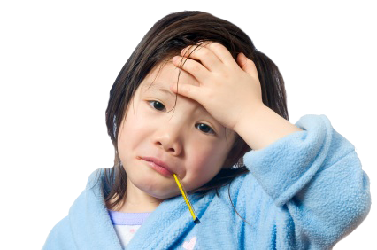

St Michael’s Catholic Primary School
Sickness / Illness
If your child is ill you must let the school know as soon as possible.
Tel. 0151 263 8460

Slide 11
St Michael’s Catholic Primary School
Online Payment System
Online payment is accessible via Parent App- Arbor
Once you have logged into the Arbor App, you can make payments
for School trips

Slide 12
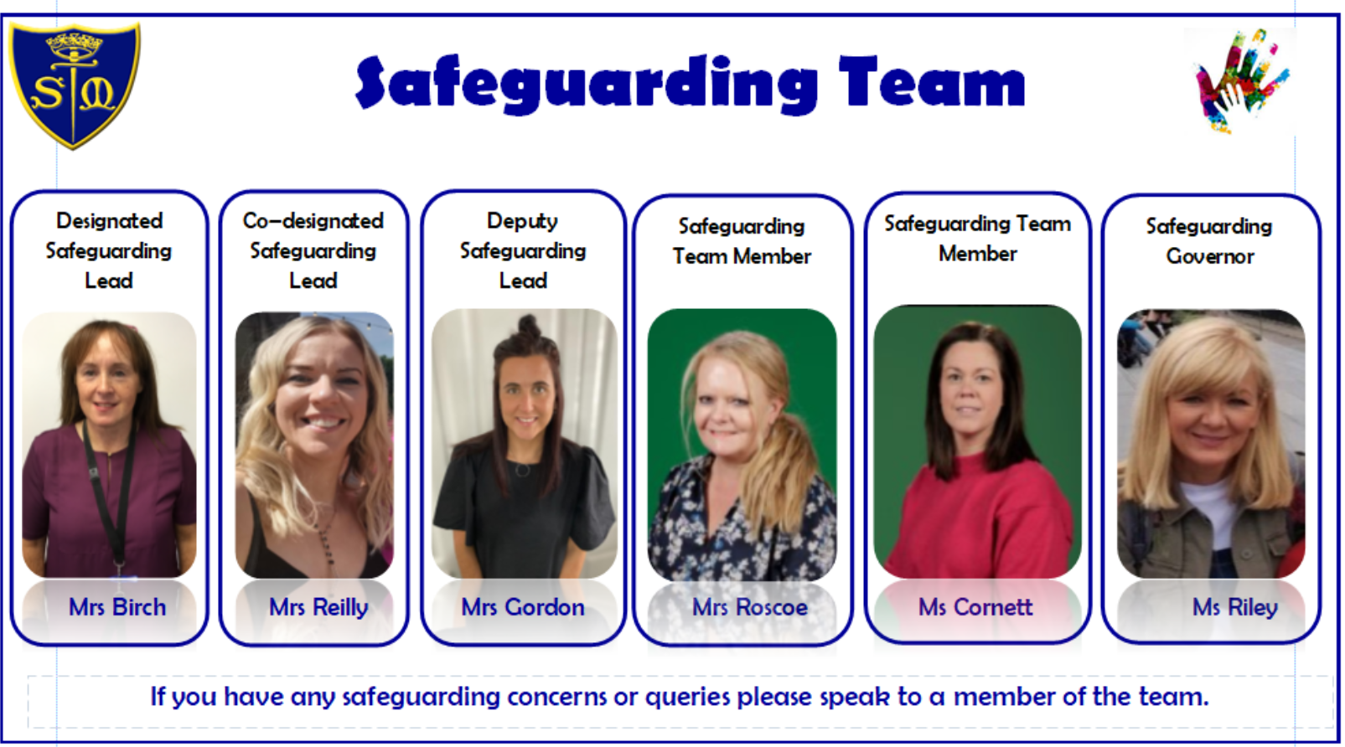
St Michael’s Catholic Primary School
Safeguarding
At St. Michael’s we hold the safety, protection and well-being of every child above all else. If you have any concerns about a child’s safety please speak to our Designated Safeguarding Lead (DSL) or any staff member. Your vigilance helps us keep every child safe.

Slide 13

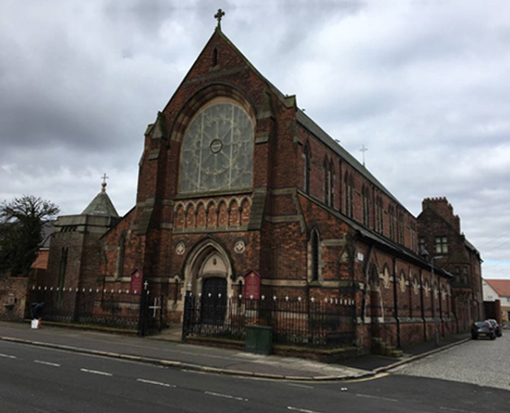
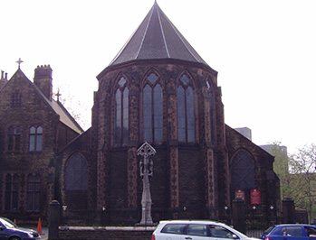

With Jesus we can achieve what we dream and believe
Mass Times
Father Fitz
St Michael’s Church
West Derby Road, L6 5EH
Sundays 10.30am
Sacred Heart Church
Low Hill, L7 8TN
Saturdays 6.30pm
St Michael’s Catholic Primary School

Slide 14
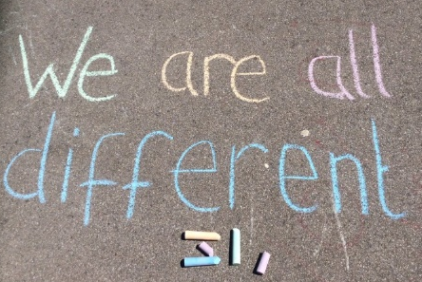
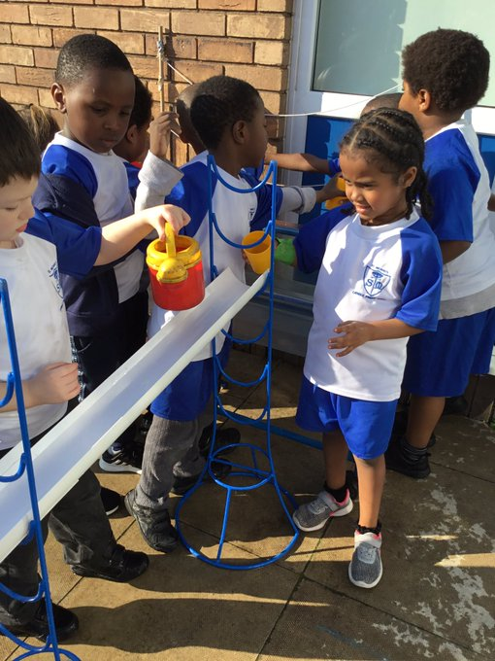
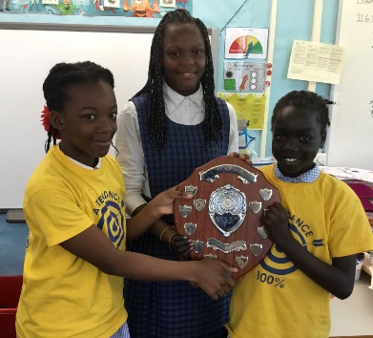
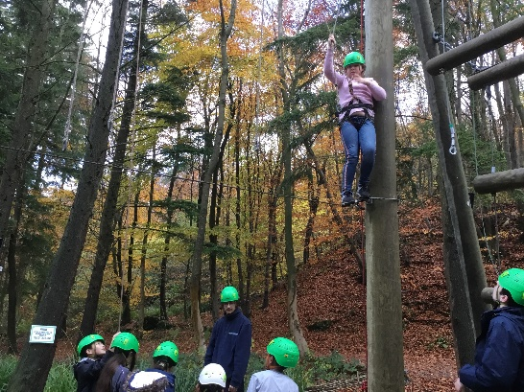
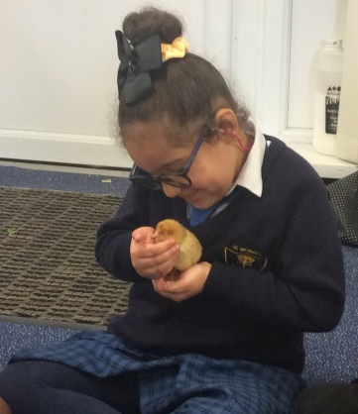
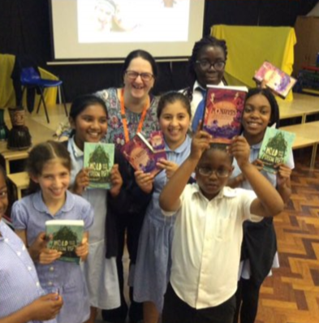
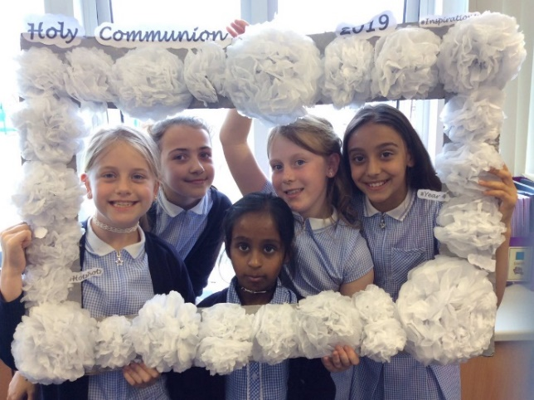
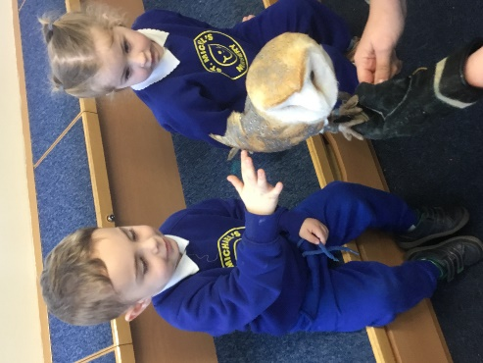
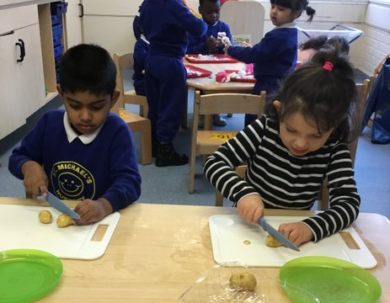
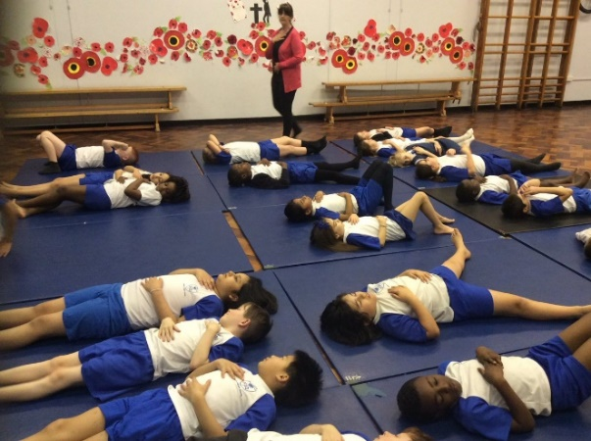
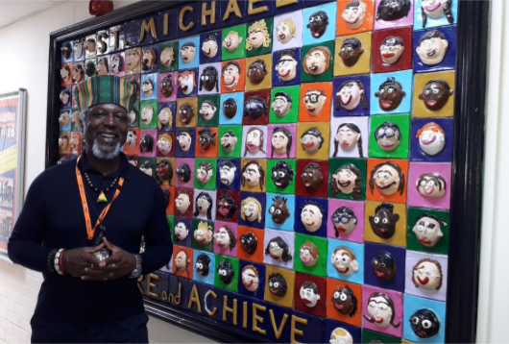
With Jesus we can achieve what we dream and believe
Thank you!
Any questions?
St Michael’s Catholic Primary School

