Slide 1

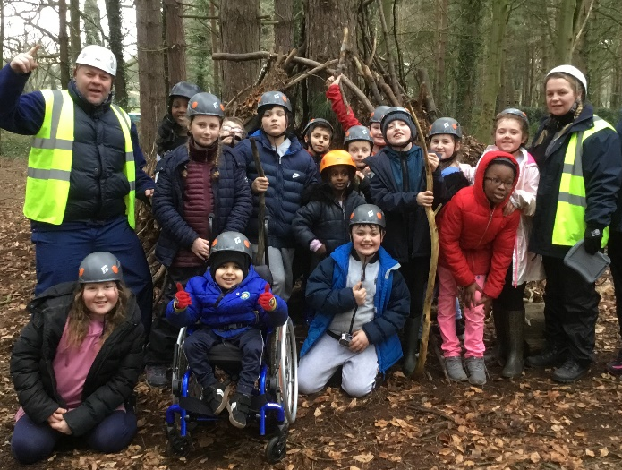
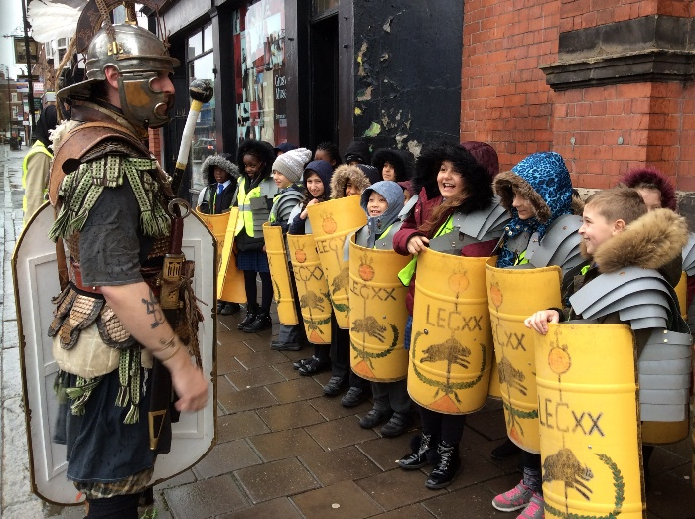
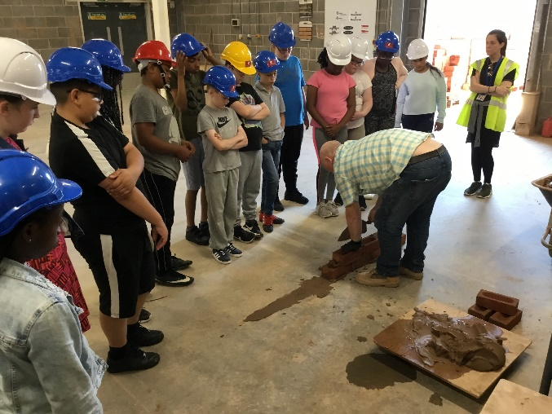


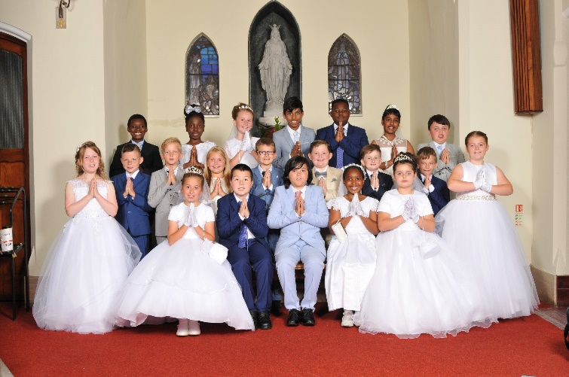
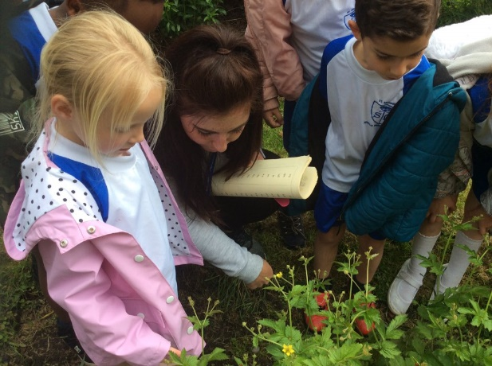
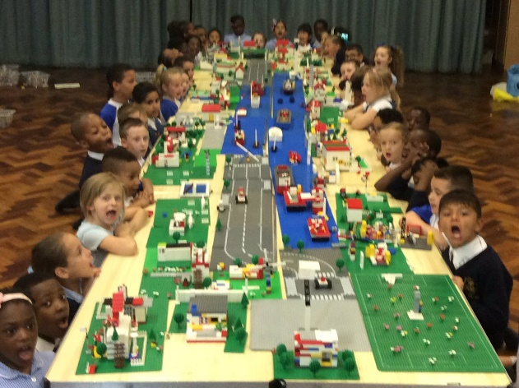
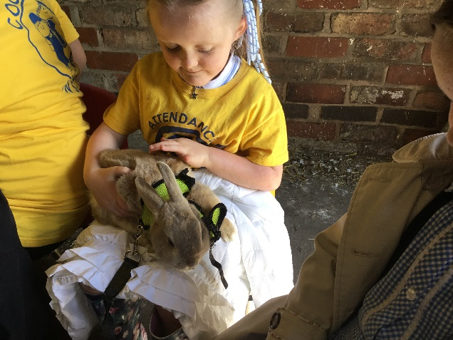
With Jesus we can achieve what we dream and believe
St Michael’s Catholic Primary School

Slide 2
With Jesus we can achieve what we dream and believe
Welcome to
Year
St Michael’s Catholic Primary School

Slide 3

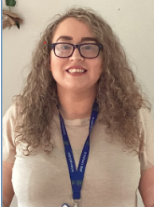
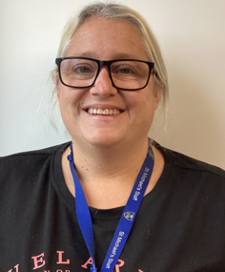
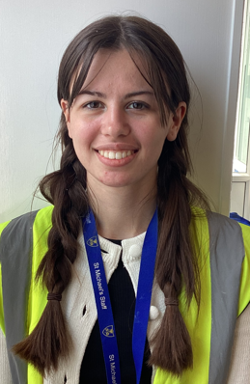
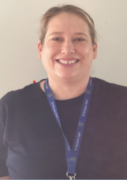
With Jesus we can achieve what we dream and believe
Staff in Nursery
Miss Potter
Class Teacher
Miss Lang
LSA
Miss Collins
HTLA
Miss Marshall
Apprentice
St Michael’s Catholic Primary School

Slide 4

With Jesus we can achieve what we dream and believe
Daily Routines
8:40 | DEAR time/ Rhyme Time/ Puppets/ Small world tuff tray retelling of story | 12:20
9:00 - | Hello Everyone / Plan do review | 12:30
9:10 | Continuous Provision | 12:40
10:00 | Rhyme time / Word rap | 13:30
10:05 | Key work groups – snack and story | 13:35
10:20 | Outdoors – Bucket time and Teaching groups | 13:50
11:20 | Squiggle whilst you wiggle / Dough disco | 14:50
11:30 | Coats and home | 15:00
11:40 | Home Time | 15:20
St Michael’s Catholic Primary School

Slide 5

With Jesus we can achieve what we dream and believe
Welcomm
Wellcomm is a speech and language toolkit that is designed to assess children's speech and language skills. Not how they talk but the language they use and the language and grammar they understand. The first Wellcomm Toolkit is designed from birth to 6 years old, so is generally used in Nursery, Reception and Year One.
St Michael’s Catholic Primary School

Slide 6

With Jesus we can achieve what we dream and believe
Homework is set on a Friday and needs to be handed in by Wednesday.
Your child should also read at home every day.
St Michael’s Catholic Primary School

Slide 7
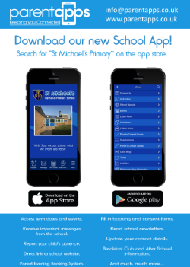
With Jesus we can achieve what we dream and believe
Supporting your child
What you can do to help?
Attendance and Punctuality – on time and attend school every day. Inform school morning of absence to prevent home visit.
Communication and Language -involves giving children opportunities to experience a rich language environment; to develop their confidence and skills in expressing themselves; and to speak and listen in a range of situations.
Personal, social and emotional – involves helping children to develop a positive sense of themselves, and others; to form positive relationships and develop respect for others; to develop social skills and learn how to manage their feelings; to understand appropriate behaviour in groups; and to have confidence in their own abilities. This also includes sharing and taking turns with others.
Physical - involves providing opportunities for young children to be active and interactive; and to develop their co-ordination, control, and movement. This also involves toileting and fine and gross motor skills. Children must also be helped to understand the importance of physical activity, and to make healthy choices in relation to food.
Independence- Encourage your child to dress themselves, put shoes on and feed themselves using knife and fork.
Ensure school has up to date contact details – should be contactable at all times
Download school app – click on link in text invite from St Michael’s and follow instructions
St Michael’s Catholic Primary School

Slide 8
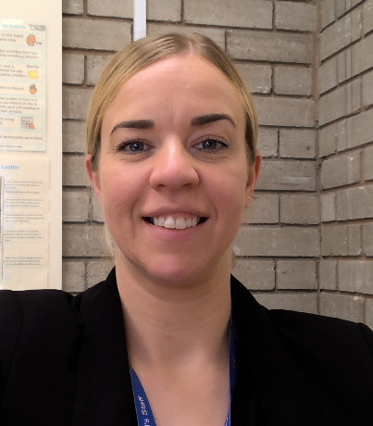
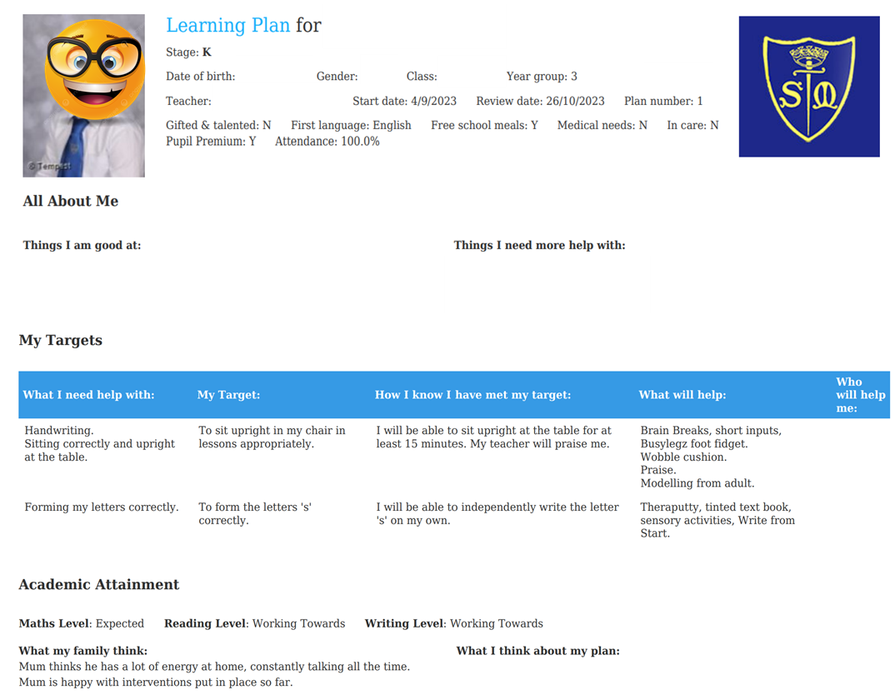
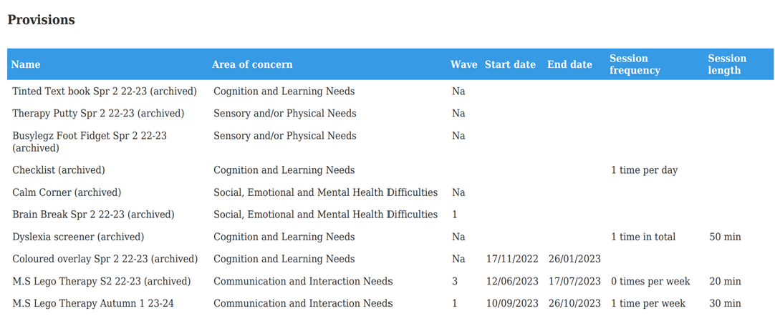
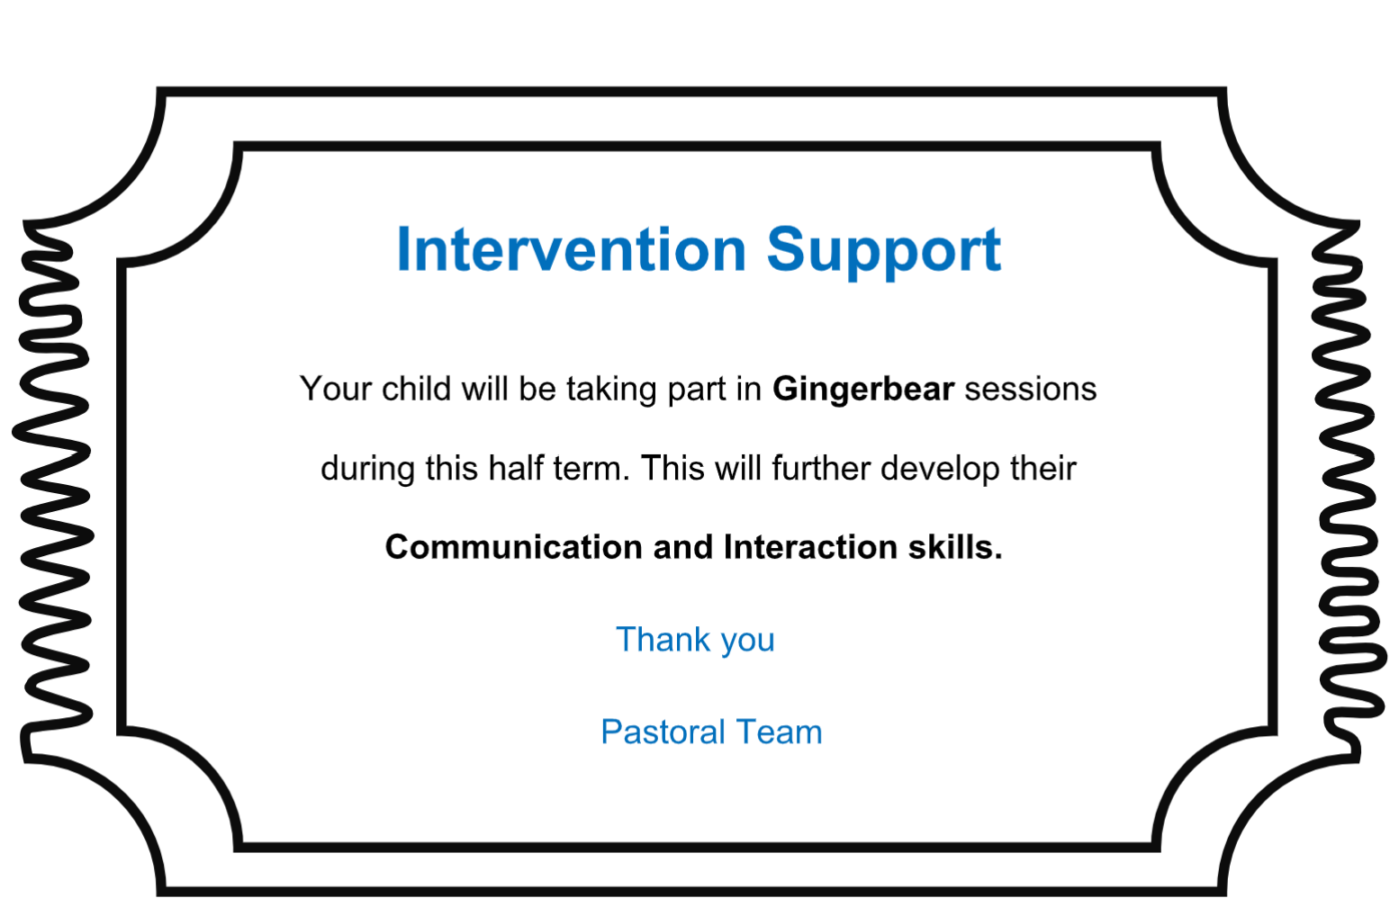
Special Educational Needs and Disability- SEND/SEN
Learning Plan
Mrs Reilly: SENCo
Sometimes our children require additional or different support to that of their peers. When this happens school will use a graduated approach to implement support, which is overseen by Mrs Reilly.
We use:
High Quality First Teaching Approaches- (Wave 1) support
Interventions with Learning Mentors (Wave 2)
Specialist support from an outreach service like seedlings, speech and language, OT or an educational psychologist (Wave 3).
Children on the SEND register will receive an Intervention Ticket this year to inform you if they are starting an intervention with Learning Mentors.
Every child on the SEND register has a learning plan, with SMART targets, which you will receive before parents evening.
Intervention Ticket

Slide 9
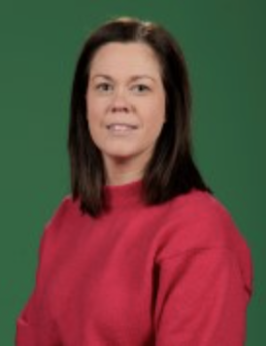
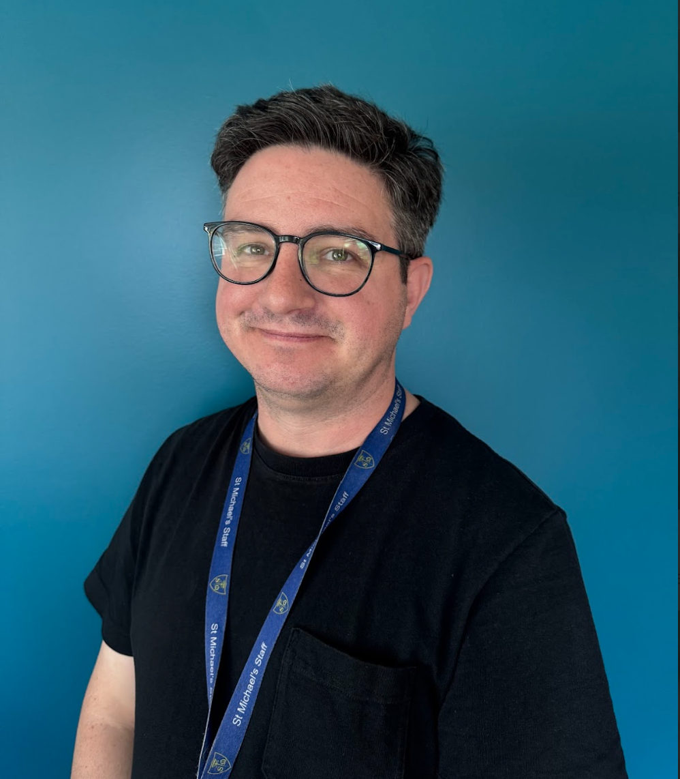
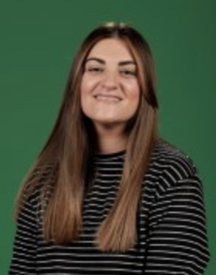
Pastoral Team
We help support the children with SEND interventions, emotional and social well-being, as well as wider family support. Please feel free to speak to us about any concerns or help you may need.
Upcoming Events for Parents:
SEND intervention Parent Coffee Morning 17/09/25 at 9:10 am
Come and find out more information about our SEND interventions your child will attend.
ASD Parent Q & A session 02/10/25 9:15 am
The ASD team will be in to support answering any questions and providing support for parents with children on the pathway or diagnosed or for those with concerns of ASD traits in their child.

Slide 10
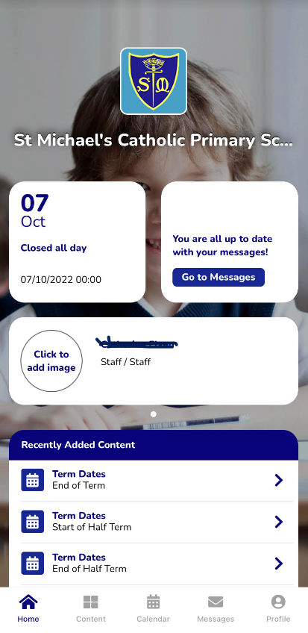






With Jesus we can achieve what we dream and believe
Communication
School App
Used regularly – click on link in text invite from St Michael’s and follow instructions.
Call into office
if you need
help or have not
received a text
Newsletter
Sent out on app and available on school website
Website/Instagram
General information and daily class page updates
Phone Calls
School require at least 2 up to date contactable numbers
Face to Face
Staff can make arrangements to meet.
Letters Home
Usually for trips, main
contact through app.
St Michael’s Catholic Primary School

Slide 11
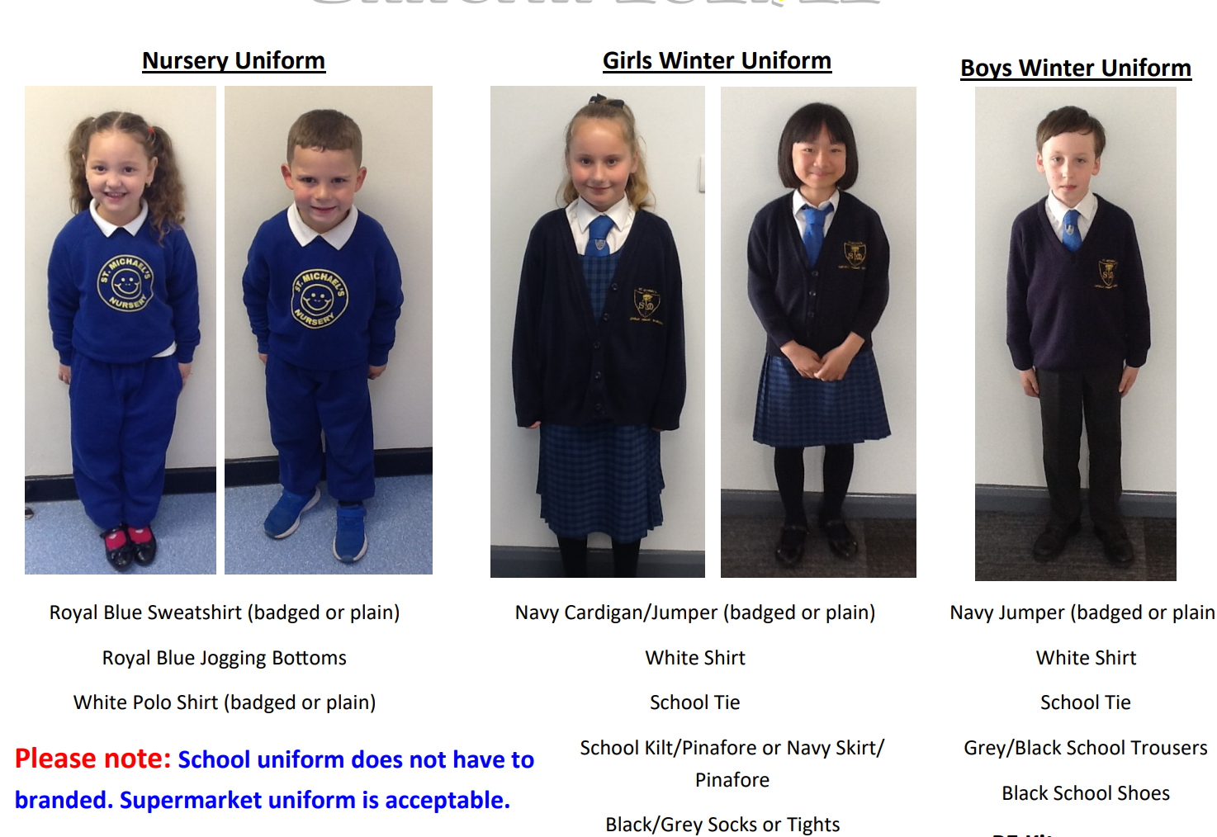

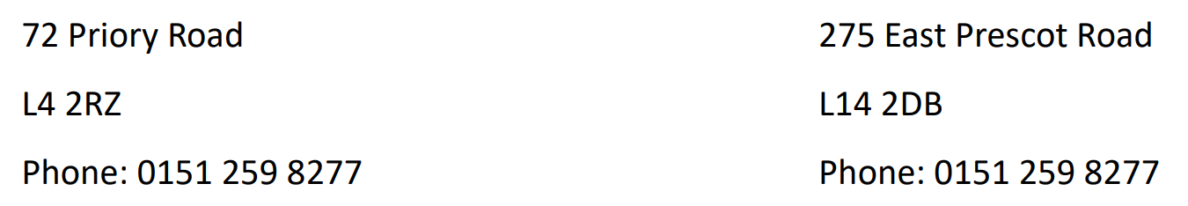
St Michael’s Catholic Primary School
St Michael’s Catholic Primary School
Uniform
Uniform

Slide 12
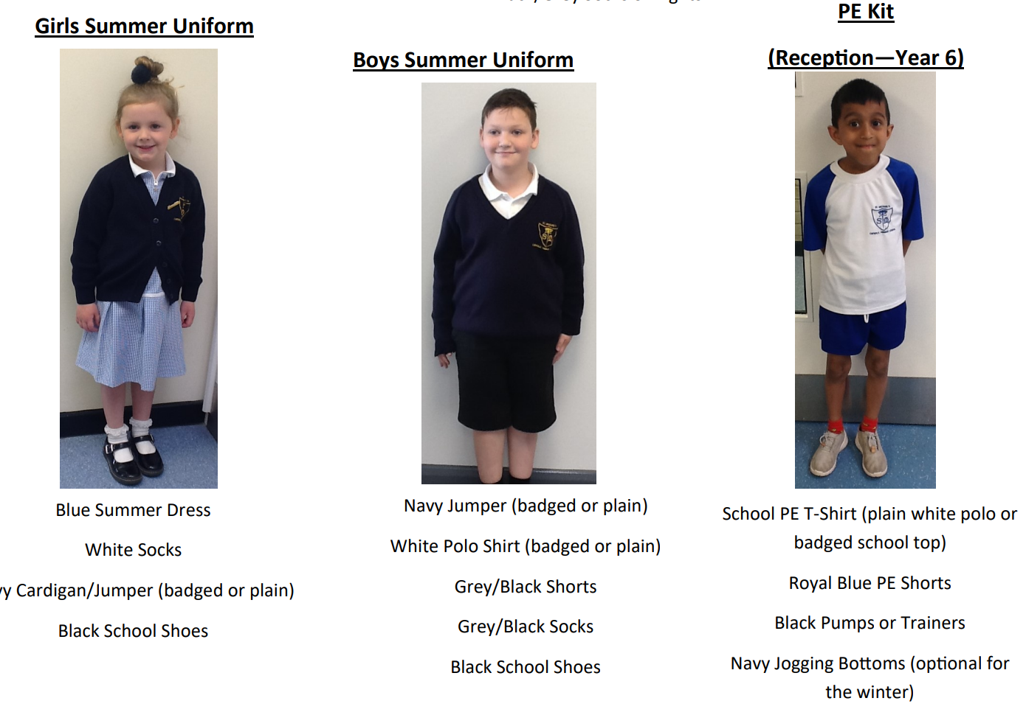
St Michael’s Catholic Primary School
St Michael’s Catholic Primary School
Uniform
Uniform

Slide 13



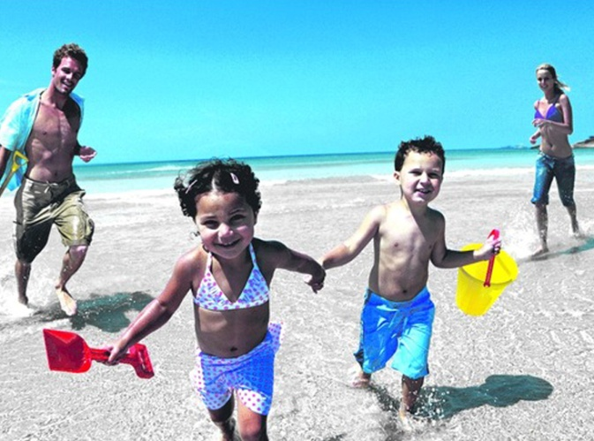
St Michael’s Catholic Primary School
Holidays
During Term Times?
During Half Term and End of Term holidays?
School is Important!

Slide 14


St Michael’s Catholic Primary School
Attendance & Punctuality
Monday
100%
Tuesday
Pupil registration closes at 8:50am
Wednesday
50%
Thursday
0%
Friday
With Jesus we can achieve what we dream and believe

Slide 15


St Michael’s Catholic Primary School
Sickness / Illness
If your child is ill you must let the school know as soon as possible.
Tel. 0151 263 8460

Slide 16
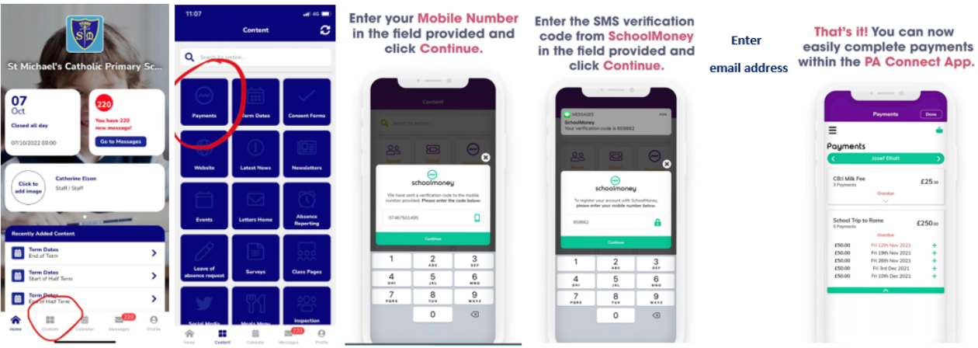
St Michael’s Catholic Primary School
Online Payment System
Access via the school app

Slide 17


St Michael’s Catholic Primary School
Breakfast Club
7:45am – start of school day
50p for breakfast – book and pay using online payment system via school app
All welcome
Entry via infant gate
‘Sparkles’ after school club
End of school day – 5:30pm
Book in advance (by midnight the day before) using online payment system via school £7 full session £4 half session

Slide 18

St Michael’s Catholic Primary School
Concerns about your child
Bullying
Unhappy
SEND
Safeguarding
Mrs Birch (DSL)
Mrs Reilly (Co-DSL)
Mrs Gordon (Deputy DSL)
Miss Sillitoe (Safeguarding Team)
With Jesus we can achieve what we dream and believe

Slide 19

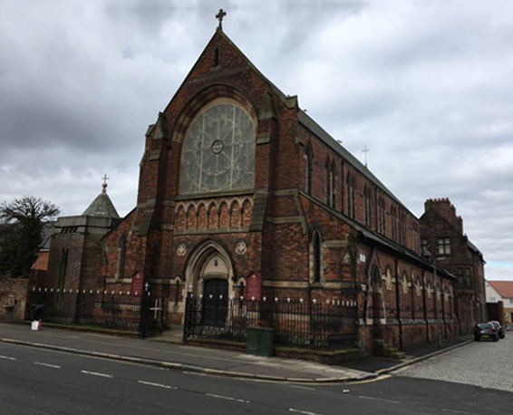
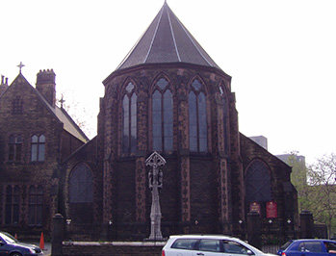

With Jesus we can achieve what we dream and believe
Mass Times
Father Fitz
St Michael’s Church
West Derby Road, L6 5EH
Sundays 10.30am
Sacred Heart Church
Low Hill, L7 8TN
Saturdays 6.30pm
St Michael’s Catholic Primary School

Slide 20
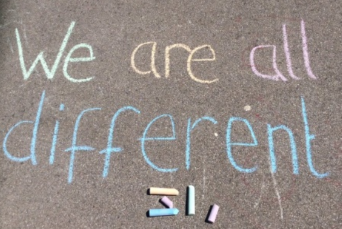
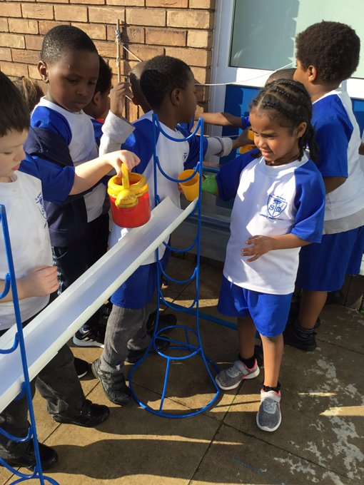

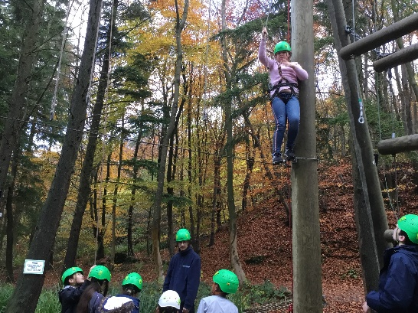
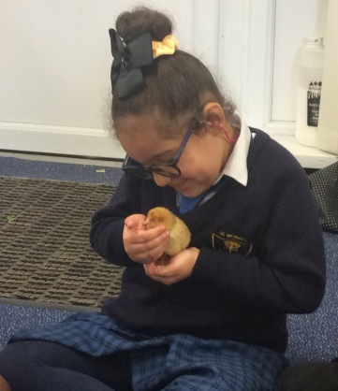
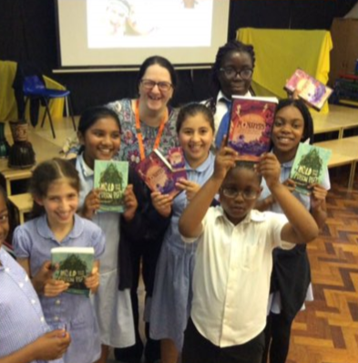
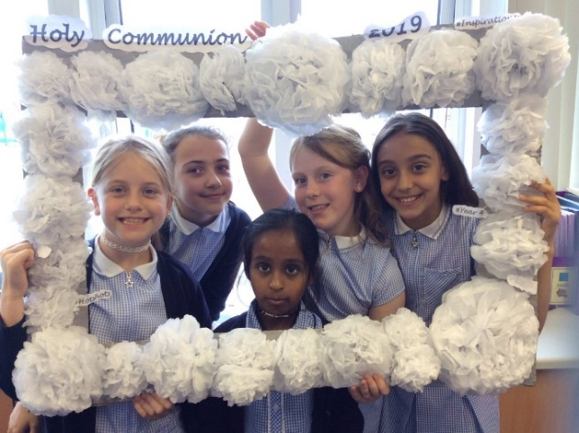
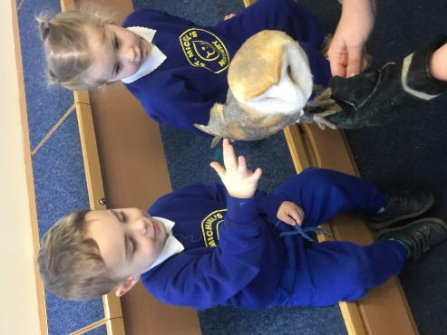
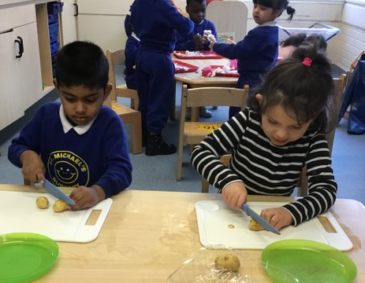
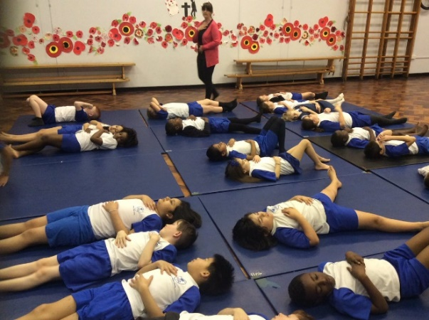
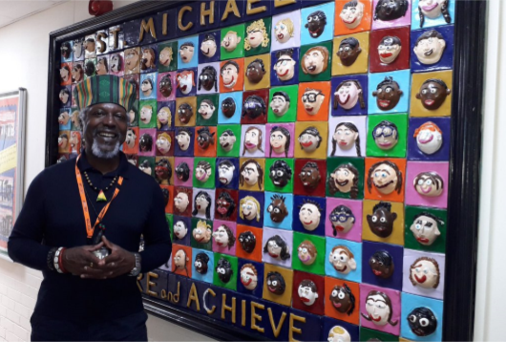
With Jesus we can achieve what we dream and believe
Thank you!
Any questions?
St Michael’s Catholic Primary School

