Slide 1
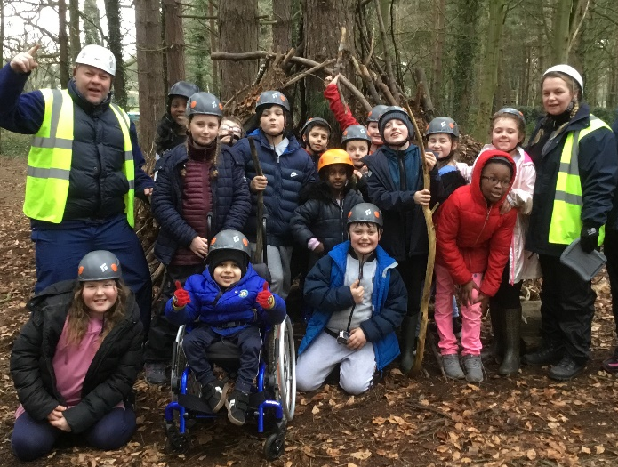
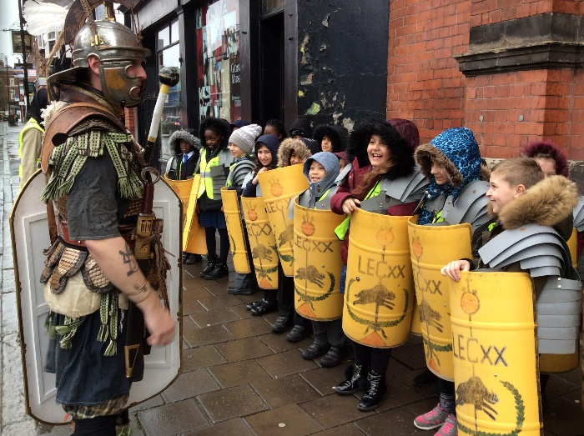
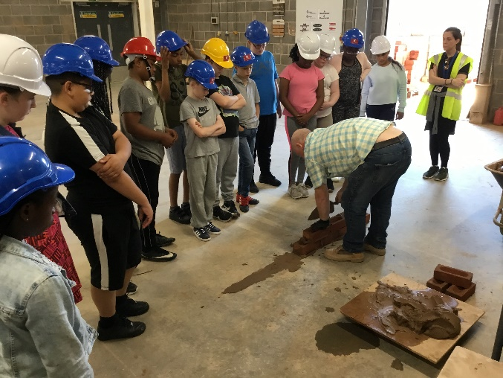
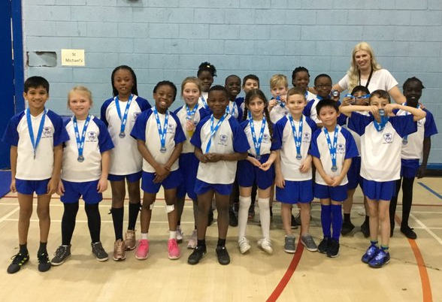
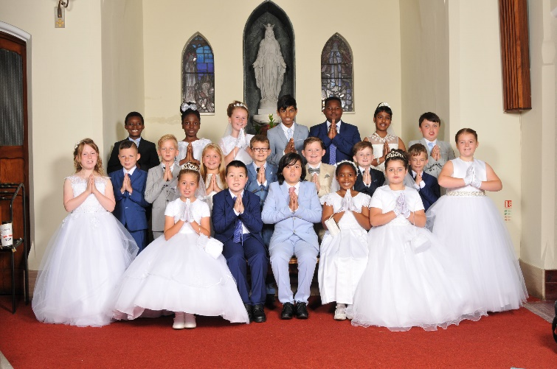
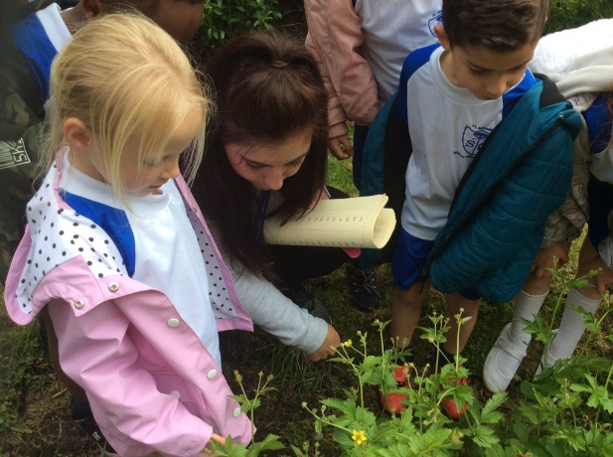
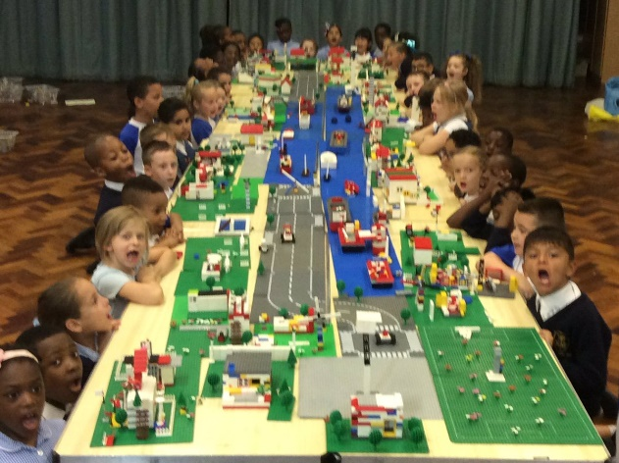
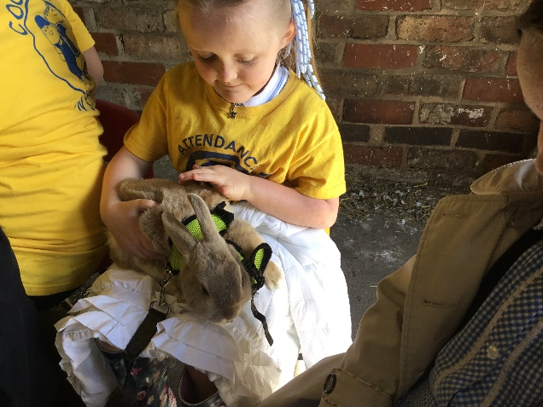
With Jesus we can achieve what we dream and believe
St Michael’s Catholic Primary School

Slide 2
With Jesus we can achieve what we dream and believe
Welcome to
Year 6
St Michael’s Catholic Primary School

Slide 3
With Jesus we can achieve what we dream and believe
Staff in Year 6
Whizz Kids - Miss Sillitoe (Assistant Headteacher)
Champions - Mrs Howard (formerly Miss Whittaker)
Across Year 6
Intervention Teacher - Miss Norman
HLTA - Miss Ghazali
St Michael’s Catholic Primary School

Slide 4
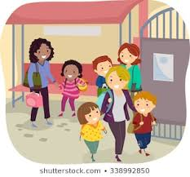
With Jesus we can achieve what we dream and believe
Daily Routines
8:40 - School gates open
8:50 - Pupil registration ends
10:45 - Playtime
12:30 - Lunchtime
3:20 - School ends
St Michael’s Catholic Primary School

Slide 5
Homework is set online every Friday. This should be completed by Wednesday the following week.
Your child should also read at home every day.
With Jesus we can achieve what we dream and believe
St Michael’s Catholic Primary School

Slide 6
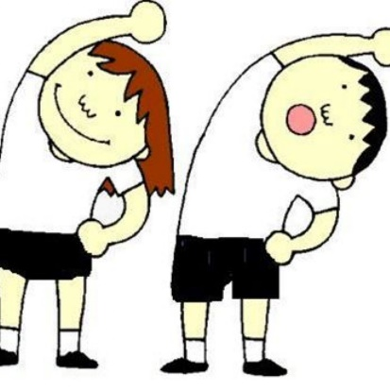
With Jesus we can achieve what we dream and believe
P.E Wednesday and swimming is every Thursday.
A St. Michaels PE kit is required.
St Michael’s Catholic Primary School

Slide 7
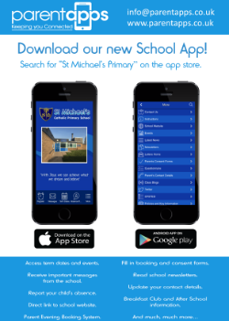
With Jesus we can achieve what we dream and believe
Supporting your child
What you can do to help?
Attendance and Punctuality – on time and attend school every day. Inform school morning of absence to prevent home visit.
English – Encourage your child to read for pleasure. Good readers become good writers. Model good grammar/vocabulary. Learning weekly spellings.
Maths - Basic skills – Times tables (All). Calculations - (All operations) Teach your child the time.
Ensure school has up to date contact details – should be contactable at all times
Download school app – click on link in text invite from St Michael’s and follow instructions
St Michael’s Catholic Primary School

Slide 8
With Jesus we can achieve what we dream and believe
SATs
May 2025
Beginning on Monday 12th May 2025, Year 6 will be sitting their SATs tests. The papers will be:
Arithmetic
Reasoning paper 1
Reasoning paper 2
Reading
Grammar and Spelling
St Michael’s Catholic Primary School

Slide 9
With Jesus we can achieve what we dream and believe
Secondary Applications
Applications for secondary school must be completed online by October 31st.
We will hold a meeting on Wednesday 25th September about the application process.
Please sign up before you leave if you would like to attend.
St Michael’s Catholic Primary School

Slide 10
With Jesus we can achieve what we dream and believe
Transition Workshops
To help our parents with the transition from primary school to secondary school, year 6 staff will be holding a Transition Workshop. We will talk through how you can help your child with the transition, how we can help at school and will give some helpful information in preparation for September 2025!
We will give information about dates as soon as possible!
St Michael’s Catholic Primary School

Slide 11
Meeting with further info - Wednesday 9th October
With Jesus we can achieve what we dream and believe
Colomendy
February 2025
Two night, three day residential trip to Colomendy in North Wales, from Wednesday 5th February until Friday 7th February 2025
The total cost of the visit is £95 and includes return travel by coach, full board accommodation and a full programme of activities.
Friday 20nd September to let us know whether or not you would like your child to attend. A deposit of £10 must be paid online by this date to secure your child’s place on the trip.
Payments must be paid online via the Parent App.
Please see the office if you have any issues with using the app.
St Michael’s Catholic Primary School

Slide 12
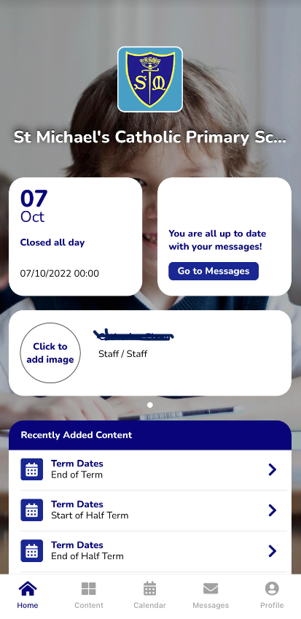
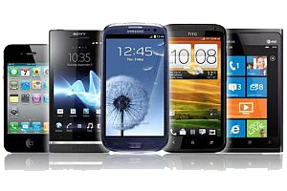
With Jesus we can achieve what we dream and believe
Communication
School App
Used regularly – click on link in text invite from St Michael’s and follow instructions.
Call into office
if you need
help or have not
received a text
Newsletter
Sent out on app and available on school website
Website/ Class Dojo
General information and daily class page updates
Phone Calls
School require at least 2 up to date contactable numbers
Face to Face
Staff can make arrangements to meet.
Letters Home
Usually for trips, main
contact through app.
St Michael’s Catholic Primary School

Slide 13
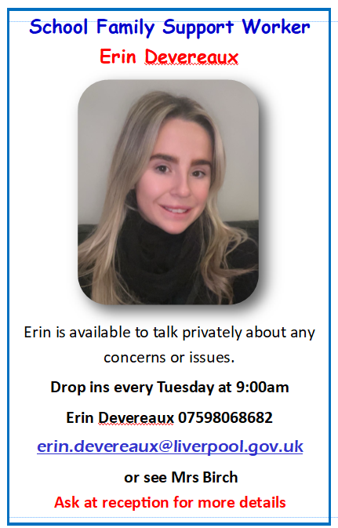
With Jesus we can achieve what we dream and believe
Family Support
If you feel you require any family support then our family support worker is here to offer in any way possible. You can contact her directly or you can ask for further information from Mrs Birch
Family Support worker: Erin Devereaux
Available: Tuesday 9:00am drop ins
St Michael’s Catholic Primary School

Slide 14
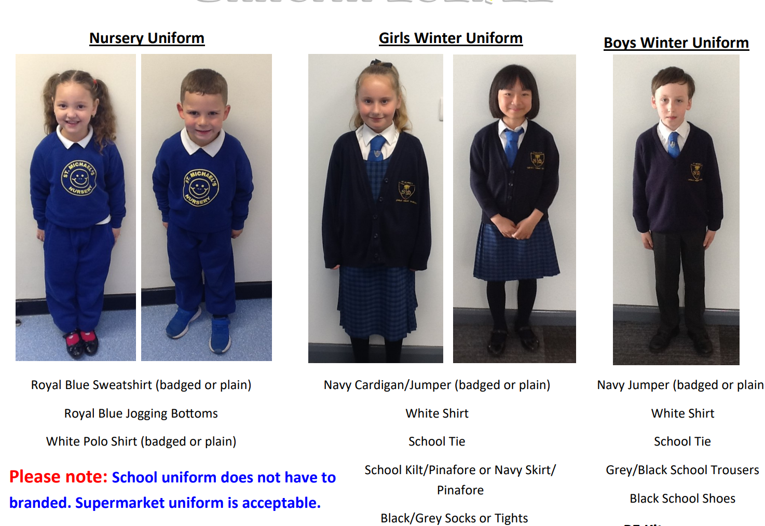
St Michael’s Catholic Primary School
St Michael’s Catholic Primary School
Uniform
Uniform

Slide 15
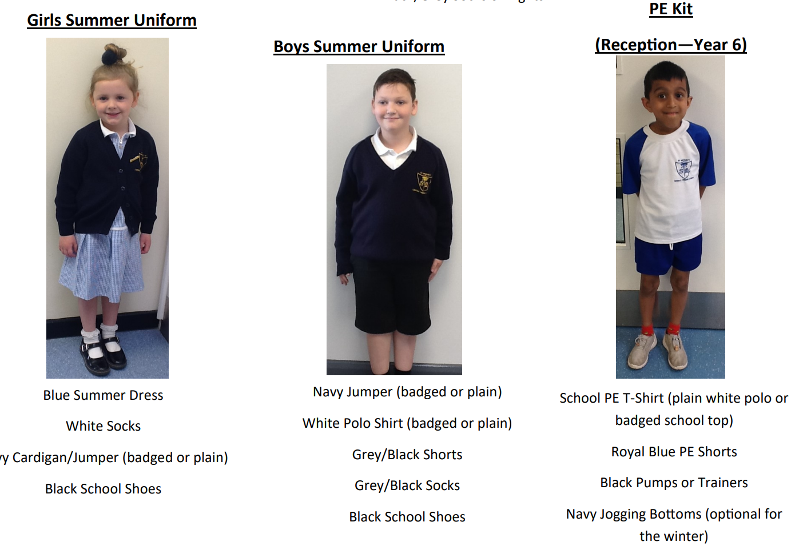
St Michael’s Catholic Primary School
St Michael’s Catholic Primary School
Uniform
Uniform

Slide 16
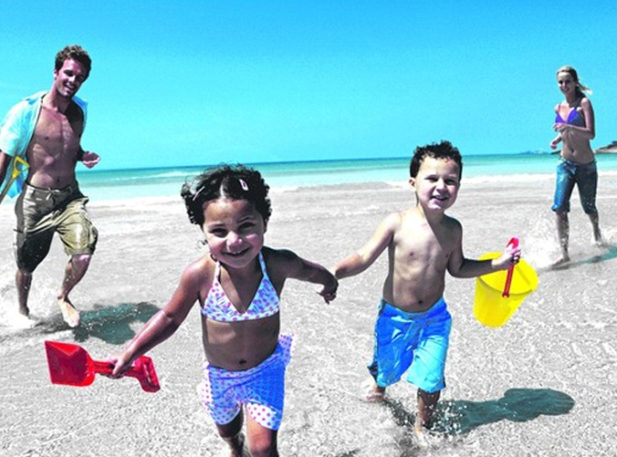
St Michael’s Catholic Primary School
Holidays
During Term Times?
During Half Term and End of Term holidays?
School is Important!

Slide 17
St Michael’s Catholic Primary School
Attendance & Punctuality
Monday
100%
Tuesday
Pupil registration closes at 8:50am
Wednesday
50%
Thursday
0%
Friday
With Jesus we can achieve what we dream and believe

Slide 18
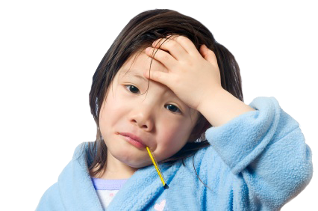
St Michael’s Catholic Primary School
Sickness / Illness
If your child is ill you must let the school know as soon as possible.
Tel. 0151 263 8460

Slide 19
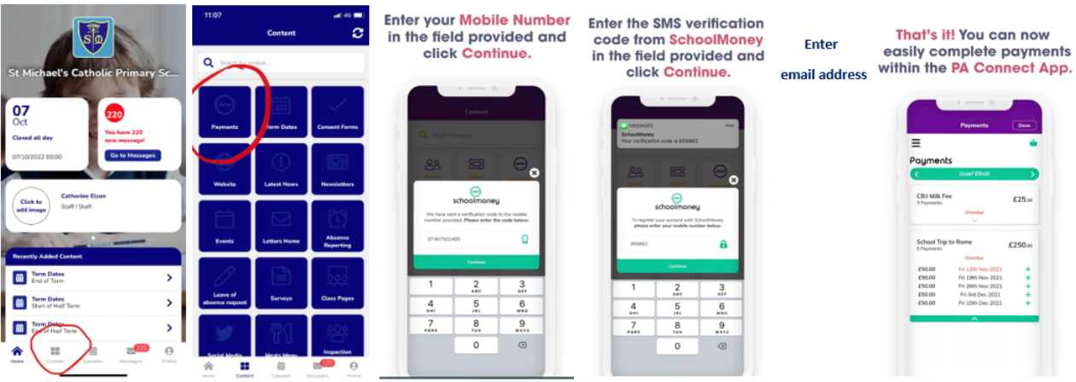
St Michael’s Catholic Primary School
Online Payment System
Access via the school app

Slide 20
St Michael’s Catholic Primary School
Breakfast Club
7:45am – start of school day
50p for breakfast – book and pay using online payment system via school app
All welcome
Entry via infant gate
‘Sparkles’ after school club
End of school day – 5:30pm
Book in advance (by midnight the day before) using online payment system via school £5 full session

Slide 21
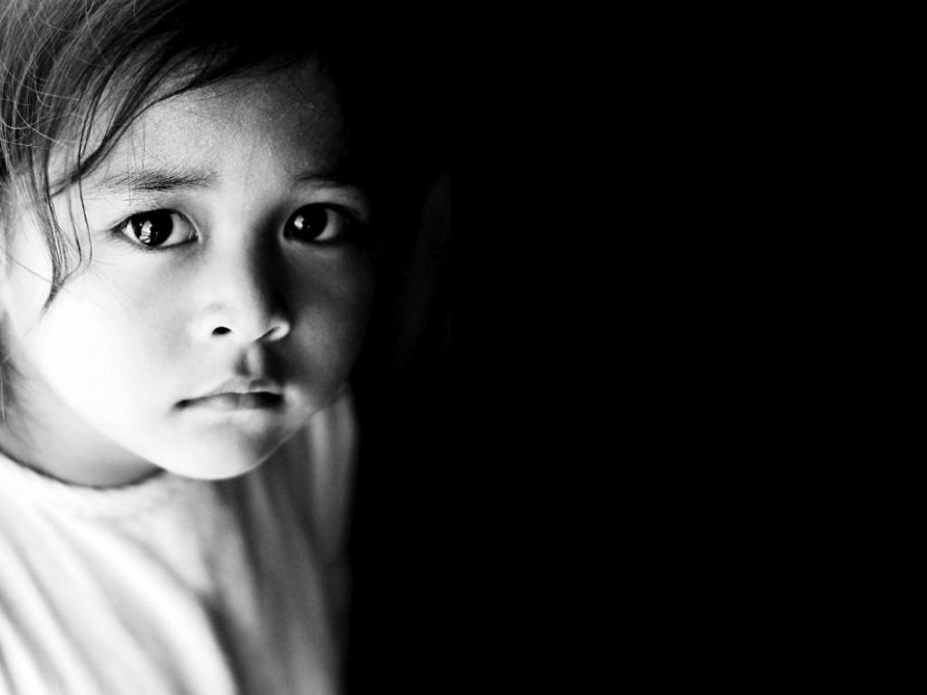
St Michael’s Catholic Primary School
Concerns about your child
Bullying
Unhappy
SEN
Safeguarding
Ms Birch (DSL)
Ms Gordon (DDSL)
With Jesus we can achieve what we dream and believe

Slide 22
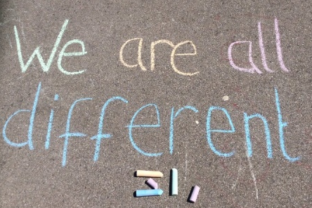
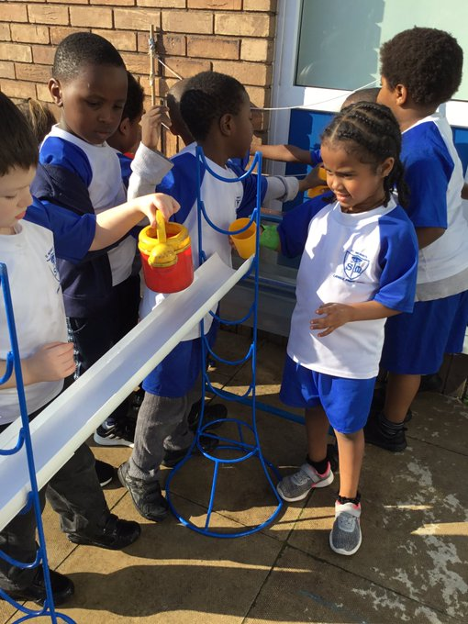
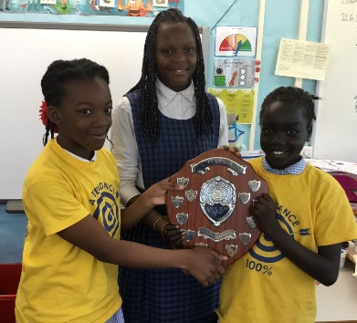
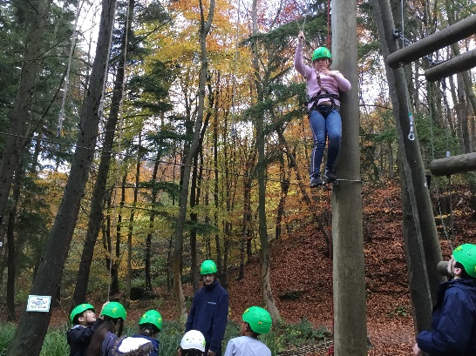
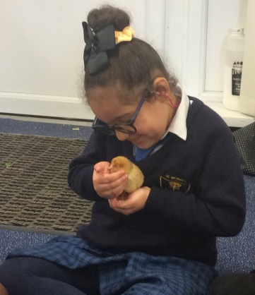
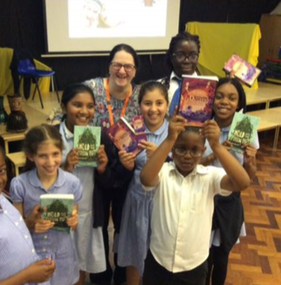
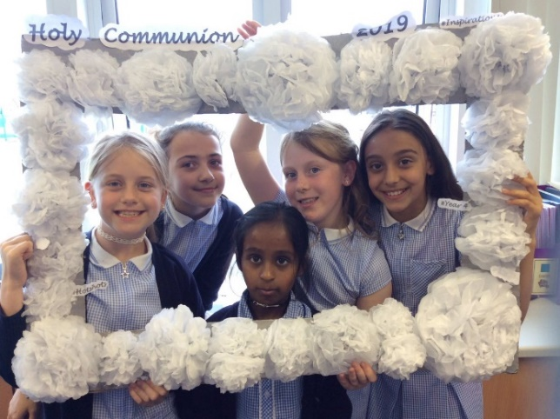
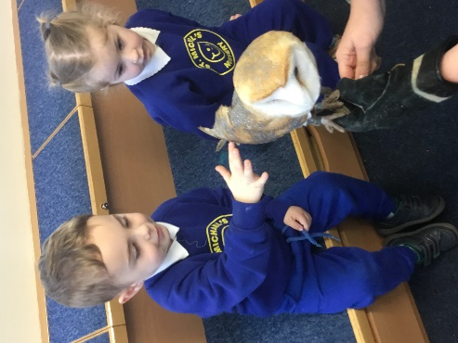
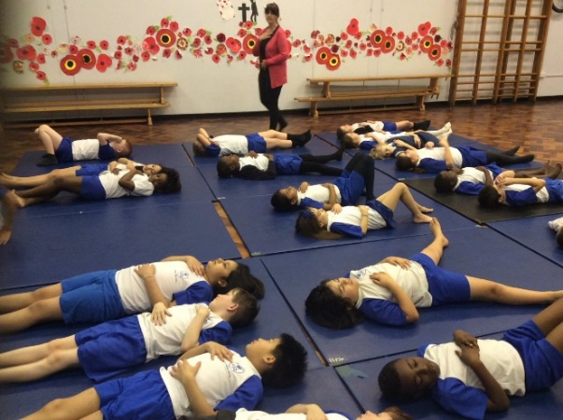
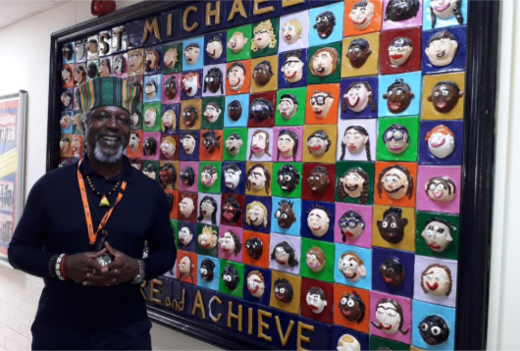
With Jesus we can achieve what we dream and believe
Thank you!
Any questions?
St Michael’s Catholic Primary School

