Slide 1
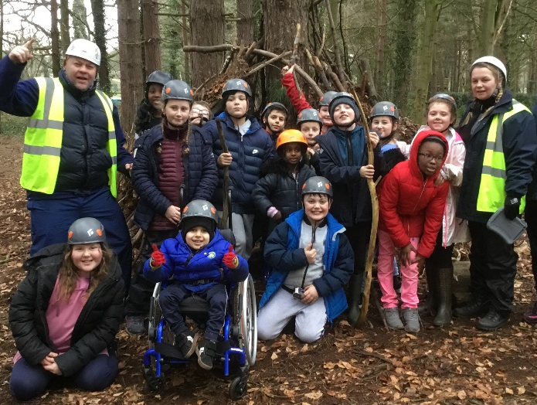
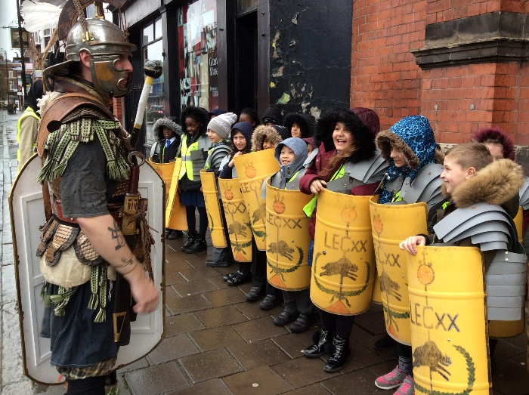
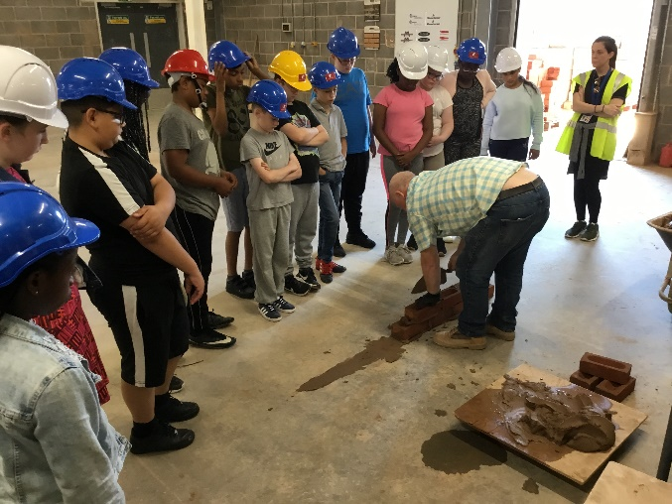
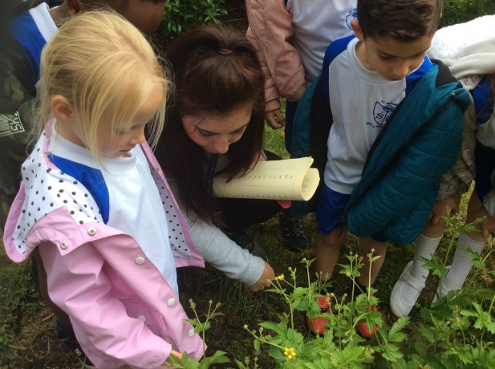
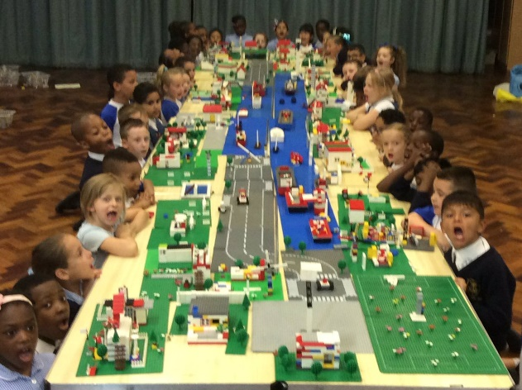
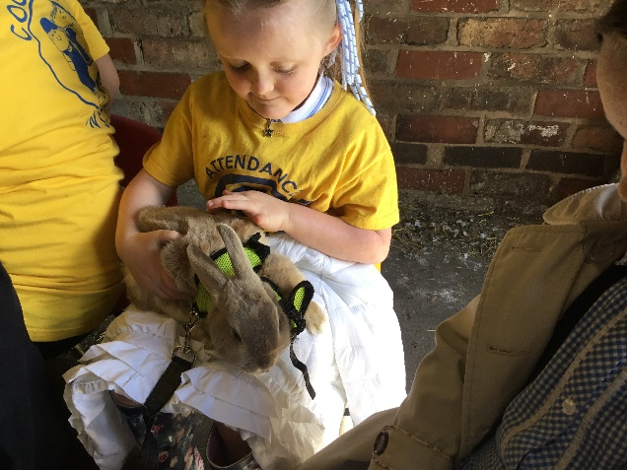
With Jesus we can achieve what we dream and believe
St Michael’s Catholic Primary School

Slide 2
With Jesus we can achieve what we dream and believe
Welcome to
Reception
St Michael’s Catholic Primary School

Slide 3
With Jesus we can achieve what we dream and believe
Staff in Reception
Mrs O’Kane - Class Teacher
Miss Jones - HLTA
Miss Lea - LSA
Miss Elson – Early Years Lead
St Michael’s Catholic Primary School

Slide 4
With Jesus we can achieve what we dream and believe
Daily Routines
8:40 - School gates open
8:50 - Pupil registration ends
11:30 - Lunchtime
3:20 - School ends
St Michael’s Catholic Primary School

Slide 5
With Jesus we can achieve what we dream and believe
Homework is set on a Friday and needs to be handed in by Thursday.
Your child should also read at home every day.
St Michael’s Catholic Primary School

Slide 6
With Jesus we can achieve what we dream and believe
PE is every Tuesday and Friday.
A St. Michaels PE kit is required.
St Michael’s Catholic Primary School

Slide 7
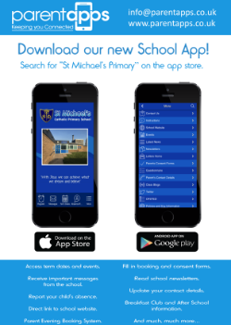
With Jesus we can achieve what we dream and believe
Supporting your child
What you can do to help?
Attendance and Punctuality – on time and attend school every day. Inform school morning of absence to prevent home visit.
English – Encourage your child to read for pleasure. Good readers become good writers. Model good grammar/vocabulary. Learning weekly spellings.
Ensure school has up to date contact details – should be contactable at all times
Download school app – click on link in text invite from St Michael’s and follow instructions
St Michael’s Catholic Primary School

Slide 8
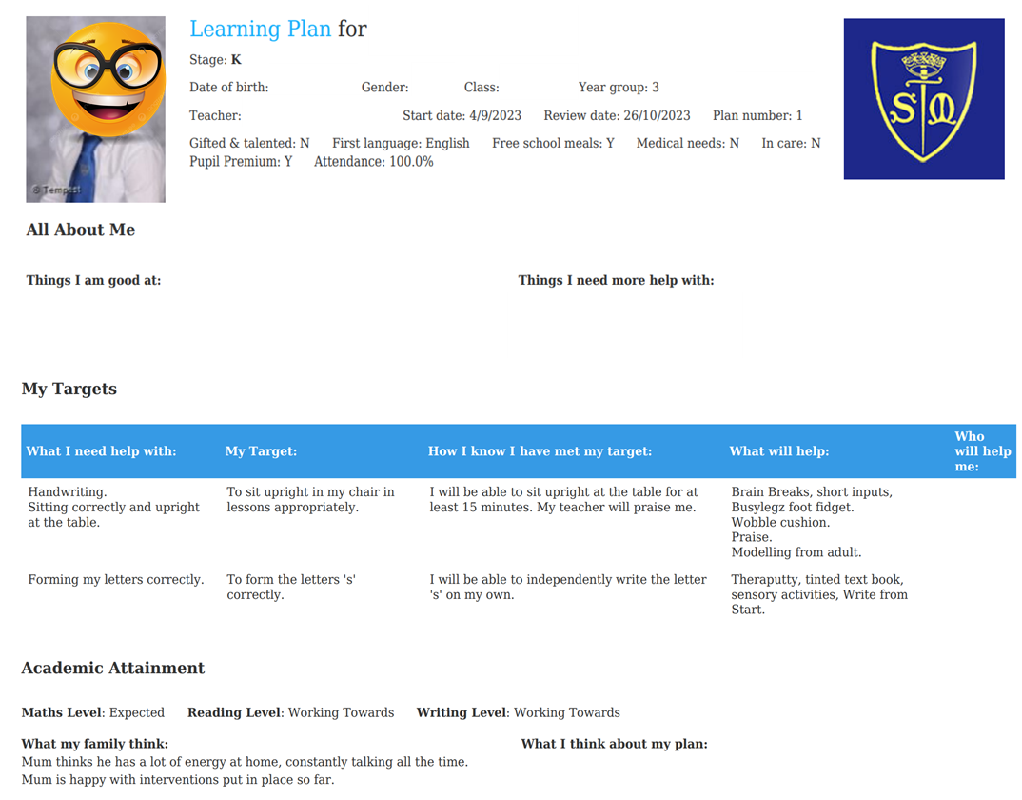
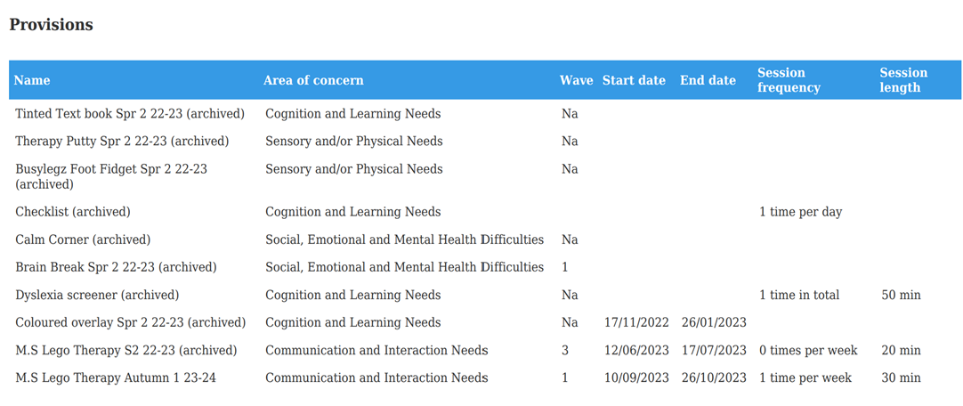
Special Educational Needs and Disability- SEND/SEN
Learning Plan
Mrs Reilly: SENCo
Sometimes our children require additional or different support to that of their peers. When this happens school will use a graduated approach to implement support, which is overseen by Mrs Reilly.
Most of the time we can use high quality teaching approaches to help your child, but on other occasions it may require something more than this for example an intervention, additional or specialised resources or even specialist support from an outreach service like seedlings, speech and language or an educational psychologist.
When a child is receiving additional or different support from school, they will be added to the SEND register and you will receive learning plans before parents evening, showing the child’s targets they are working towards and what extra provisions they are receiving from school to support them.

Slide 9
I think my child may require a diagnosis
While not all children on the SEND register will require a diagnosis, some may and Mrs Reilly will support you to get the necessary assessments to get you the help you require for your child.
If you are worried or need a little extra help:
Speak to the class teacher and share your concerns:
They will share what they see in class
Take some additional information from you around your concerns
You may be directed to meet with Mrs Reilly who can support with:
Specialist support, advice
Request assessments for external services: OT, Speech and Language, School Nurse etc.
Signposting to other external providers
Seek parental support for you
Help with issues such as toileting, independence, diet, behaviour, communication, social interactions etc.

Slide 10
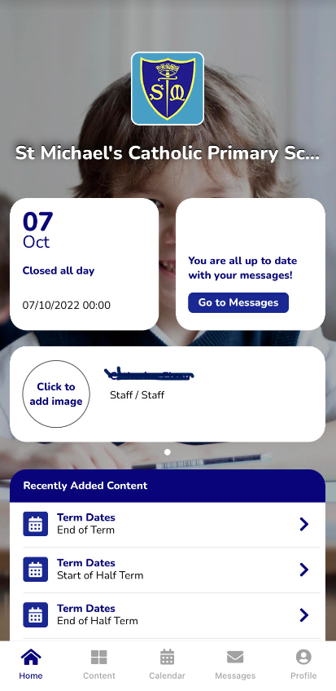
With Jesus we can achieve what we dream and believe
Communication
School App
Used regularly – click on link in text invite from St Michael’s and follow instructions.
Call into office
if you need
help or have not
received a text
Newsletter
Sent out on app and available on school website
Website
General information and daily class page updates
Phone Calls
School require at least 2 up to date contactable numbers
Face to Face
Staff can make arrangements to meet.
Letters Home
Usually for trips, main
contact through app.
St Michael’s Catholic Primary School

Slide 11
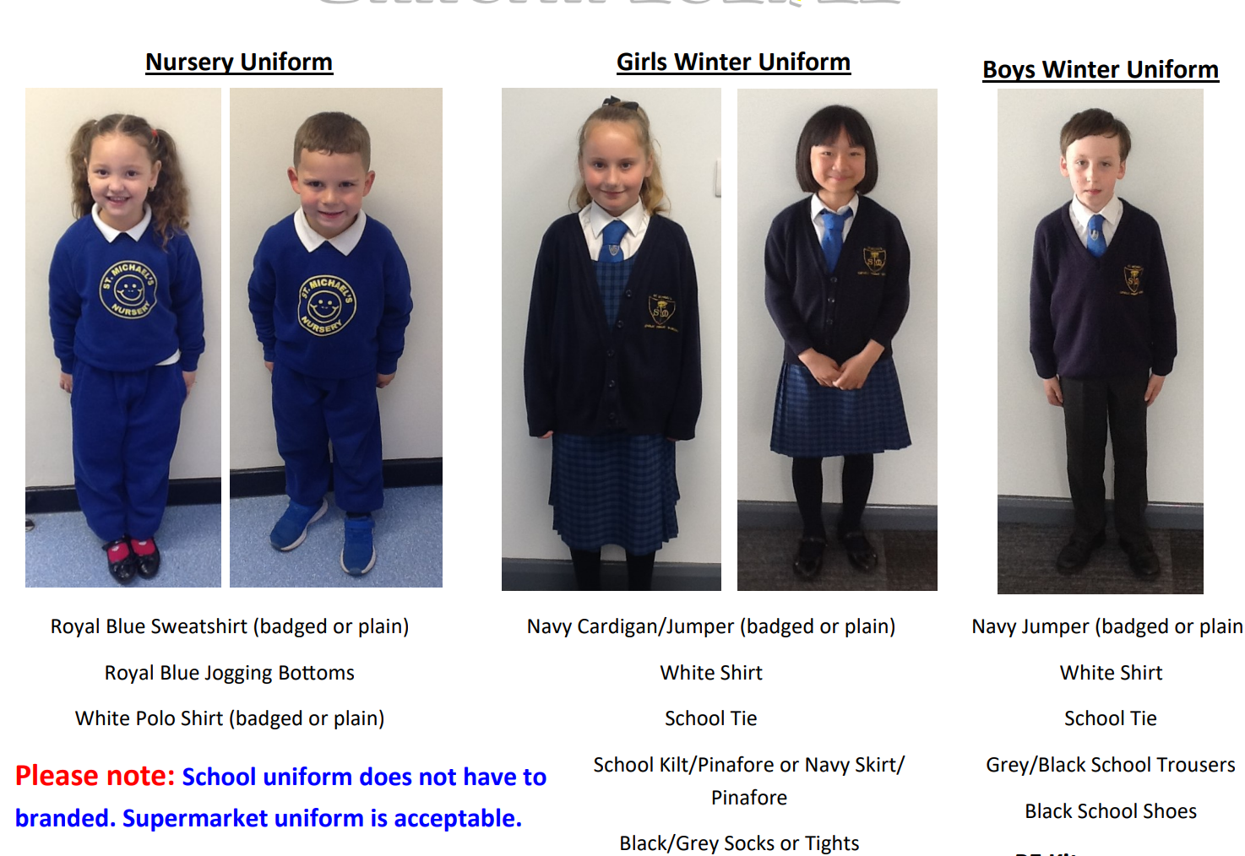
St Michael’s Catholic Primary School
St Michael’s Catholic Primary School
Uniform
Uniform

Slide 12
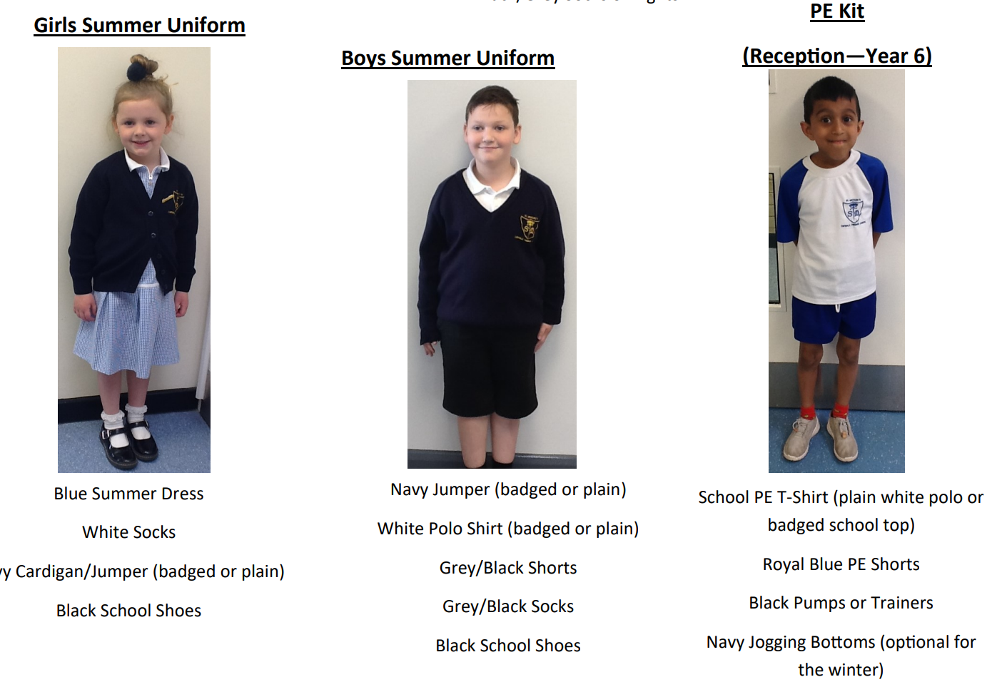
St Michael’s Catholic Primary School
St Michael’s Catholic Primary School
Uniform
Uniform

Slide 13
St Michael’s Catholic Primary School
Sickness / Illness
If your child is ill you must let the school know as soon as possible.
Tel. 0151 263 8460

Slide 14
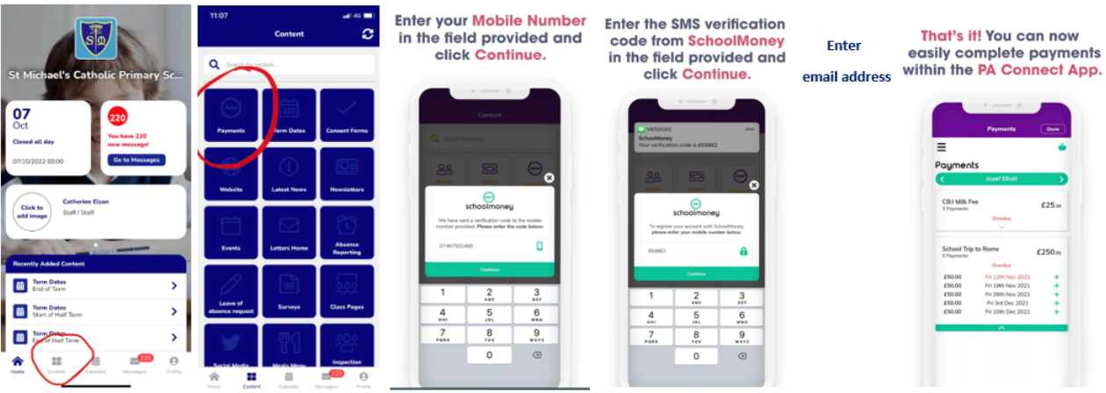
St Michael’s Catholic Primary School
Online Payment System
Access via the school app

Slide 15
St Michael’s Catholic Primary School
Breakfast Club
7:45am – start of school day
50p for breakfast – book and pay using online payment system via school app
All welcome
Entry via infant gate
‘Sparkles’ after school club
End of school day – 5:30pm
Book in advance (by midnight the day before) using online payment system via school £7 full session £4 half session

Slide 16
St Michael’s Catholic Primary School
Concerns about your child
Bullying
Unhappy
SEN
Safeguarding
Ms Birch (DSL)
Ms Gordon (DDSL)
With Jesus we can achieve what we dream and believe

Slide 17
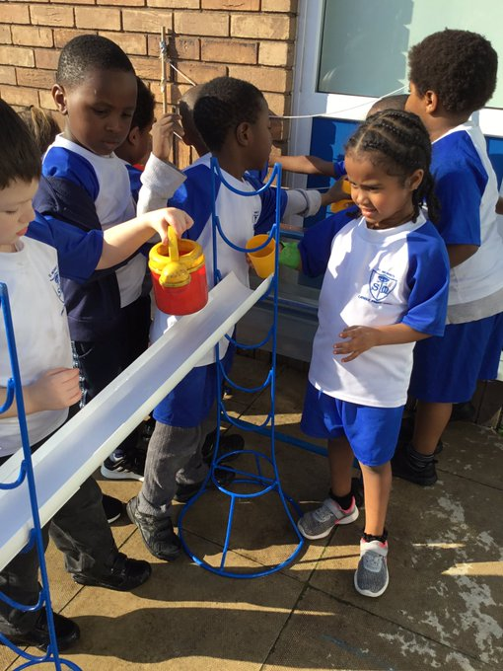
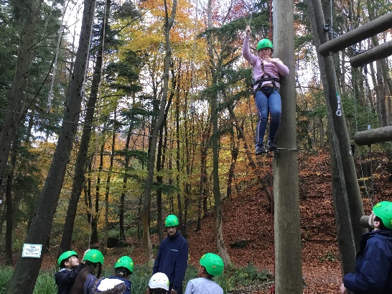
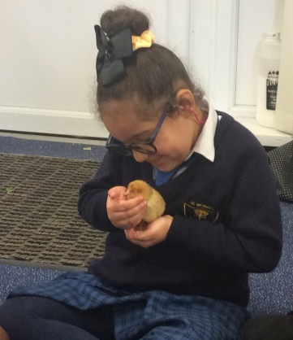
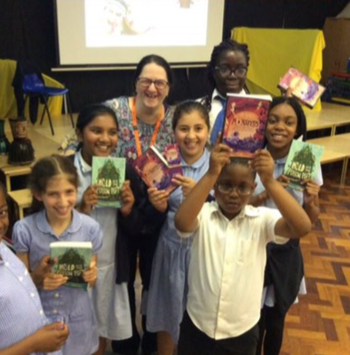
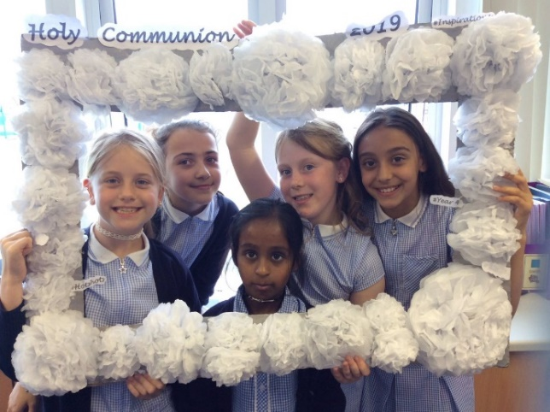
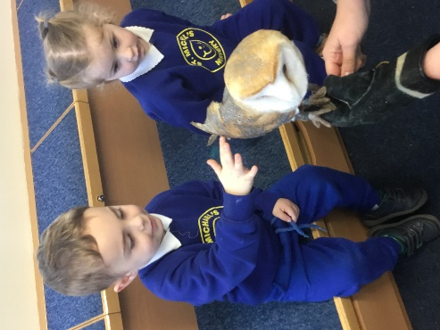
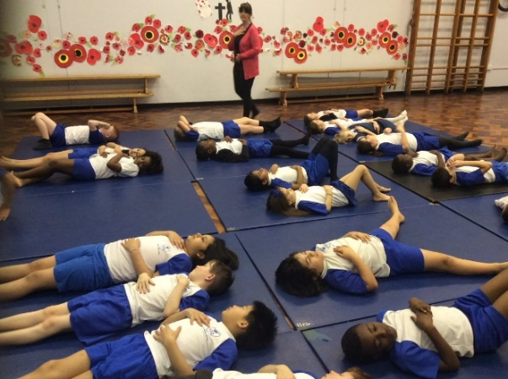
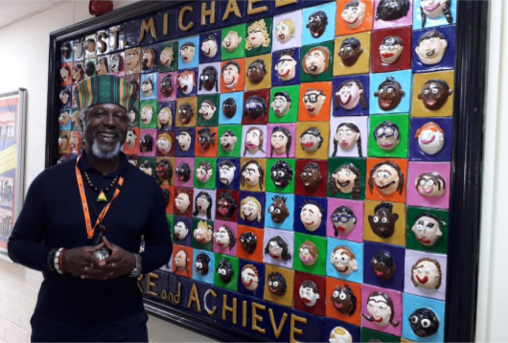
With Jesus we can achieve what we dream and believe
Thank you!
Any questions?
St Michael’s Catholic Primary School

