Slide 1
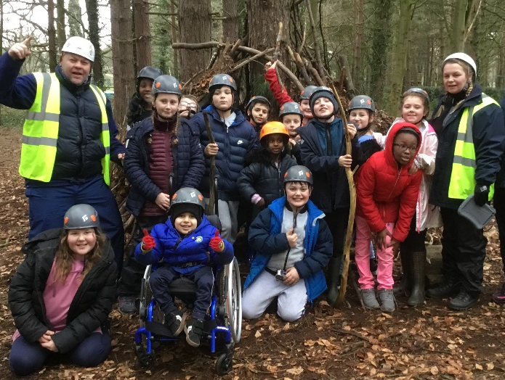
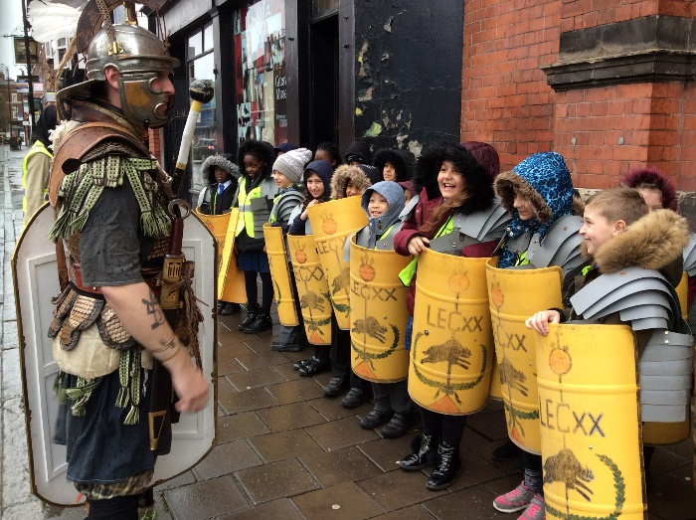
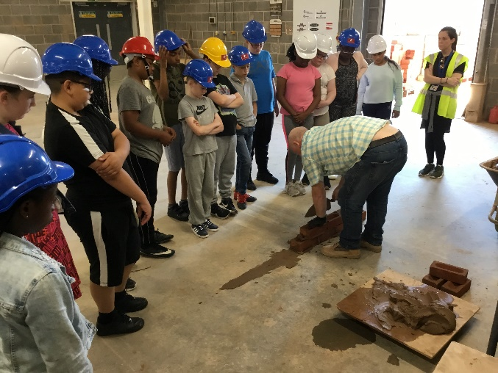
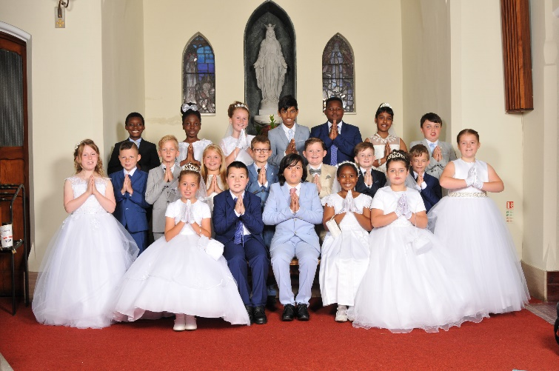
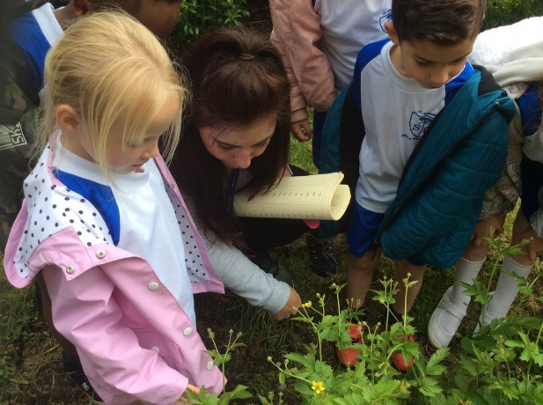
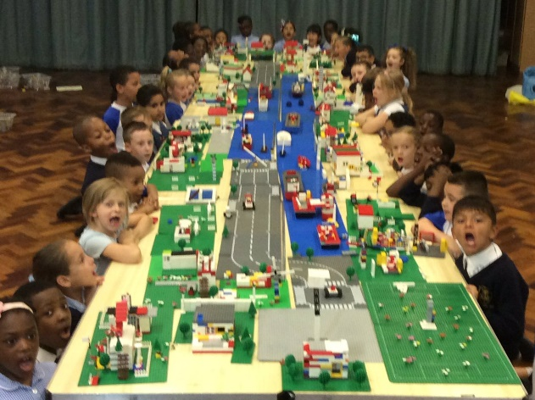
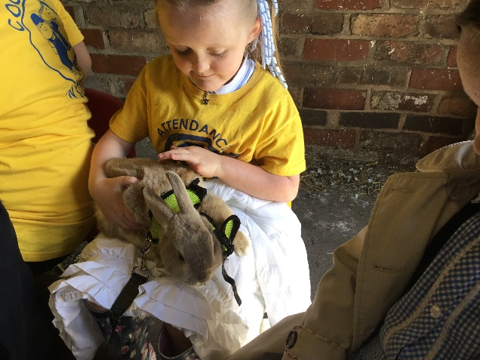
With Jesus we can achieve what we dream and believe
St Michael’s Catholic Primary School

Slide 2
With Jesus we can achieve what we dream and believe
Welcome to
Year
3
Olympians
St Michael’s Catholic Primary School

Slide 3
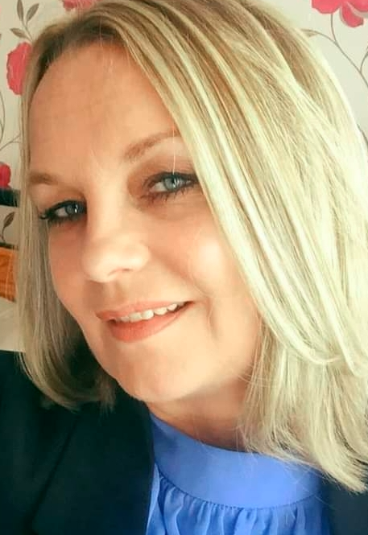
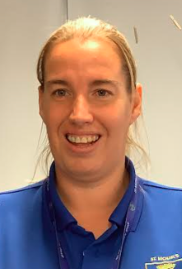
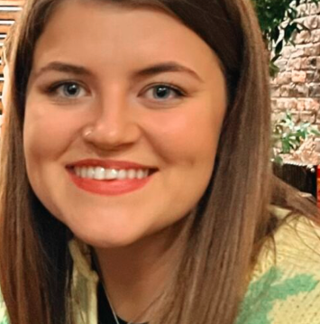
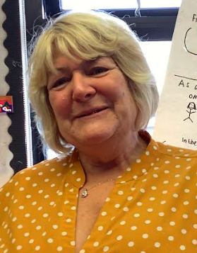
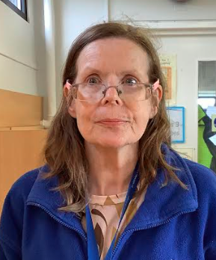
With Jesus we can achieve what we dream and believe
Staff in Year 3
Olympians
Class Teacher
Ms Gibney
Olympians
LSA
TBC
Olympians
1:1 teacher
Mrs Ealey
Heroes
Class Teacher
Mrs Hollywood
Heroes
LSA
Mrs Haynes
Heroes
1:1 teacher
Mrs Brown
St Michael’s Catholic Primary School

Slide 6
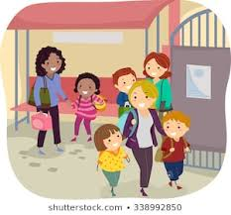
With Jesus we can achieve what we dream and believe
Daily Routines
8:40 - School gates open
8:50 - Pupil registration ends
10:45 - Playtime
12:30 - Lunchtime
3:15 - School ends
St Michael’s Catholic Primary School

Slide 7
Homework is set on a Friday and needs to be handed in by Monday or Tuesday.
(you even earn a dojo for getting it in on time)
Your child should also read at home every single day!
With Jesus we can achieve what we dream and believe
St Michael’s Catholic Primary School

Slide 8
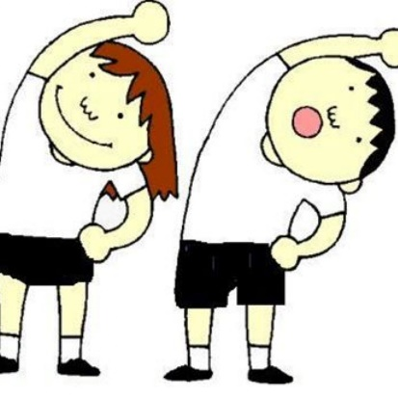
With Jesus we can achieve what we dream and believe
PE is every Monday and Wednesday.
A St. Michaels PE kit is required.
(White t-shirt, blue shorts)
These don’t have to have the school logo on them as long as they are the correct colours and are plain.
St Michael’s Catholic Primary School

Slide 9
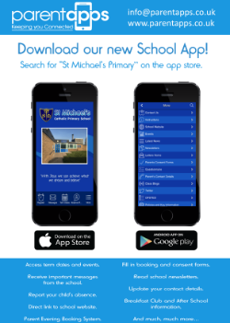
With Jesus we can achieve what we dream and believe
Supporting your child
What you can do to help?
Attendance and Punctuality – on time and attend school every day. Inform school morning of absence to prevent home visit.
English – Encourage your child to read for pleasure. Good readers become good writers. Model good grammar/vocabulary. Learning weekly spellings. (Reading Eggs)
Maths - Basic skills – Times tables (All-TTRS). Calculations - (All operations) Teach your child the time.
Ensure school has up to date contact details – should be contactable at all times
Download school app – click on link in text invite from St Michael’s and follow instructions
St Michael’s Catholic Primary School

Slide 10
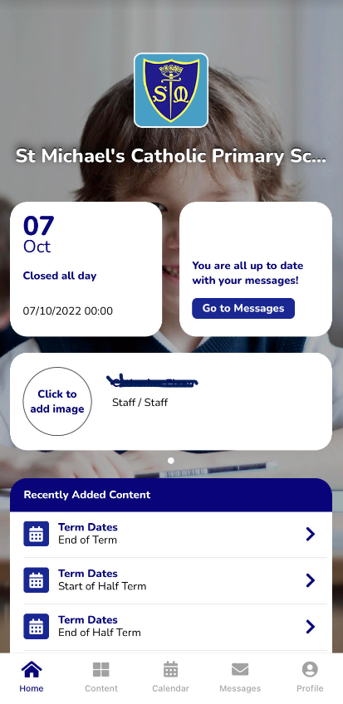
With Jesus we can achieve what we dream and believe
Communication
School App
Used regularly – click on link in text invite from St Michael’s and follow instructions.
Call into office
if you need
help or have not
received a text
Newsletter
Sent out on app and available on school website
Website/Twitter
General information and daily class page updates
Face to Face
Staff can make arrangements to meet. This is by appointment only.
Phone Calls
School require at least 2 up to date contactable numbers
Letters Home
Usually for trips, main
contact through app.
St Michael’s Catholic Primary School

Slide 11
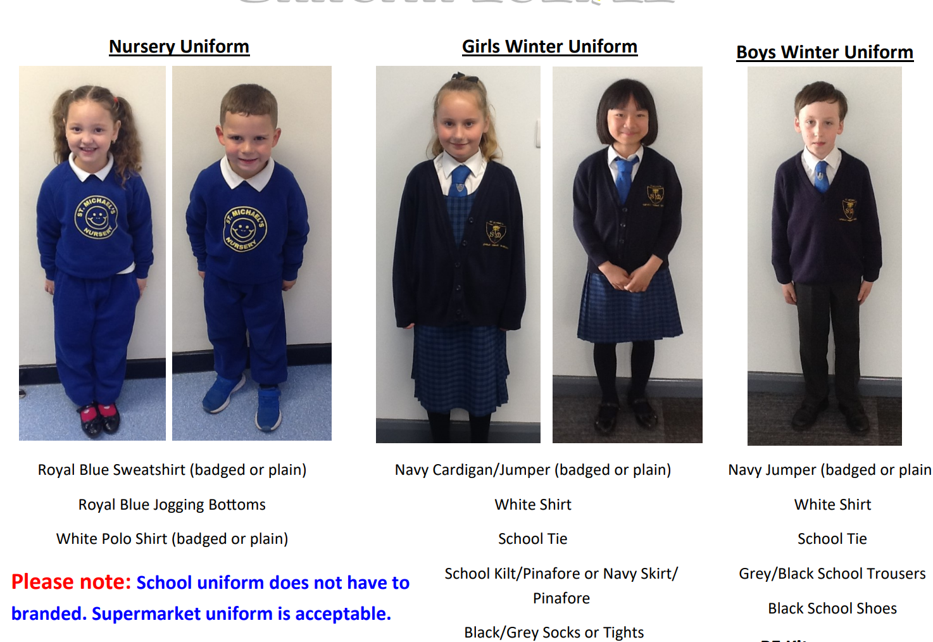
St Michael’s Catholic Primary School
St Michael’s Catholic Primary School
Uniform
Uniform

Slide 12
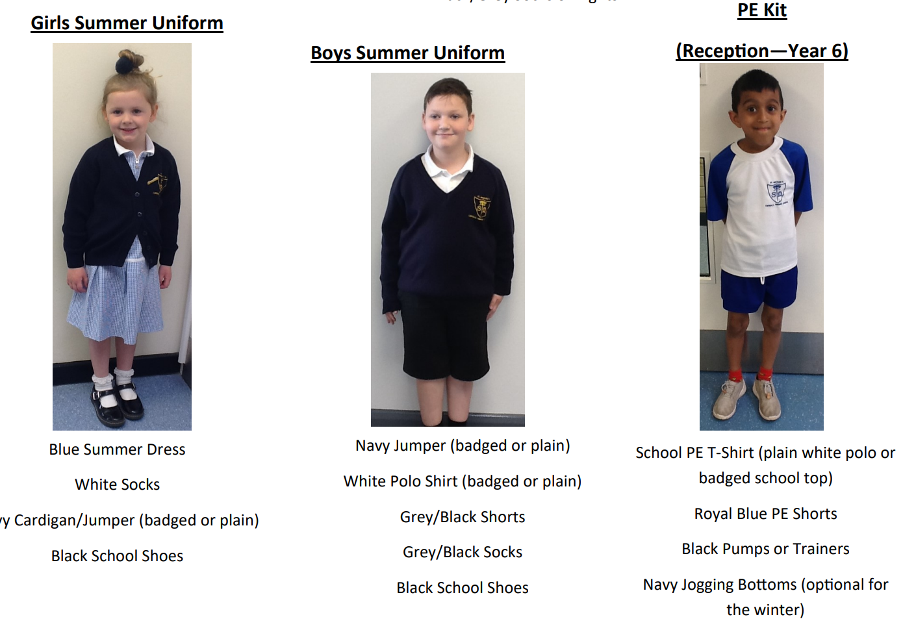
St Michael’s Catholic Primary School
St Michael’s Catholic Primary School
Uniform
Uniform

Slide 13
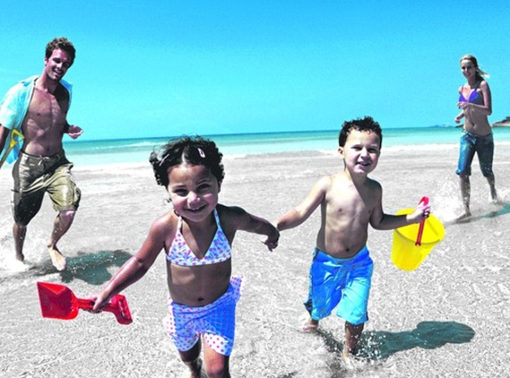
St Michael’s Catholic Primary School
Holidays
During Term Times?
During Half Term and End of Term holidays?
School is Important!

Slide 14
St Michael’s Catholic Primary School
Attendance & Punctuality
Monday
100%
Tuesday
Pupil registration closes at 8:50am
Wednesday
50%
Thursday
0%
Friday
With Jesus we can achieve what we dream and believe

Slide 15
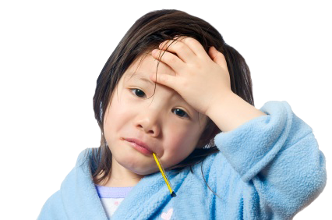
St Michael’s Catholic Primary School
Sickness / Illness
If your child is ill you must let the school know as soon as possible.
Tel. 0151 263 8460

Slide 16
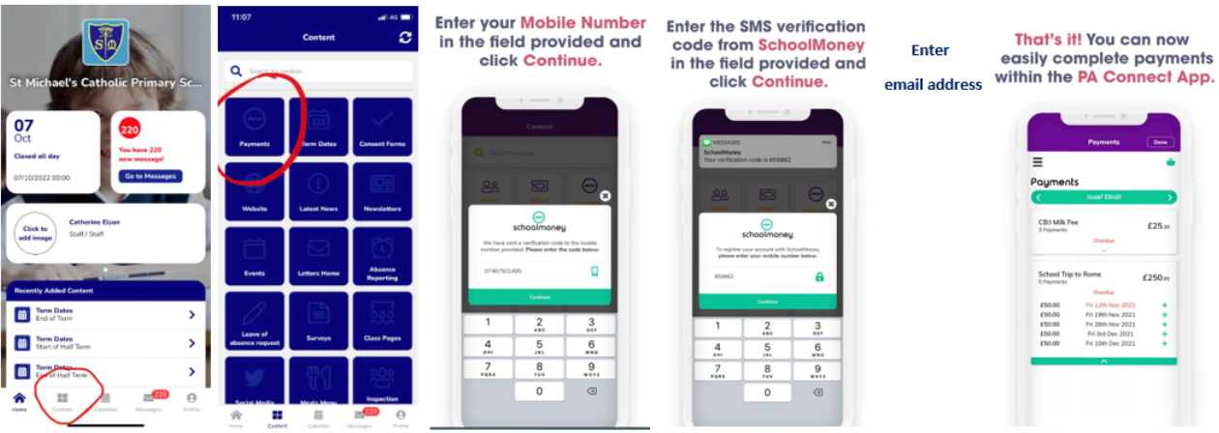
St Michael’s Catholic Primary School
Online Payment System
Access via the school app

Slide 17
St Michael’s Catholic Primary School
Breakfast Club
7:45am – start of school day
50p for breakfast – book and pay using online payment system via school app
All welcome
Entry via infant gate
‘Sparkles’ after school club
End of school day – 5:30pm
Book in advance (by midnight the day before) using online payment system via school
£3 up to 1 hour, £5 full session

Slide 18
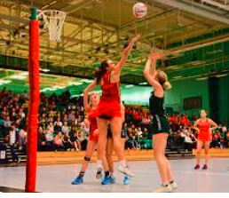
St Michael’s Catholic Primary School
After School Clubs
All after school clubs will finish at 4.15pm.
It is important that you are punctual when picking your child up.
If your child is late being picked up from any club on 2 occasions, then unfortunately they will lose their place in the club and it will be given to someone else.

Slide 19
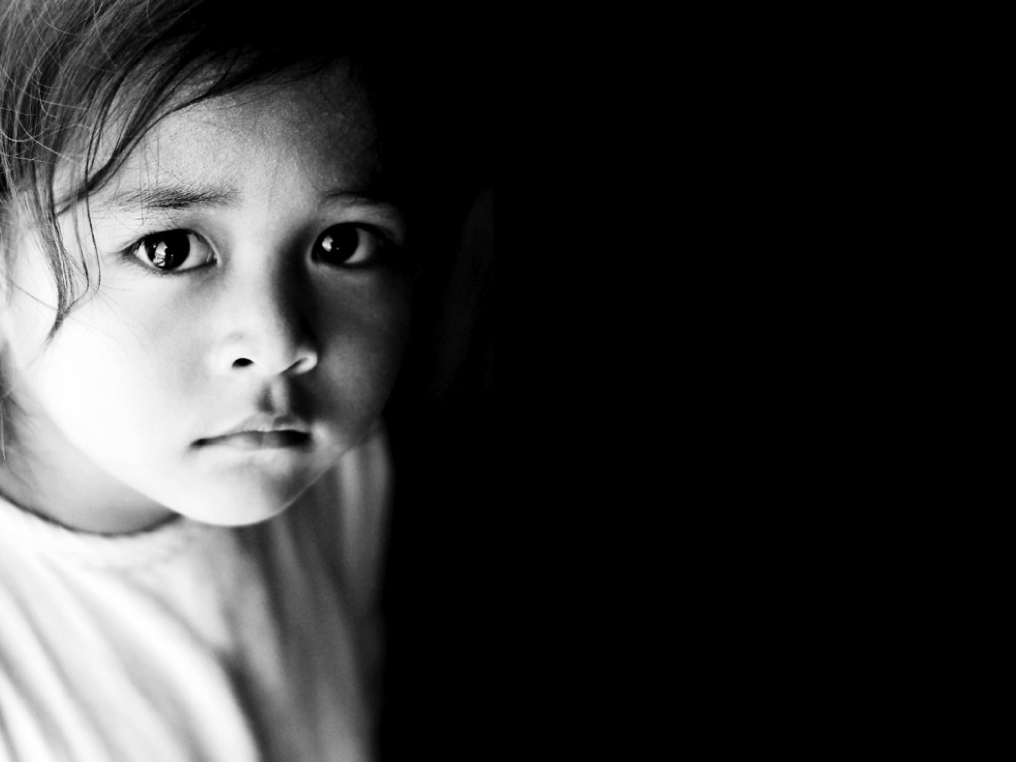
St Michael’s Catholic Primary School
Concerns about your child
Bullying
Unhappy
SEN
Safeguarding
With Jesus we can achieve what we dream and believe

Slide 20
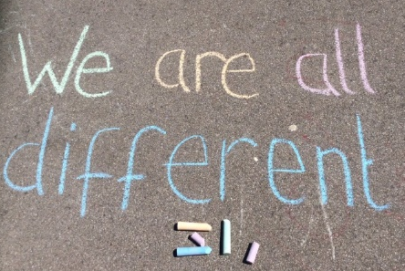
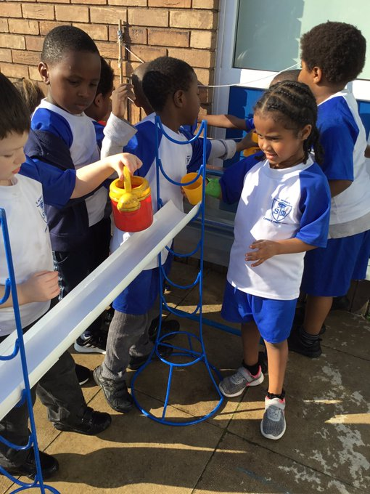
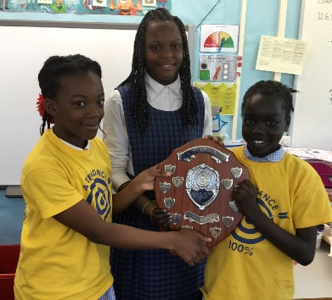
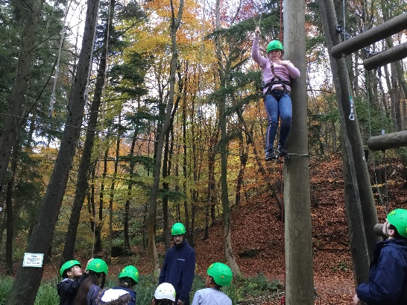
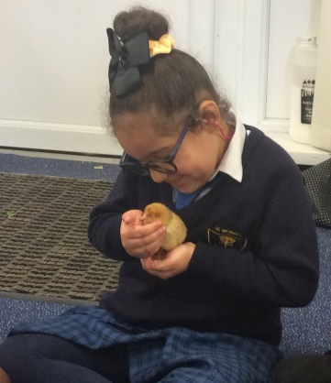
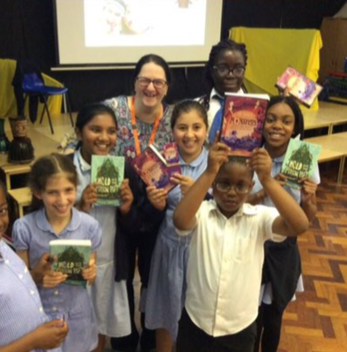
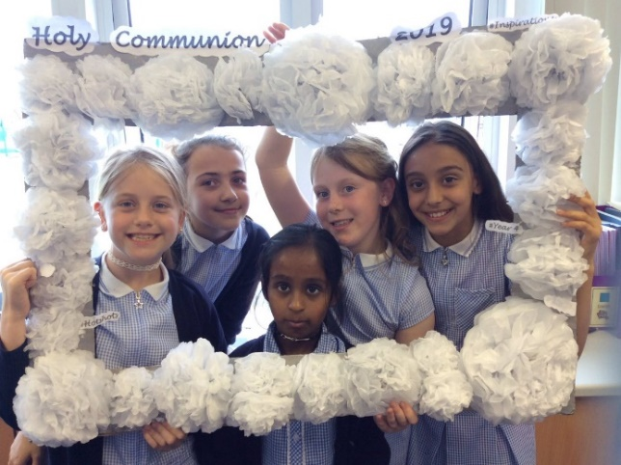
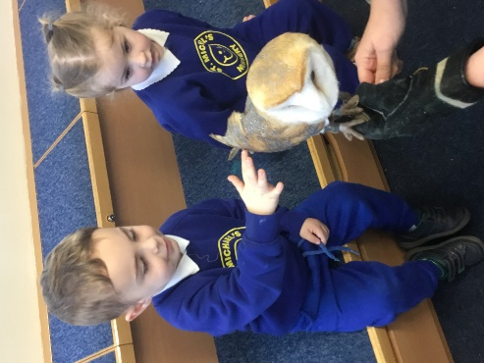
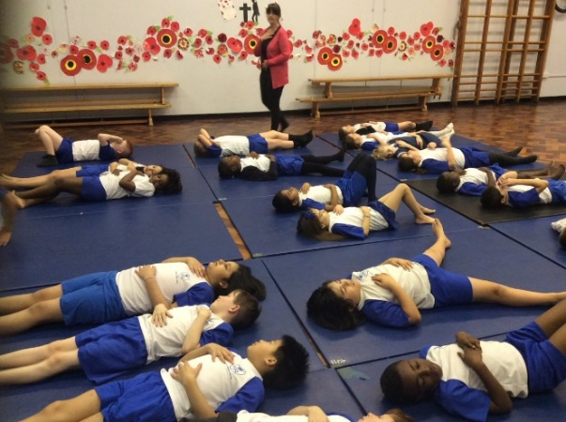
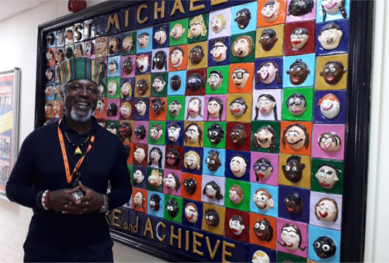
With Jesus we can achieve what we dream and believe
Thank you!
Any questions?
St Michael’s Catholic Primary School

