Slide 1
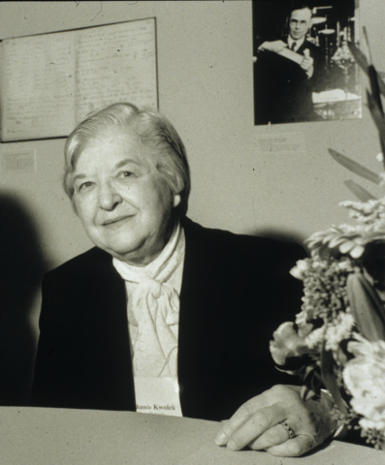
Stephanie Kwolek
A Famous Female Scientist

Slide 2
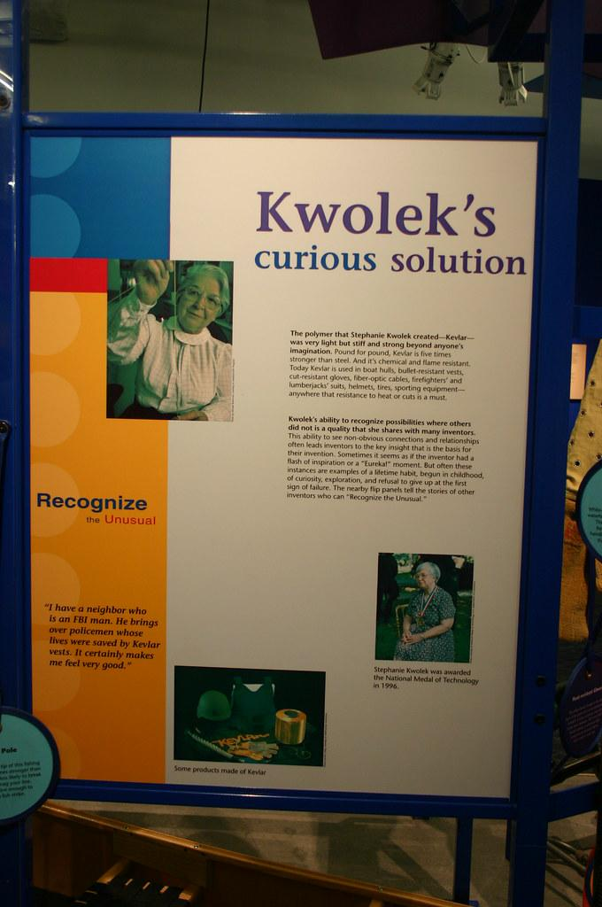
Stephanie kwolek facts
Stephanie kwolek lived till 1923-2014 stephanie was a organic chemist,best known for inventing kevlar in 1965. Place of birth - she was born 31st July 1923 in pittsburgh, pennsylvania, United States. Died - 18 June 2014, wilmington, Delaware , United States.

Slide 3
More facts and some interesting facts
What inspired stephanie ? stephanie’s father inspired her by helping her label and write some descriptions of them. Stephanie’s father died when she was 10 it was a
very young age very sad. Stephanie’s mother inspired her by her creativity.

Slide 4
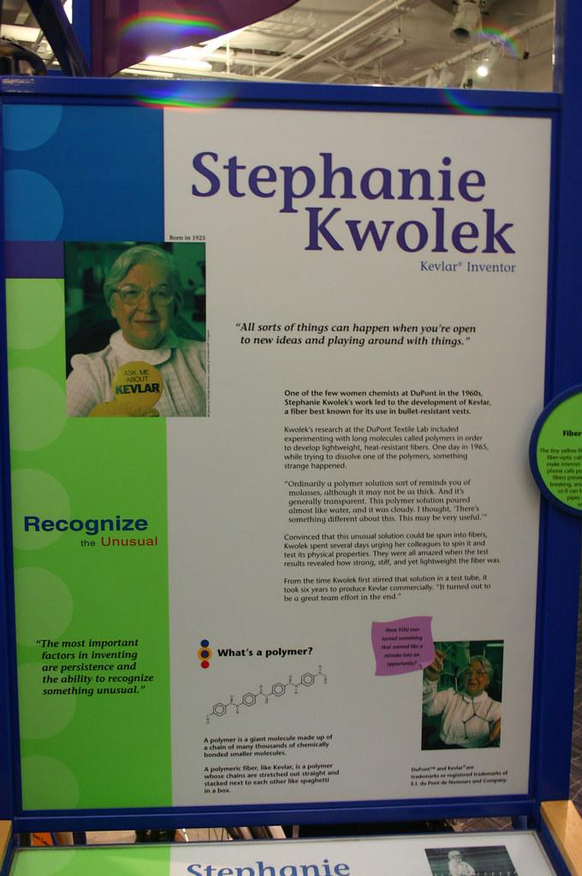
What was stephanie’s job ?
Her jobs were :inventor :writer :chemist

Slide 5
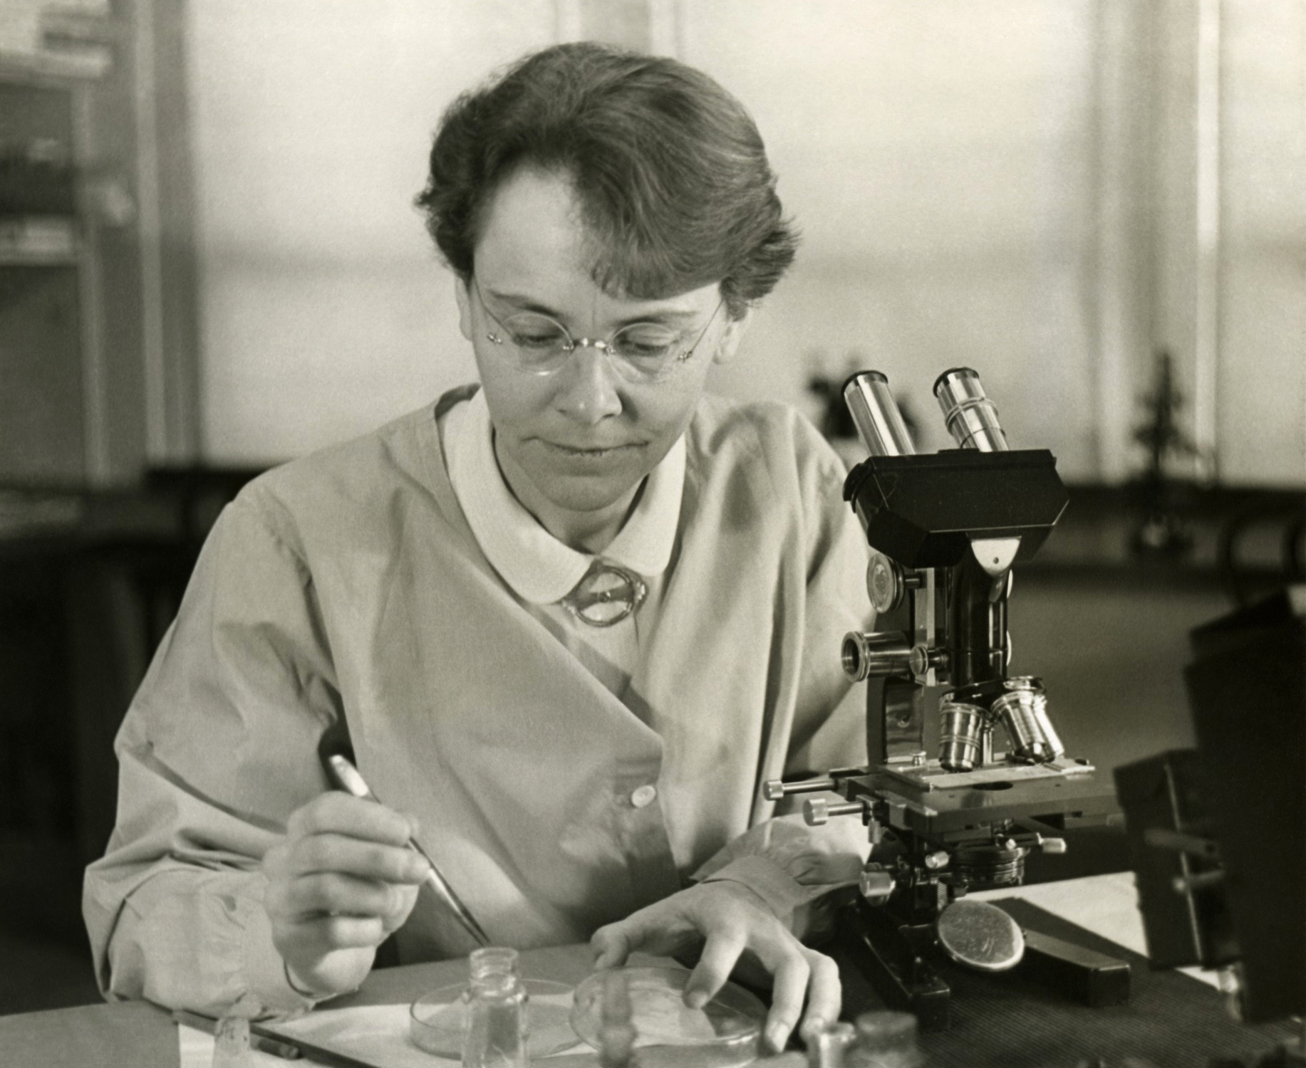
What did stephanie kwolek do for a living ?
Stephanie headed polymer research at du points pioneering lab until her retirement in 1986.

Slide 6
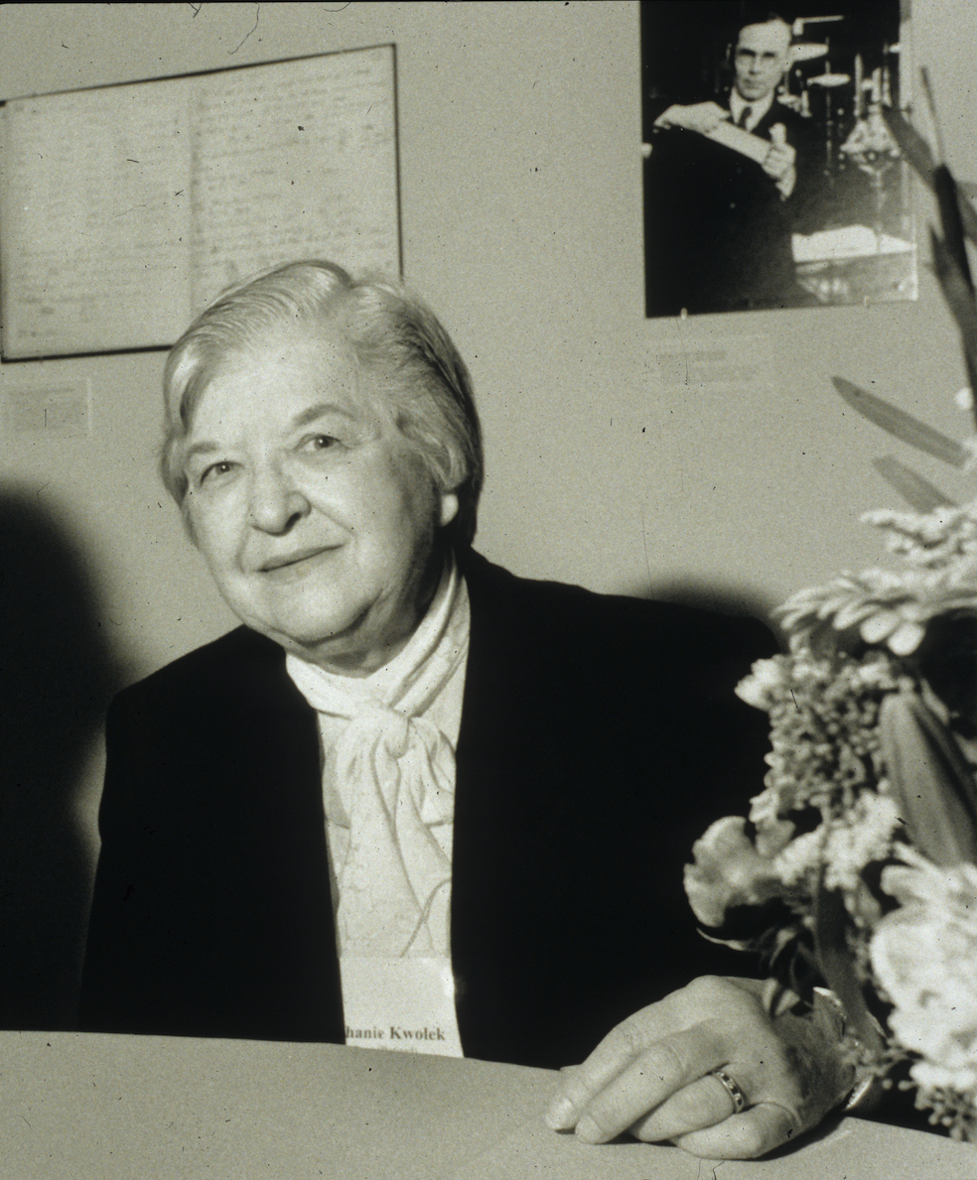
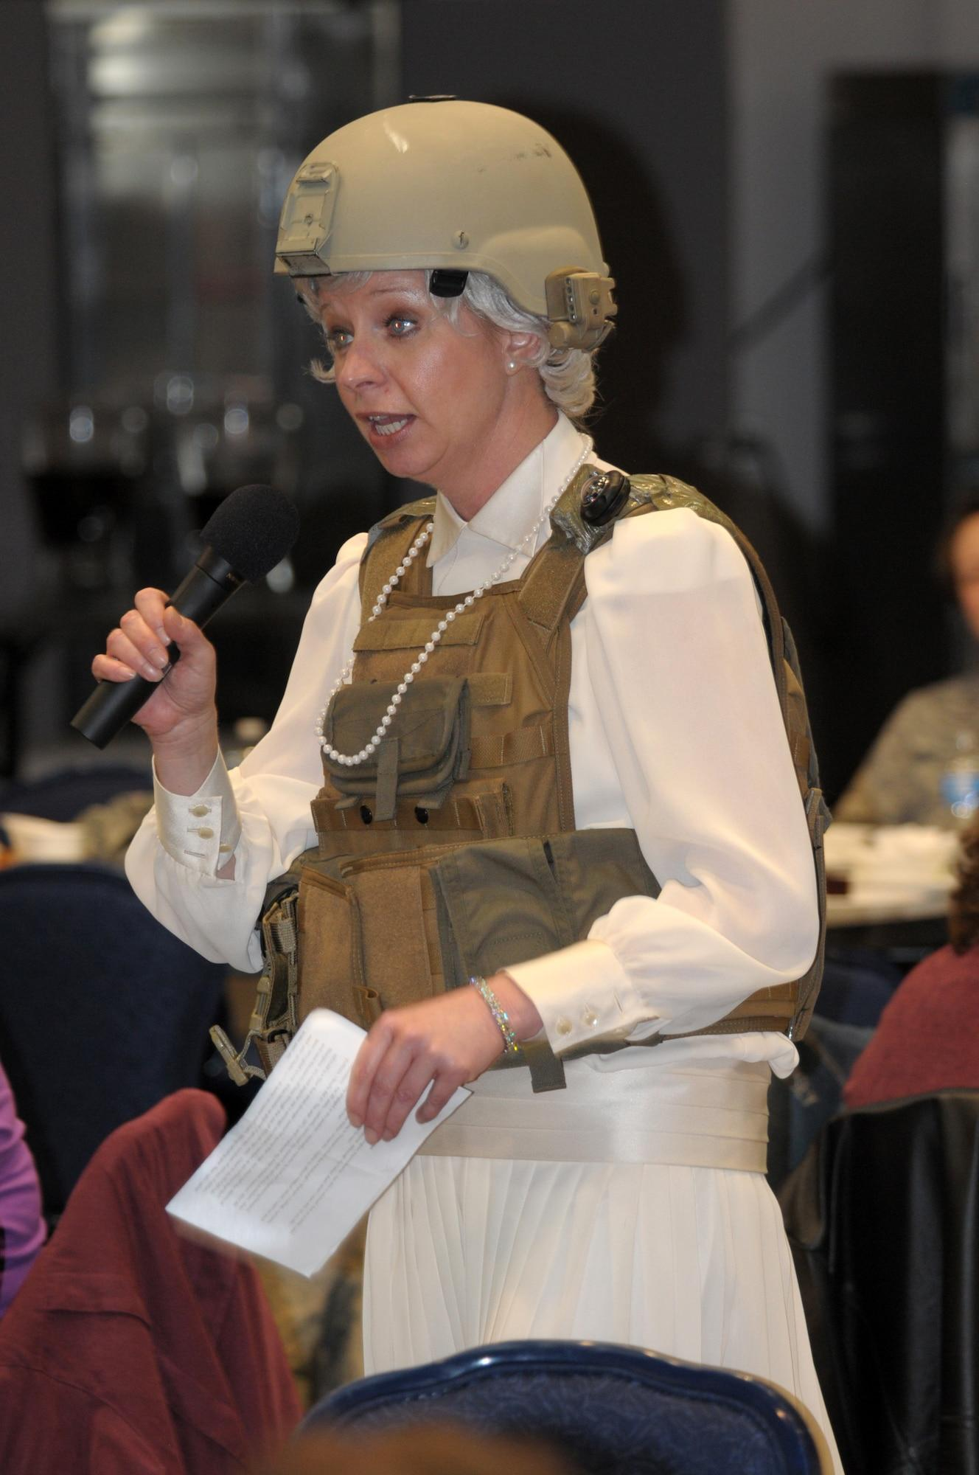
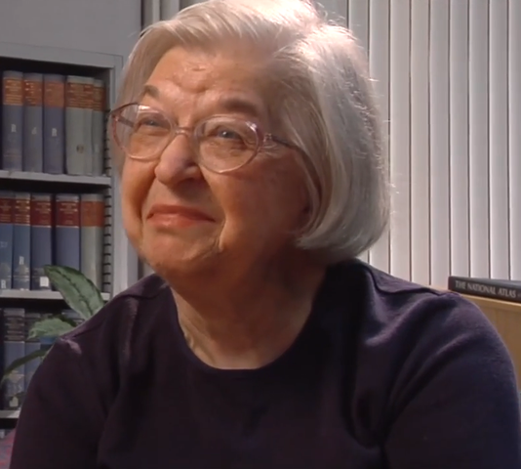
Here are some pictures when she was alive.

Slide 7
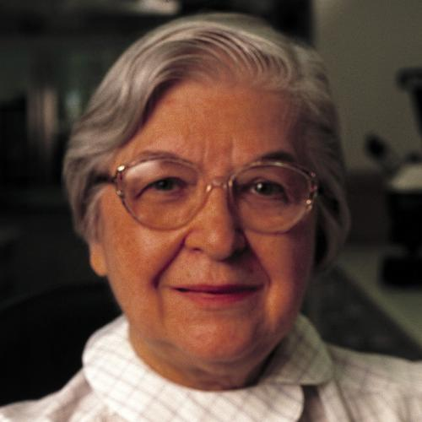
Stephanie kwolek is dead and died in 2014.
Stephanie kwolek was remembered by a lot of people and still is.

Slide 8
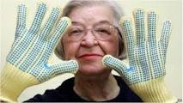
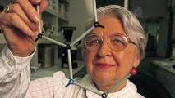
Here are more pictures of her

