Slide 1
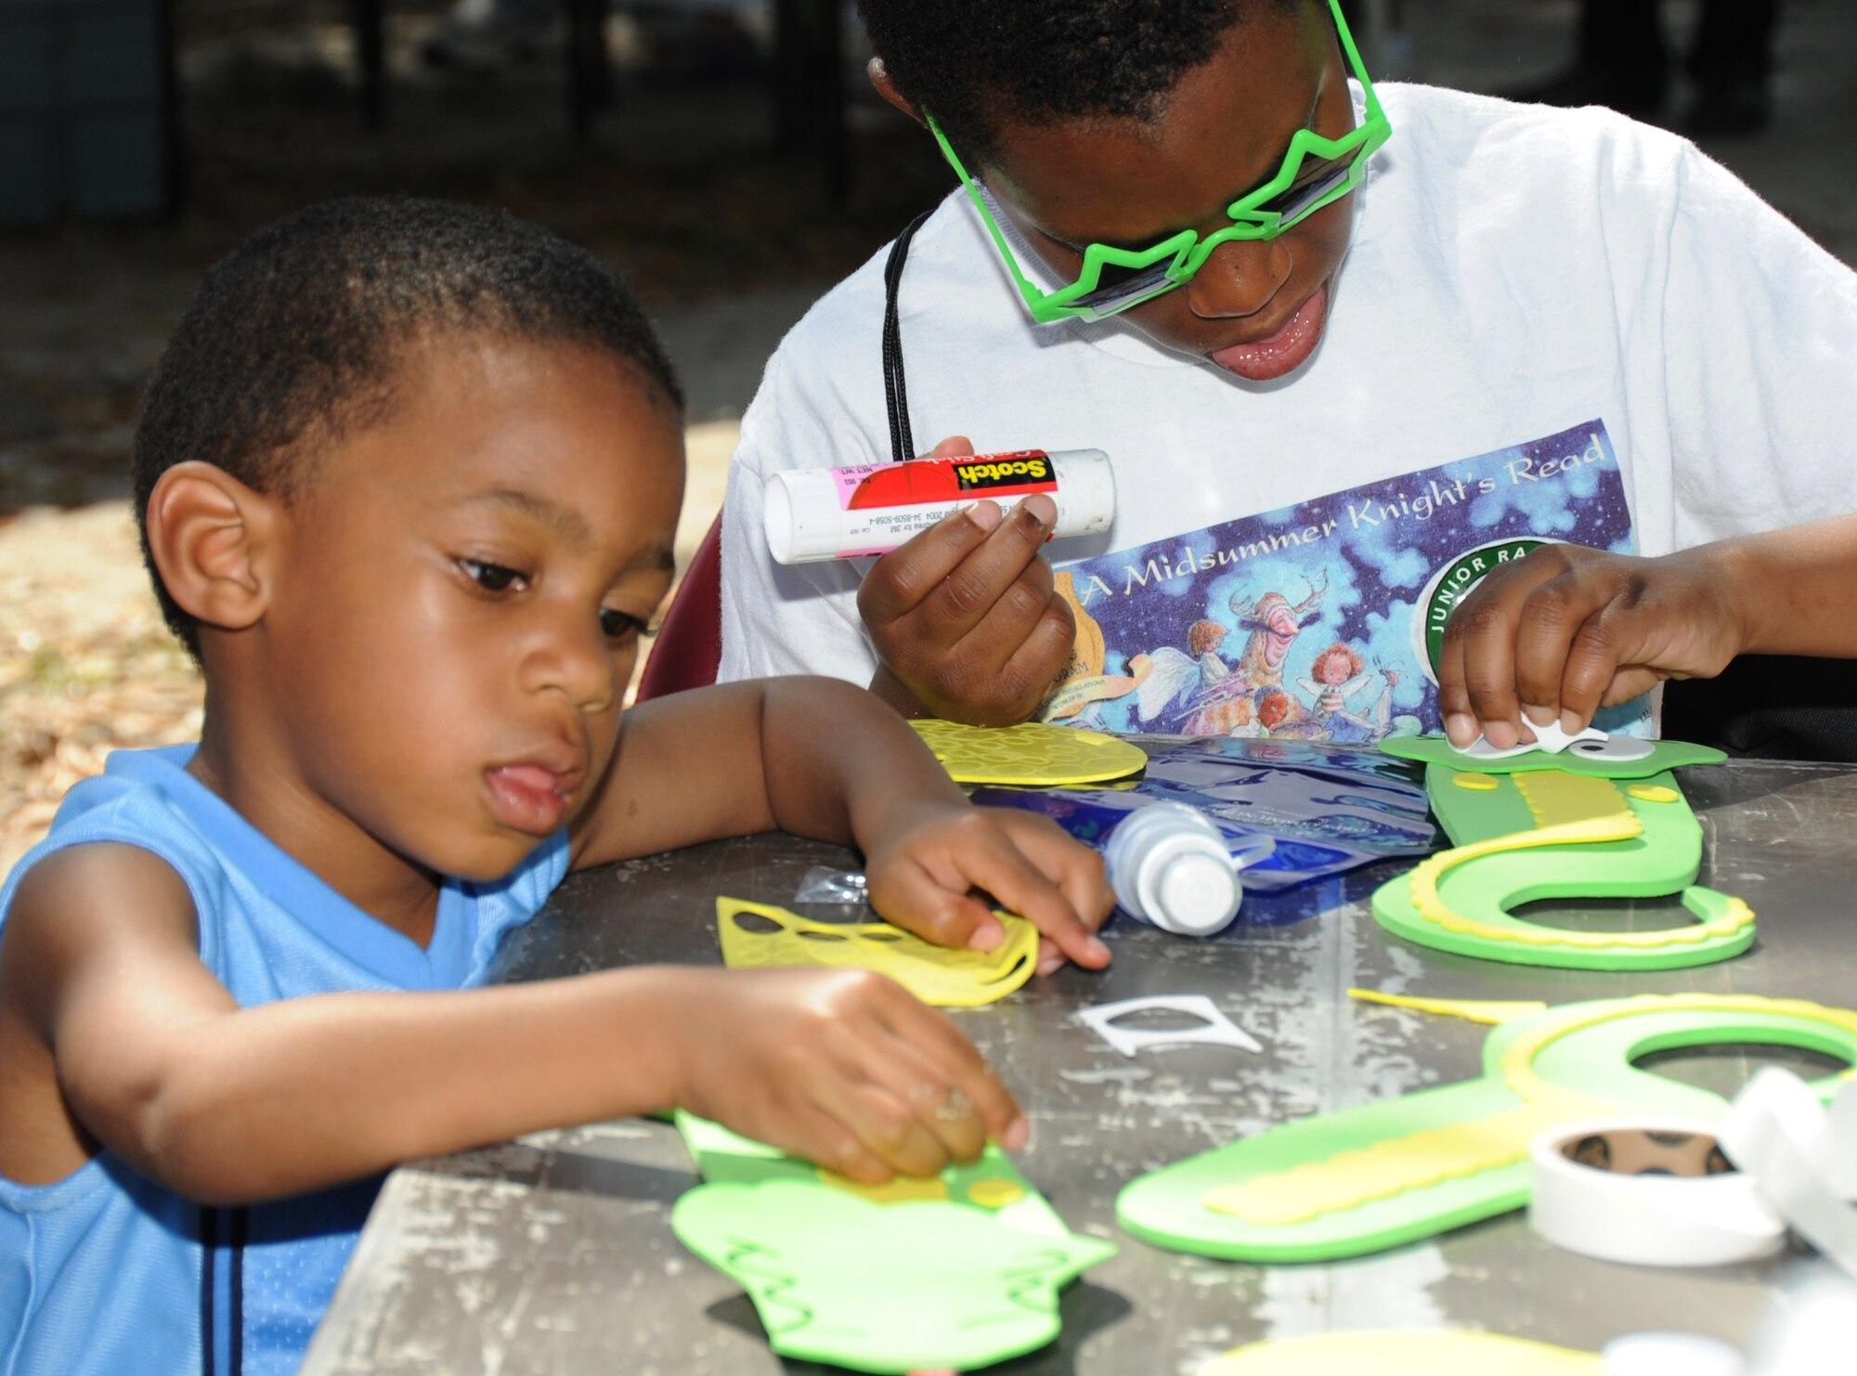
Female scientist
Rachel was born on may 27th 1907 springdale us.
Died in 1964 april 14th silver spring maryland us.`
Rachel
carson

Slide 2
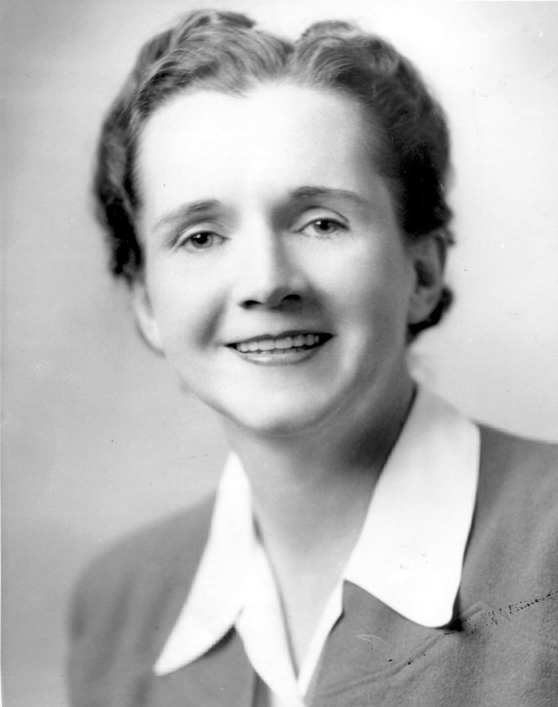
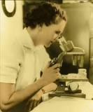
This is rachel carson.she died at the age 56 and she is also famous for her creations…
What she is famous for.
Rachel Carson was an American biologist well known for her writings on environmental pollution and the natural history of the sea. Her book, Silent Spring (1962), became one of the most influential books in the modern environmental movement and provided the impetus for tighter control of pesticides, including DDT.26 Jan 2023
fact.

Slide 3
What she is known for.
A marine biologist and nature writer, Rachel Carson catalyzed the global environmental movement with her 1962 book Silent Spring. Outlining the dangers of chemical pesticides, the book led to a nationwide ban on DDT and other pesticides and sparked the movement that ultimately led to the creation of the US Environmental Protection Agency (EPA).
Born on May 27, 1907 on a farm in Springdale, Pennsylvania, Carson was the youngest of Robert and Maria McLean Carson’s three children. She developed a love of nature from her mother, and Carson became a published writer for children’s magazines by age 10. She attended the Pennsylvania College for Women (now Chatham University), graduating magna cum laude in 1929. She next studied at the oceanographic institute at Woods Hole, Massachusetts and at Johns Hopkins University, where she received a master’s degree in zoology in 1932. Strained family finances forced her to forego pursuit of a doctorate and help support her mother and, later, two orphaned nieces.
After outscoring all other applicants on the civil service exam, in 1936 Carson became the second woman hired by the US Bureau of Fisheries. She remained there for 15 years, writing brochures and other materials for the public. She was promoted to Editor-in-Chief of all publications for the US Fish and Wildlife Service.
Meanwhile, she wrote several popular books about aquatic life, among them Under the Sea Wind (1941) and The Sea Around Us (1951). The latter was serialized in the New Yorker and sold well worldwide. She won a National Book Award, a national science writing-prize and a Guggenheim grant, which, with the book’s sales, enabled her to move to Southport Island, Maine in 1953 to concentrate on writing. In 1955, she published The Edge of the Sea, another popular seller. She also began a relationship with Dorothy Freeman, a married summer resident. Though much of their correspondence was destroyed shortly before Carson’s death, the rest was published by Freeman’s granddaughter in 1995 as Always, Rachel: The Letters of Rachel Carson and Dorothy Freeman, 1952–1964: An Intimate Portrait of a Remarkable Friendship.
After a niece died in early 1957, Carson adopted her son and relocated to Silver Spring, Maryland, to care for her aging mother. A letter from a friend in Duxbury, Massachusetts about the loss of bird life after pesticide spraying inspired Carson to write Silent Spring. The book primarily focuses on pesticides' effects on ecosystems, but four chapters detail their impact on humans, including cancer. She also accused the chemical industry of spreading misinformation and public officials of accepting industry claims uncritically.
Chemical companies sought to discredit her as a Communist or hysterical woman. Many pulled their ads from the CBS Reports TV special on April 3, 1963, entitled “The Silent Spring of Rachel Carson.” Still, roughly 15 million viewers tuned in, and that, combined with President John F. Kennedy’s Science Advisory Committee Report—which validated Carson’s research—made pesticides a major public issue. Carson received medals from the National Audubon Society and the American Geographical Society, and induction into the American Academy of Arts and Letters.
Seriously ill with breast cancer, Carson died two years after her book’s publication. In 1980, she was posthumously awarded the Presidential Medal of Freedom. Her homes are considered national historic landmarks, and various awards bear her name.
Works Cited
How to Cite this page
Additional Resources
Related Biographies
Stacey Abrams
Abigail Smith Adams
Jane Addams
Toshiko Akiyoshi
Related Background
Lesson Plan
Frances Ellen Watkins Harper
Lesson Plan
Elinor “Lin” Ostrom, Nobel Prize Economist
Lesson Plan
Lessons in Leadership: The Honorable Yvonne B. Miller
Lesson Plan
Stacey Abrams: Changing the Trajectory of Protecting People’s Voices and Votes
SUPPORT US
DONATE
Select Site Text Size
RegularLargeLargerLargest
STAY IN TOUCH
We’ll never share your email with anyone else
Terms of Use Privacy Policy
GENEROUSLY SUPPORTED BY
Ironically, she is best known to English-speaking readers as the author of a single novella — "Gigi" — written during the Second World War, which is unique in her oeuvre precisely for the mellowness that makes it so popular.
1

Slide 4
Rachel carson.
Rachel Carson was an American biologist well known for her writings on environmental pollution and the natural history of the sea. Her book, Silent Spring (1962), became one of the most influential books in the modern environmental movement and provided the impetus for tighter control of pesticides, including DDT.26 Jan 2023

Slide 5
Rachel’s father, Robert Carson, was a traveling insurance salesman who was often absent from home.
Her mother, Maria McLean, had been educated at an elite Presbyterian high school in Washington D.C. and was an accomplished singer and musician; before marriage she was a school teacher.
Rachel was the youngest of her parents’ three children – her sister Marian and brother Robert were ten and eight years older than her.
Although the Carson’s home had plenty of land, the family had very little money. Their home had no indoor plumbing and no electricity.
facts…

