Slide 1
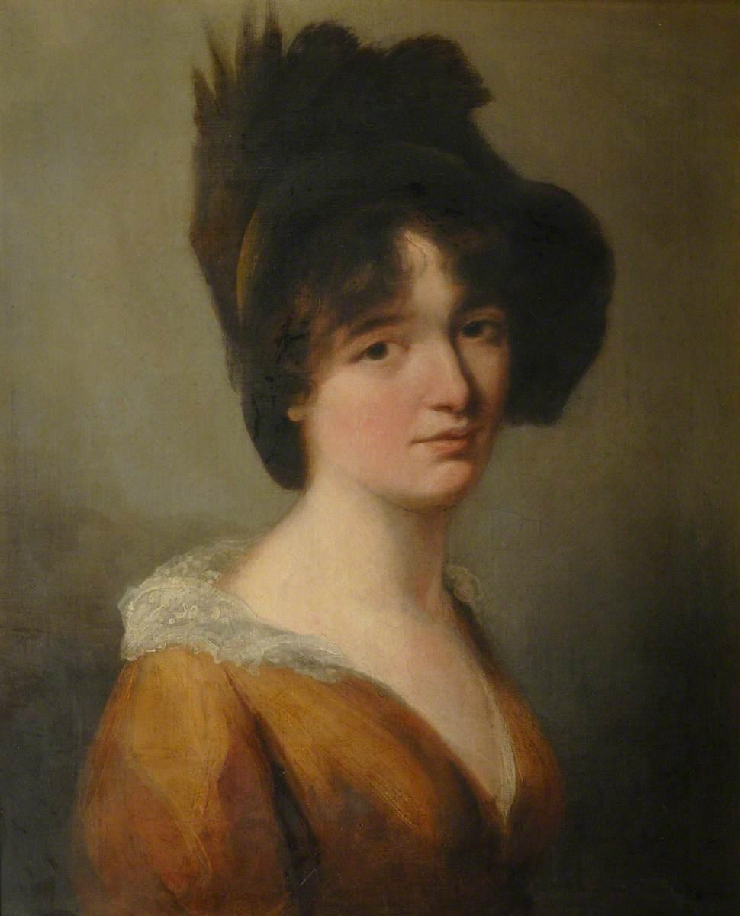
The great mathematician and scientist
Mary somerville

Slide 2
Happy Birthday!
Mary Somerville was a famous polymath, writer and scientist .She was born 26th December 1780 (Jedburgh, scotland) and died 29th November 1872 (Naples , Italy ). She gave birth to 5 children 3 females & 2 males (Martha Somerville ,Woronzow Greig ,Margaret Farquhar ,Thomas Somerville , Mary Charlotte Somerville), married 2 men (William Somerville & Samuel Greig ) and her parents were William George Fairfax & Margaret Charters.
(A polymath is a person of a wide range of knowledge)

Slide 3
She was famous for?
Somerville was famous for being a range of different thing such as
. a scottish scientist (mainly)
. A polymath
. an astrologist
Her and Caroline herschel were elected as the first female honorary members of the RAS
(RAS stands for Royal Astronomical Society)

Slide 4
R.I.P
Unfortunately this brainy super mathematician died at the ripe old age of 91 . She died from old age in Naples, Italy 1872 29th November . During her life she discovered the Planet neptune , became a member of RAS and married 2 men .

Slide 5
Quick Facts
. she discovered Neptune
. As a child she had very poor education

