Slide 1
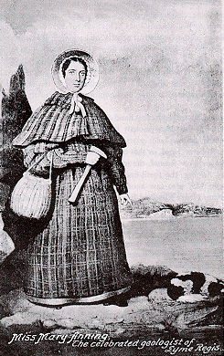
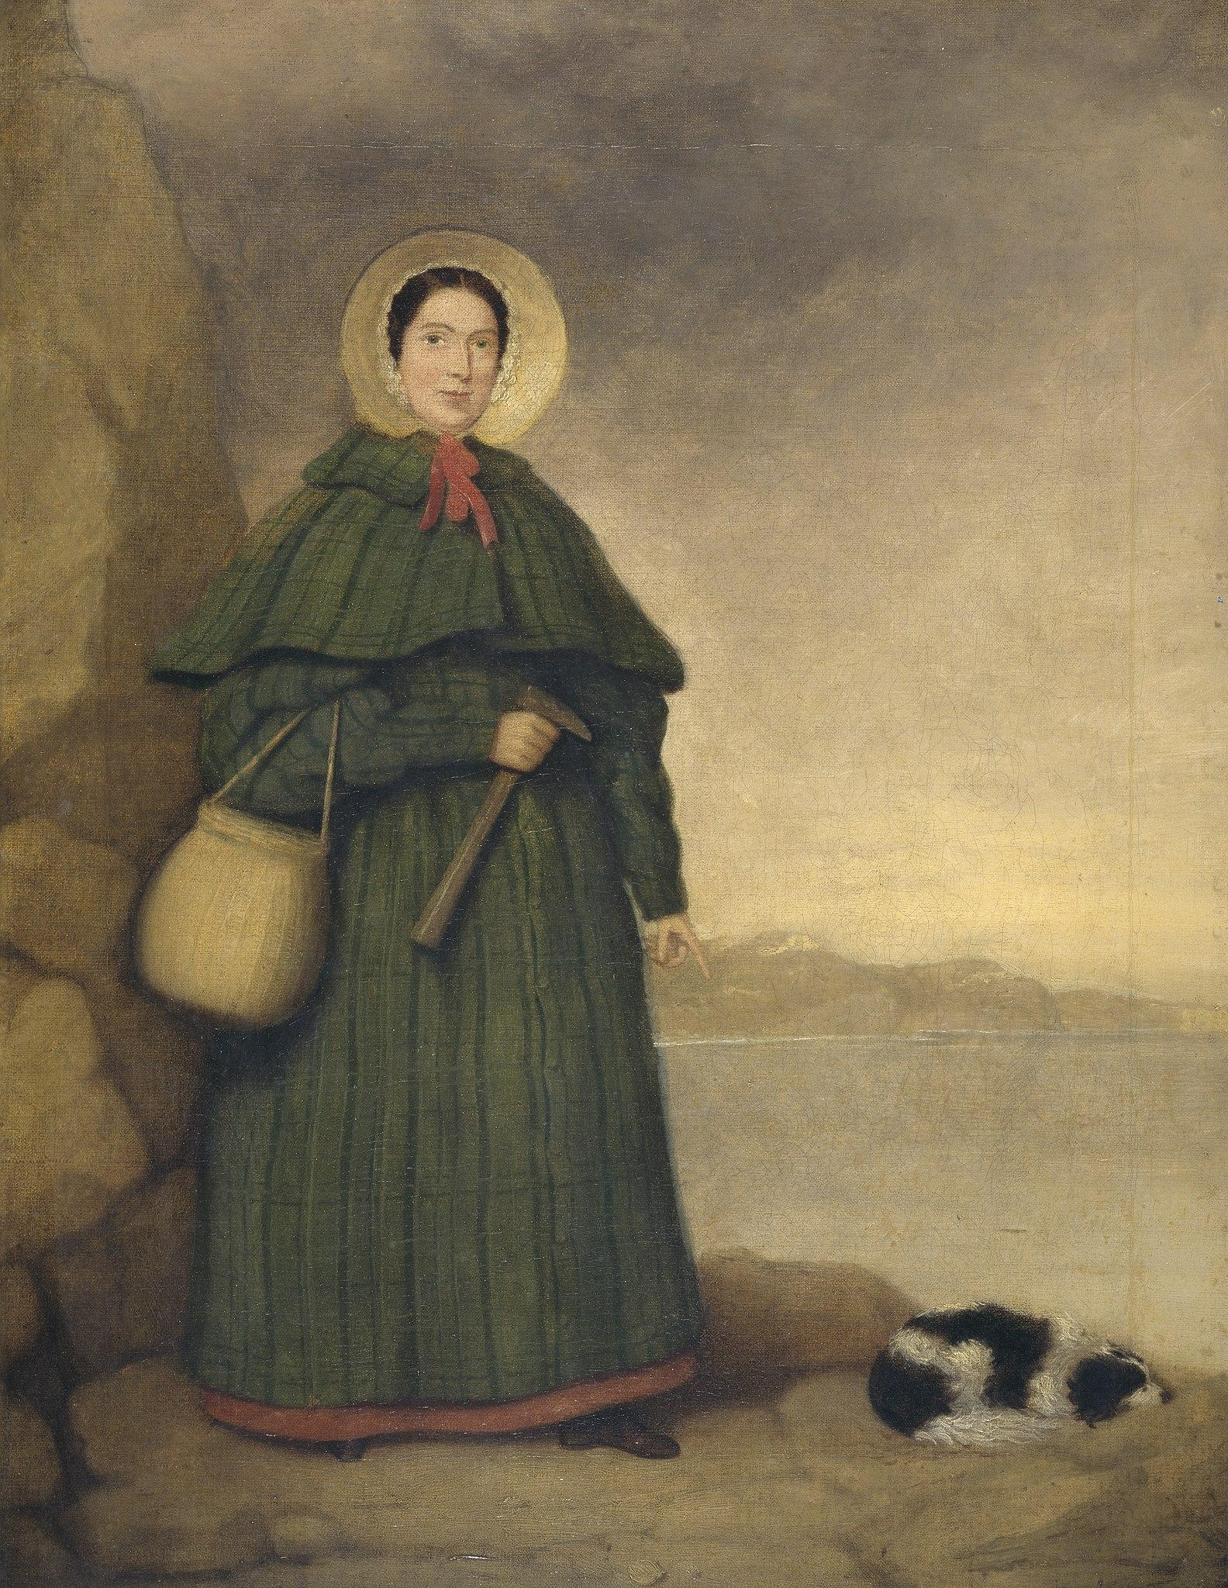
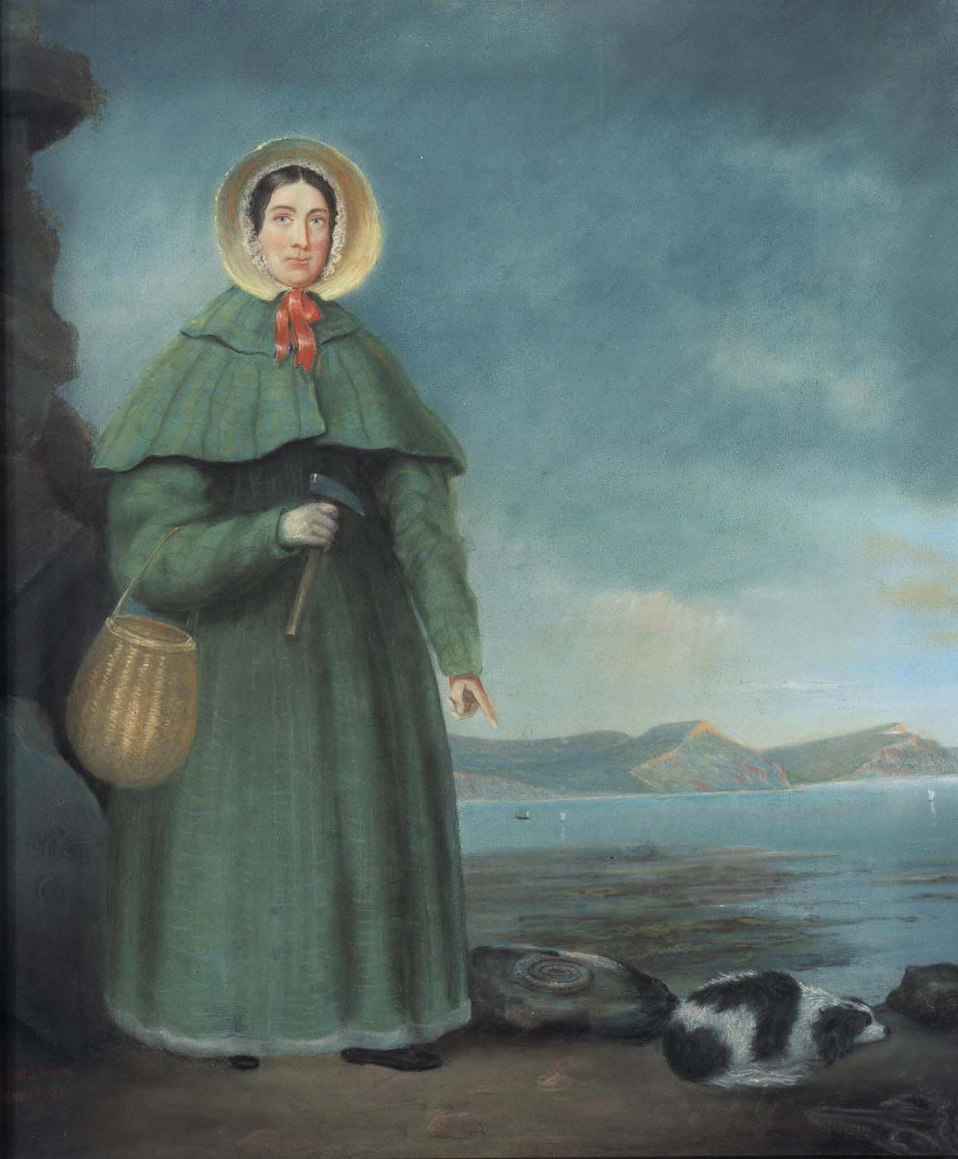
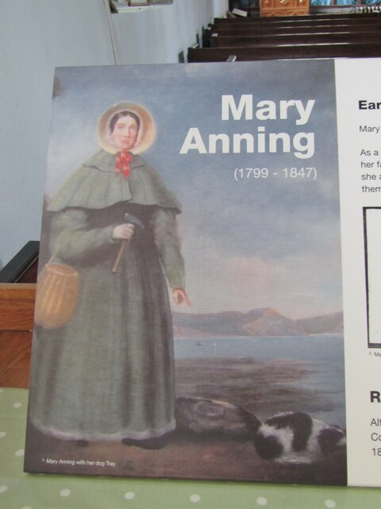
Mary anning
By Noah

Slide 2
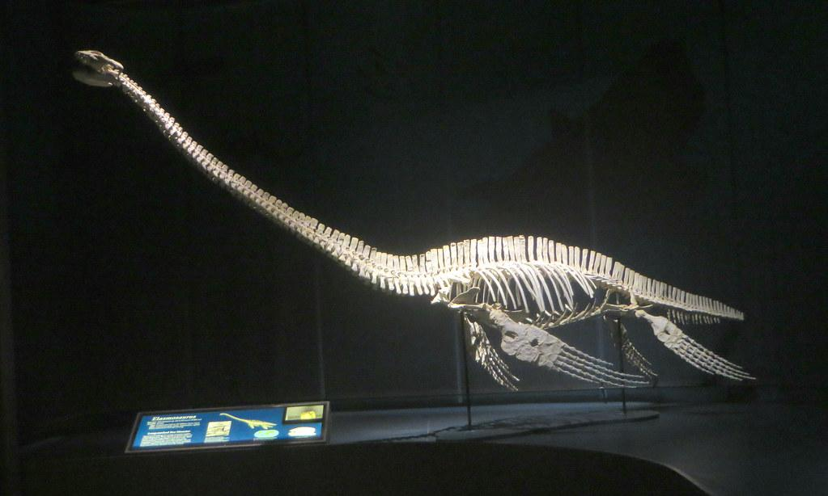
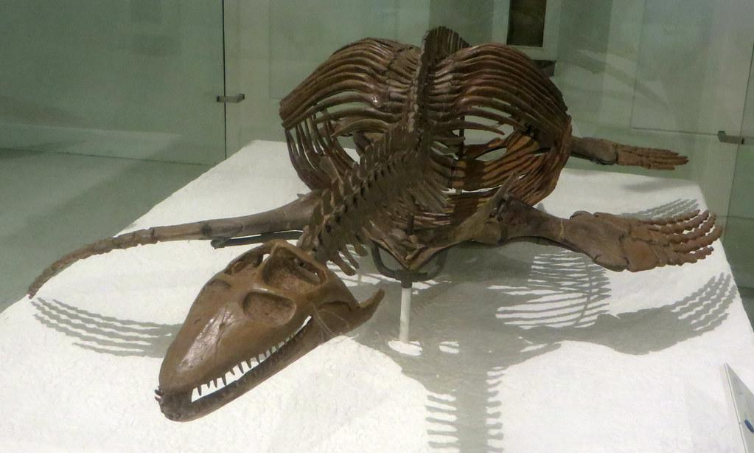
Mary’s discovery
In 1823 Mary found the complete
skeleton of the plesiosaurus and
The news spread fast and Georges Cuvier
Thought the fossil was a fake.

Slide 3
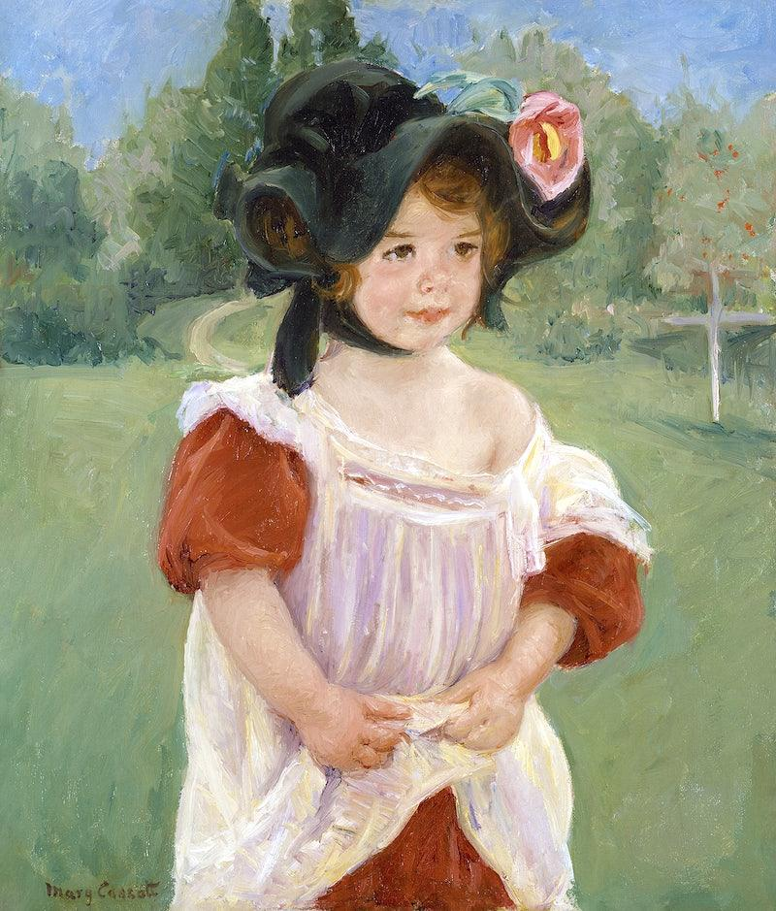
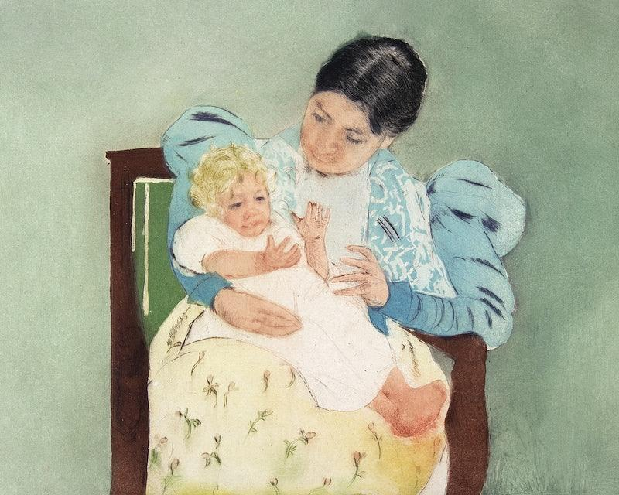
Birth and early life
Mary anning was born 21nd of May 1799 and when she was 15 months
Old a lightning bolt struck her.

Slide 4
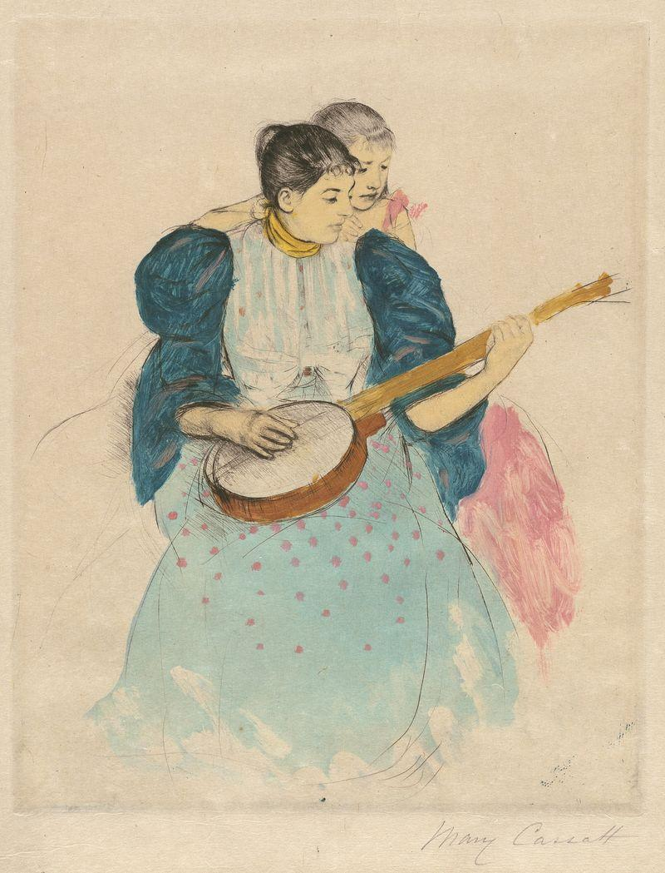
Dead
Mary Anning died 48 1847 but to today everyone knows what she did.

