Slide 1
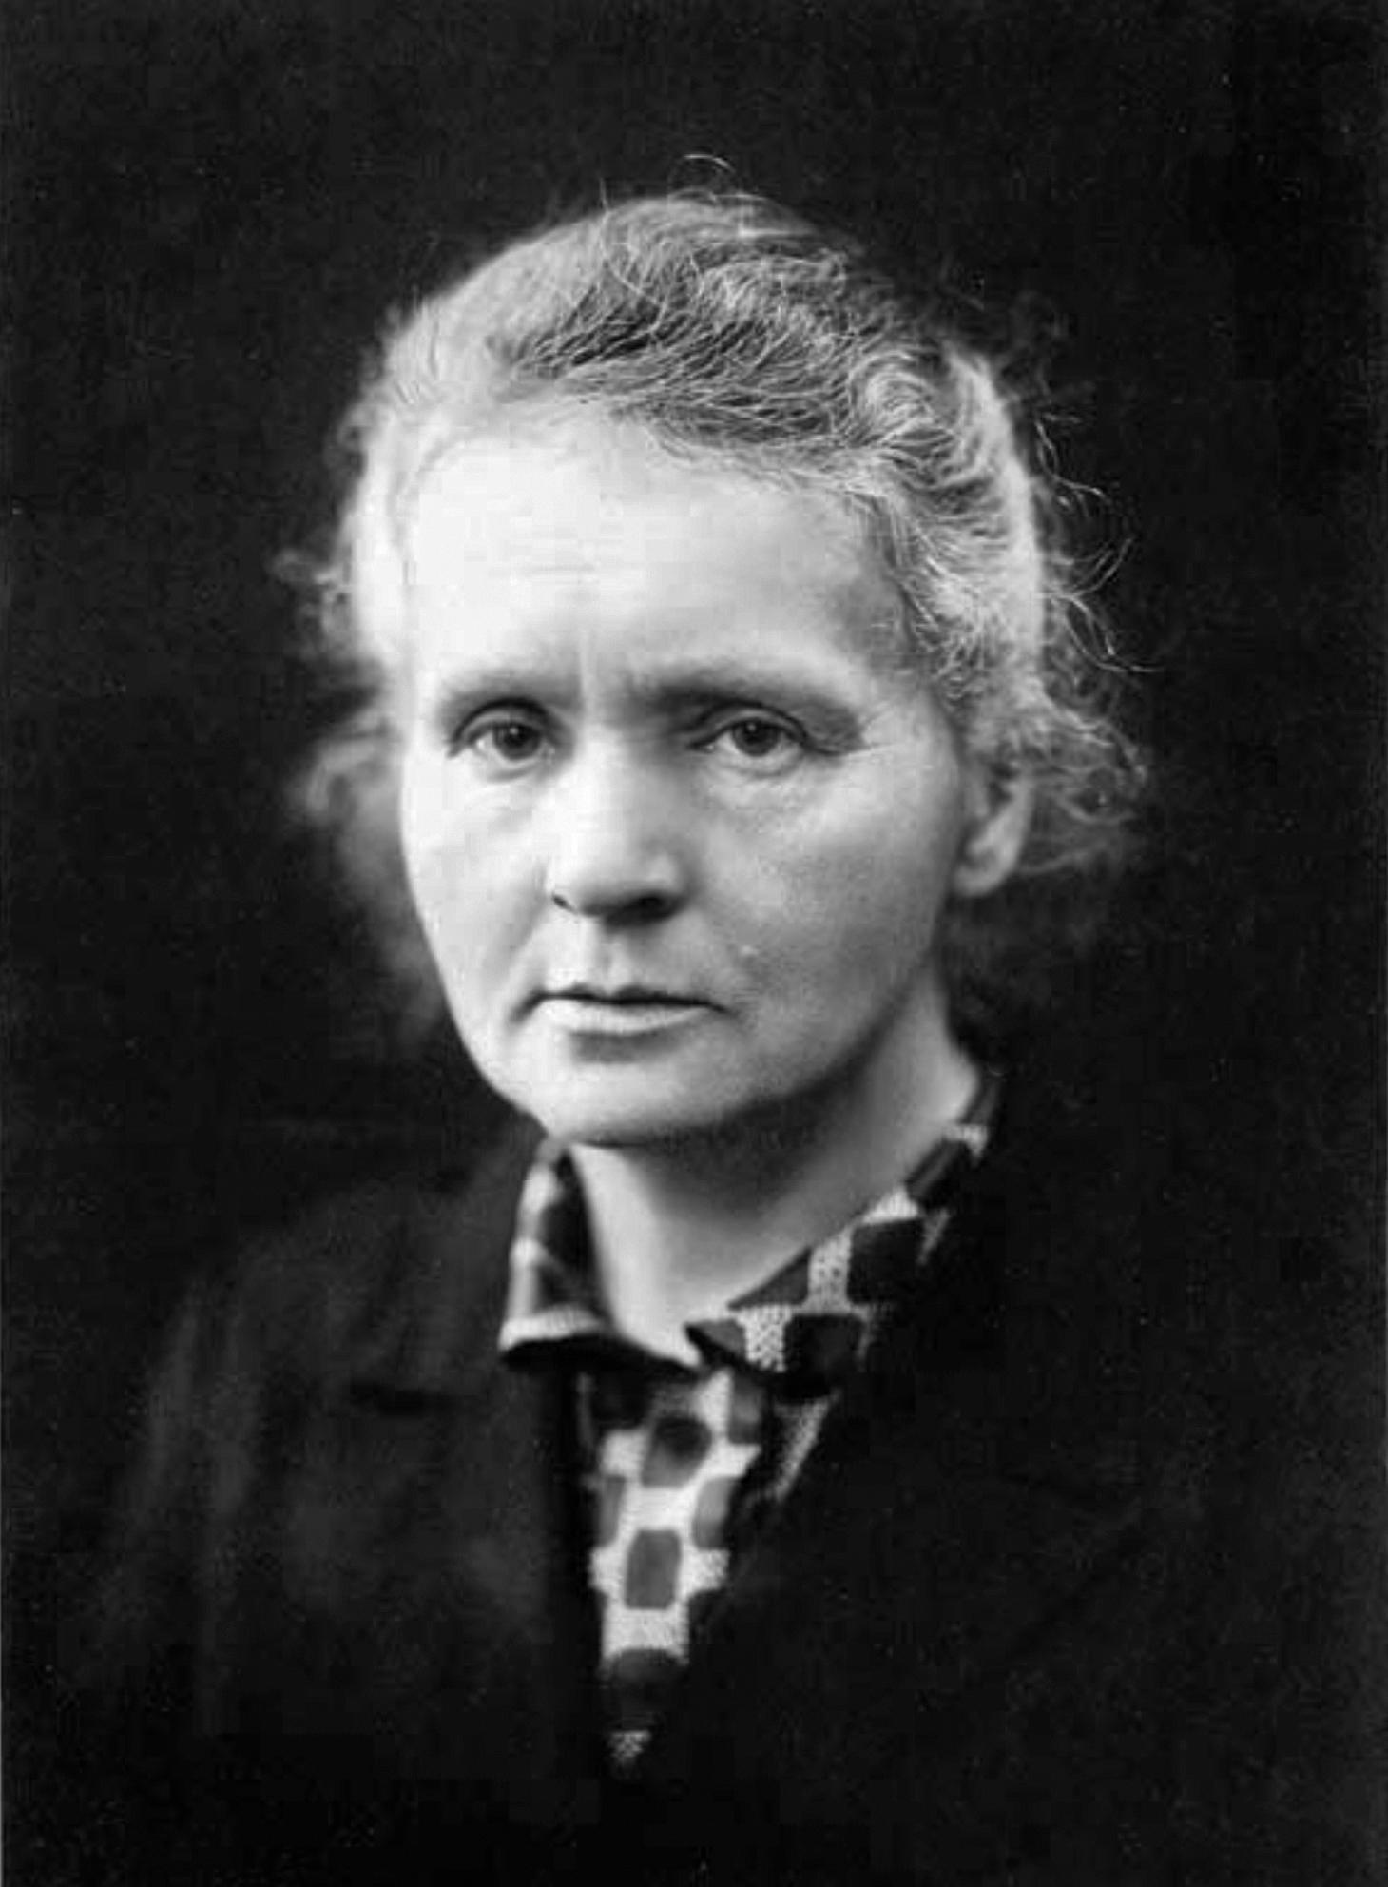
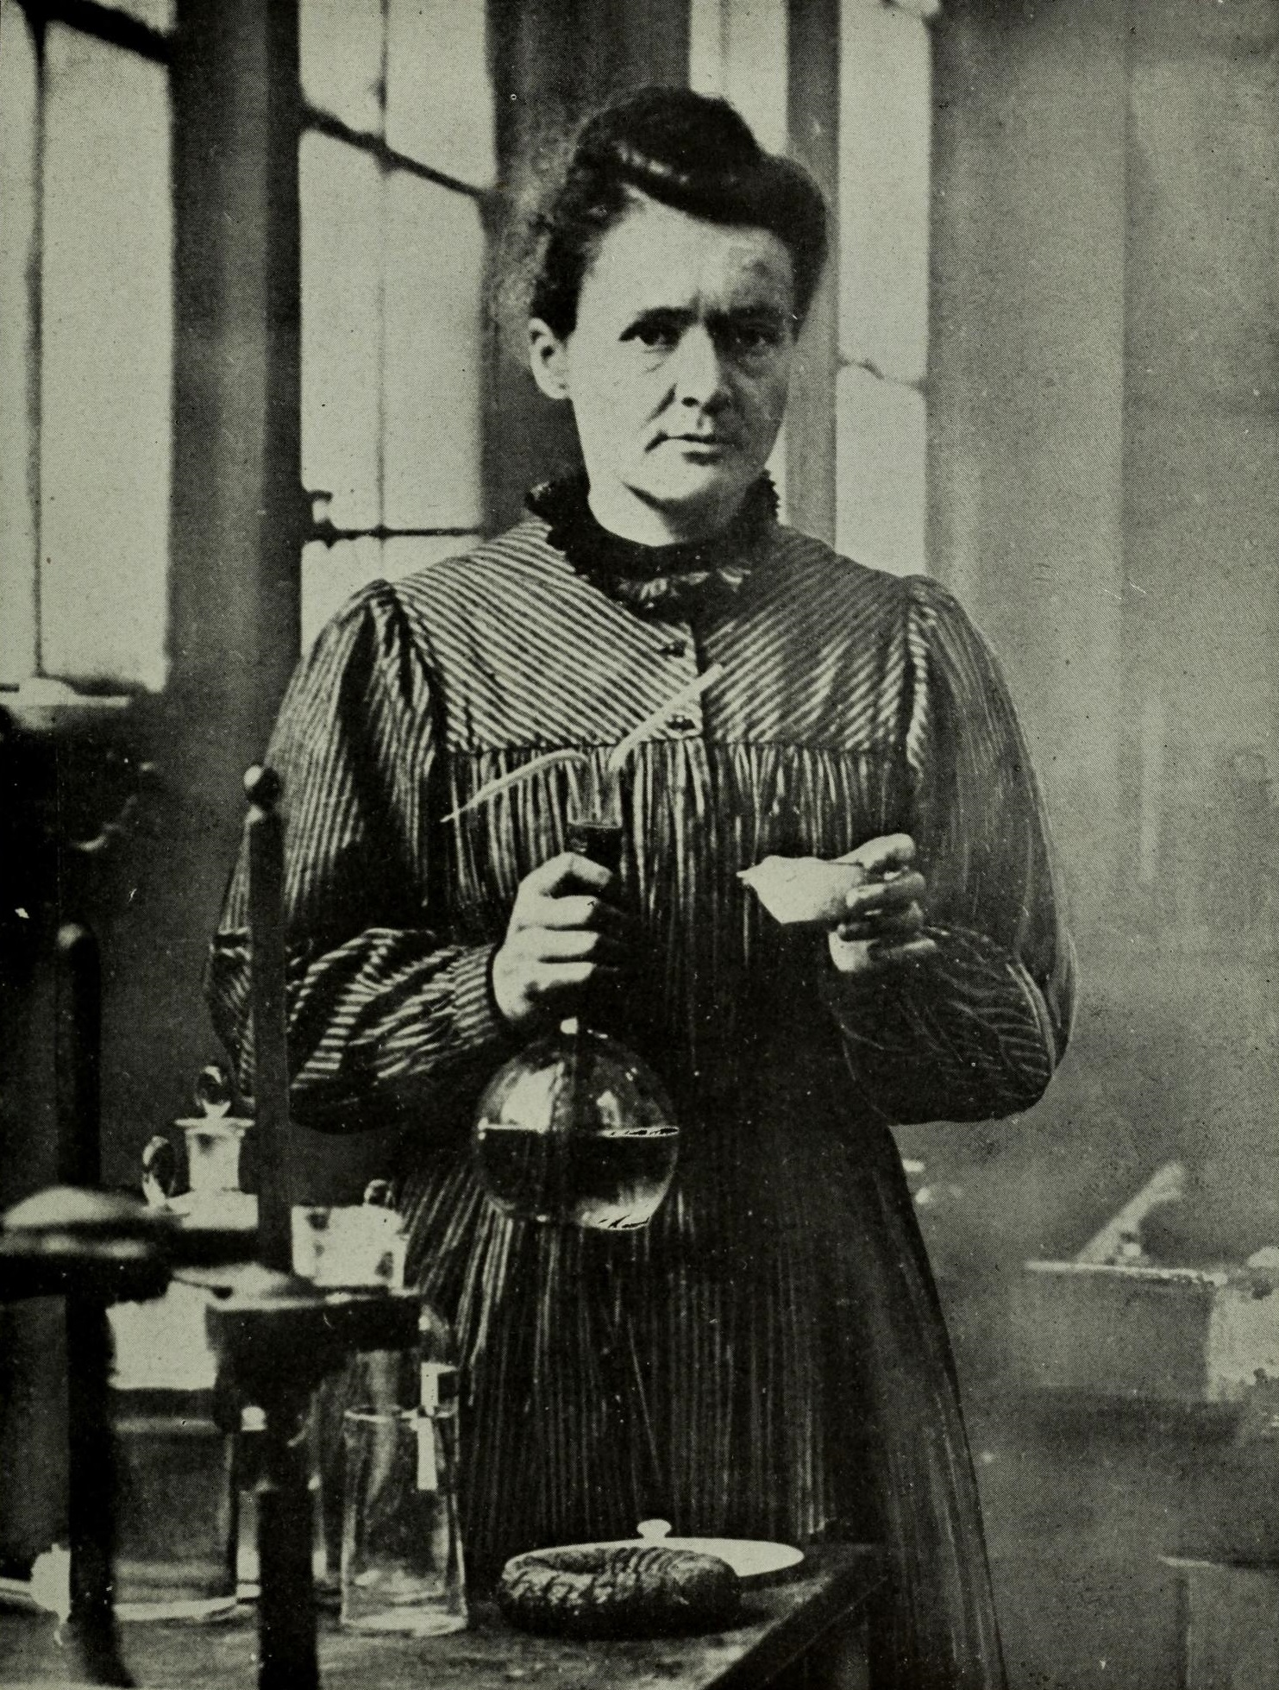
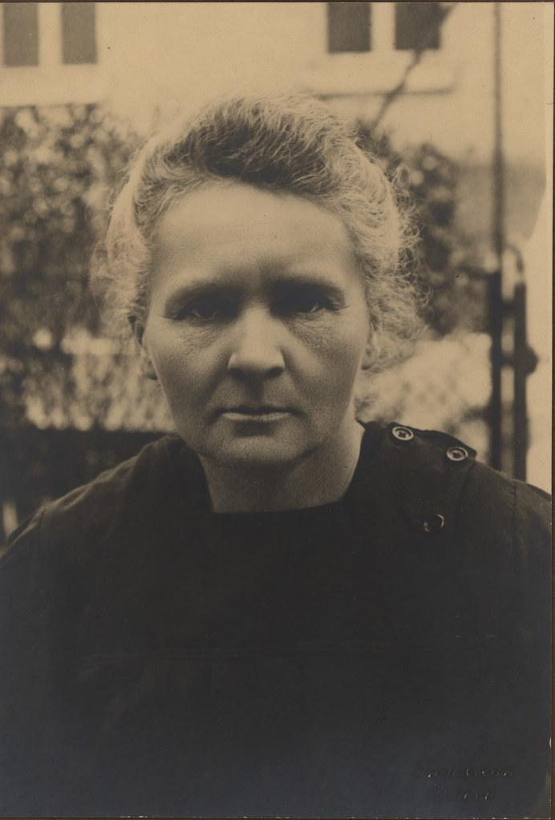
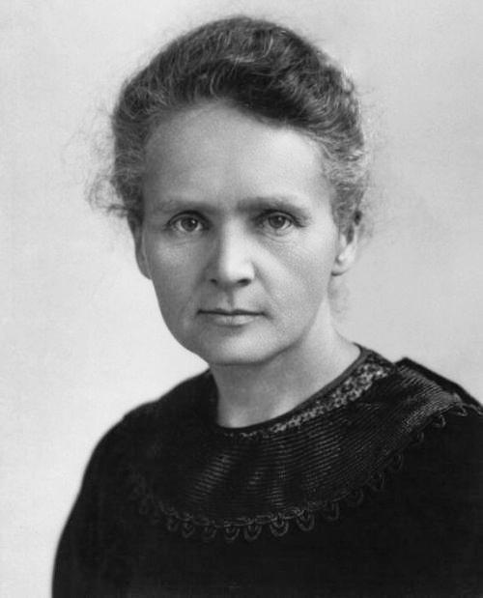
Mary Curie
A Famous Female Scientist!
Female Scientist
1867-1934

Slide 2
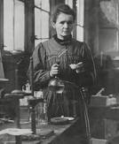
How Did She Get Famous?
Marie Curie is remembered for her discovery of radium and polonium, and her huge contribution to finding treatments for cancer.
When Did She Get Famous?
Working with her husband, Pierre Curie, Marie Curie discovered polonium and radium in 1898. In 1903 they won the Nobel Prize for Physics for discovering radioactivity. In 1911 she won the Nobel Prize for Chemistry for isolating pure radium.

Slide 3
How Did She Die?
On 4 July 1934, at the Sancellemoz Sanatorium in Passy, France at the age of 66, Marie Curie died. The cause of her death was given as aplastic pernicious anaemia, a condition she developed after years of exposure to radiation through her work. She left two daughters, Irene (born 1898) and Eve (born 1904).
Aplastic pernicious anemia is a rare but serious blood condition that occurs when your bone marrow cannot make enough new blood cells for your body to work normally.

Slide 4
What Did Marie Curie Discover?
Marie Curie discovered Radium and Polonium which is used for research purposes.
Marie Curie made the world a better place by discovering a cure for cancer. Her work led to the development of nuclear energy and radiotherapy.
Radiotherapy kills cancer cells or slows their growth by damaging their D.N.A!

Slide 5
Conclusion
Marie Curie is dead and died in 1934.
Marie Curie was remembered by a lot of people and still is.
Questions?

