Slide 1
Read Write Inc. Phonics
Parents’ Meeting
Set 1 Sounds
Notes:
Approximately 20 minutes is needed for this session.
Notes are provided to help you lead the presentation.
Notes in italics are for your attention only.
This bitesize parent session is best used alongside a demo lesson of teaching a Set 1 sound. Alternatively, you may wish to use a film from the School Portal.
Provide copies of ‘Reading at Home Booklet 1’ from Oxford Owl for each parent.

Slide 2
Reading changes everything
Teach a child to read and keep that child reading and we will change everything.
And I mean everything.
Jeanette Winterson
Notes:
Read quote.
Today I want to help you understand how your child is learning to read with phonics – specifically ‘Read Write Inc.’ Phonics.

Slide 3
How is Phonics taught at St Michaels?
10 minute sound lesson learning a new sound everyday.
Practise spelling words for 10 minutes
20 minutes reading texts that include the sounds they have already learnt. Accuracy, fluency and comprehension skills to become confident and independent readers.
30 minutes writing activities about the story they have read.

Slide 4
What is phonics?
Sounds
Graphemes
Notes:
All words are made up of individual sounds. These sounds are merged together to form words.
e.g. in ‘mat’ we have the sounds ‘m’, ‘a’, ‘t’, ship – ‘sh’, ‘i’, ‘p’.
Click A grapheme is another name for the letters we use to write the sound. The spelling of that sound on the page.
Phonics is the method of teaching reading through the identification of sounds and graphemes.
The new National Curriculum ensures that all children are taught Phonics systematically.
This gives your children the tools to read any word.

Slide 5
English alphabetic code
44 sounds
26 letters
Over 150+ graphemes (letter combinations)
One of the most complex alphabetic codes in the world.
Notes:
We use 44 sounds to make all the words in the English language.
This means we’ve got a problem.
We’ve got 44 sounds and only 26 letters.
The 26 letters work singly, in pairs and sometimes in threes to represent one sound.
We have to group letters together to write some sounds e.g. ‘igh’, ‘air’.
In English we have more than 150 ways to represent 44 sounds, using the 26 letters in the alphabet.
Click
This makes our language one of the most complex in the world!

Slide 6
https://www.youtube.com/watch?v=sjlPILhk7bQ

Slide 7
Speed Sounds Set 1
Notes:
Using RWI, we make learning to read easy for children because we start by teaching them just one way of reading and writing every sound. Here they are on the Simple Speed Sounds chart.
We teach Set 1 sounds first - (sounds as far as a e i o u).
Children need to know sounds – not letter names – to read words.
Use MTYT to teach each of the Set 1 sounds to parents.

Slide 8
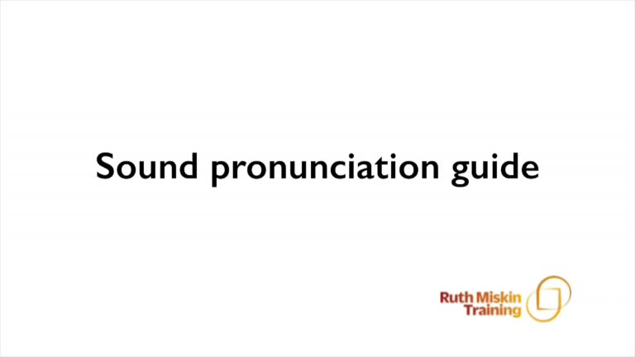
Pure Sounds (ruthmiskin.com)
Notes:
We teach using pure sounds.
We pronounce the sounds clearly, using pure sounds (‘m’ not’ muh’, ’s’ not ‘suh’, etc.) so that your child will be able to blend the sounds together to make words more easily.
You can watch this film of little Sylvie on the Ruth Miskin website to practise using pure sounds. Play a little bit of the video.

Slide 9
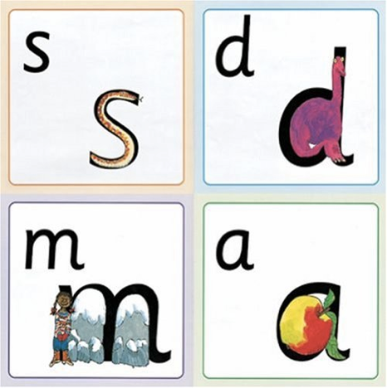
Name the pictures
Notes:
We give children a hook to learn the sounds by using pictures in the same shape as the letter.
‘s’ looks like a snake.
‘d’ looks like a dinosaur.
‘m’ looks like a mountain.
‘a’ looks like an apple.
We teach the children to name the mnemonic pictures before they learn the sound.
This means that children learn to read and write the sounds really easily.

Slide 10
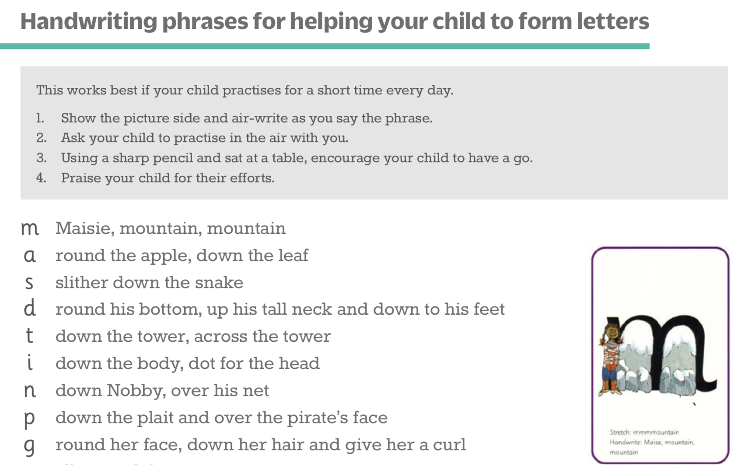
Teaching letter formation
Notes:
Children use the picture mnemonic to learn to form letters correctly at the same time they learn to read each sound.
Each sound has a handwriting phrase e.g. down Maisie, and over the mountains.
Use these handwriting phrases when practising writing at home with your child.
Avoid using these to read the sound.
I will give you a handout of these handwriting phrases when you leave today.

Slide 11
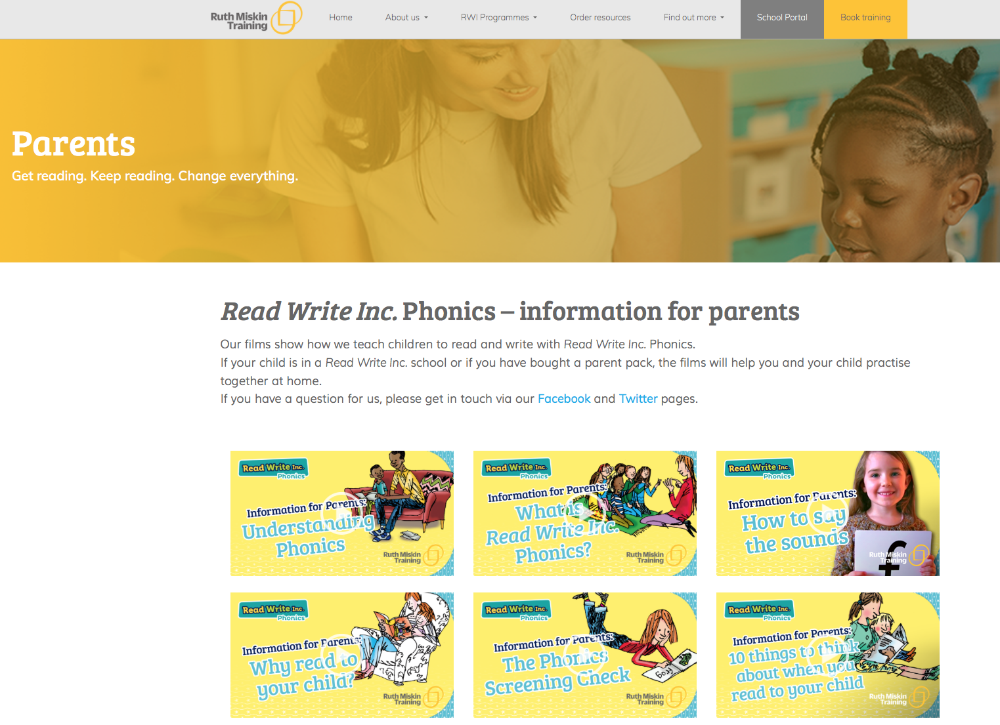
Free Video Tutorials (ruthmiskin.com)
Notes:
Watch these video tutorials on the Ruth Miskin website to help you to practise reading and writing with your child at home:
The frieze
reading the stretchy sounds with your child
reading the bouncy sounds with your child
Handwriting
I will also give you a copy of the ‘Reading at Home Booklet 1’.

Slide 12
What can I do?
1. Use pure sounds, not letter names
2. Teach the picture names
3. Practise reading sounds speedily -
‘review, review, review’
4. Use the handwriting phrases for writing only
Notes:
Show how to use ‘My Set 1 Speed Sounds Book 1’ or cards if you send these home.
You can purchase Set 1 flashcards or My Reading and Writing Kit ages 3-5 early sounds and blending to support your child with Set 1 sounds at home.

Slide 13
Online resources available
Ruth Miskin Parents’ Page:
http://www.ruthmiskin.com/en/parents/
Ruth Miskin Facebook:
https://www.facebook.com/miskin.education
Free e-books for home reading:
http://www.oxfordowl.co.uk/Reading/

Slide 14
Teaching a Set 1 Sound - in action
Notes:
Demonstrate teaching a Set 1 sound to a group of children.
Alternatively, you may wish to use a film from the School Portal.

Slide 15
Speed Sounds Set 2
Notes:
Set 2 sounds are shaded. They are long vowel sounds with 2 or more letters. We call these ‘Special Friends’ – two letters together that make one sound.
Let’s practise saying these sounds together.
Say each sound MTYT.
Once children know these Set 2 sounds, they know one way of reading and writing every sound.

Slide 16
Speed Sounds Set 3
Notes:
Once children know how to read Set 2 sounds, they start to learn Set 3 sounds.
These are shaded in the chart.
They are alternative graphemes (spelling of a sound) for the Set 1 and Set 2 sounds the children already know.
Point to the chart to show. For example, they know ‘ay’ and now learn a-e and ai as other spellings for the same sound.

Slide 17
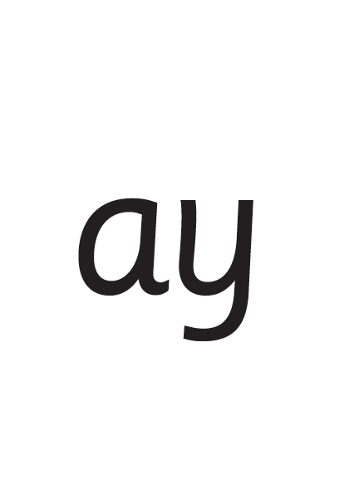
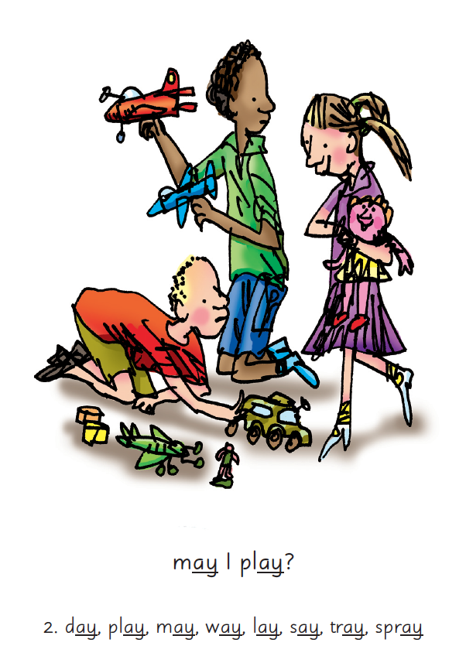

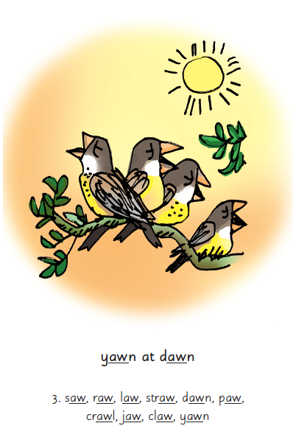
Picture Phrases
Notes:
We use picture phrases to help children remember the Set 2 and Set 3 sounds.
For example, ay, may I play? aw, yawn at dawn

Slide 18


‘Special Friends’, ‘Fred Talk’, read the word
Notes:
Then children practise reading these sounds in words using the routine ‘Special Friends’, ‘Fred Talk’, read the word’.
They spot the ‘Special Friends’ first, then Fred Talk to read the word.
For example, ‘ay’, s-p-r-ay, spray.

Slide 19
What can you do?
Practise the sounds and phrases
Practise reading sounds speedily -
‘review, review, review’
Use ‘Special Friends’, ‘Fred Talk’,
read the word’ to read words that are unfamiliar.
Notes:
Show how to use Set 2/3 cards if you send these home.
You can purchase Set 2/3 flashcards or My Reading and Writing Kit ages 5-7 becoming a reader to support your child with Set 2 sounds at home.
I will give you a copy of ‘Reading at Home Booklet 2’ from Oxford Owl.

Slide 20
Online resources available
Ruth Miskin Parents’ Page:
http://www.ruthmiskin.com/en/parents/
Ruth Miskin Facebook:
https://www.facebook.com/miskin.education
Free e-books for home reading:
http://www.oxfordowl.co.uk/Reading/

Slide 21
Teaching Set 2/ 3 sounds - in action
Notes:
Now let me show you this in action with a group.
Demonstrate teaching a Set 2/3 sound to a group.
Alternatively, you may wish to use a film from the School Portal.

Slide 22
Reading changes everything
Teach a child to read and keep that child reading and we will change everything.
And I mean everything.
Jeanette Winterson
Notes:
Remember that all parents have the power to change outcomes for their children.

